Slide 1
Present Perfect Tense

Slide 2
subject
I have finished home work
You have finished home work
He/she/it has finished home work
We have finished home work
You have finished home work
They have finished home work
Ester and Dami Present Perfect

Slide 3
+
Verb ‘have’
(Present simple form)
+
Verb
(past participle form)
Subject
I have finished homework
You have finished homework
He/she/it has finished homework
We have finished homework
You have finished homework
They have finished homework
Auxiliary verb
Ester and Dami Present Perfect

Slide 4
+
Verb ‘have’
(Present simple form)
+
+
Verb
(past participle form)
Subject
not
I have not finished homework
You have not finished homework
He/she/it has not finished homework
We have not finished homework
You have not finished homework
They have not finished homework
Auxiliary verb
Ester and Dami Present Perfect

Slide 5
past participle Irregular verb
verb past participle
be
break
buy
choose
come
do
drink
Eat
Go
Have
Make
Run
Say
See
think
been
broken
bought
choosen
Come
Done
Drunk
Eaten
Gone
Had
Made
Run
Said
Seen
thought
Ester and Dami Present Perfect

Slide 6
Position of Adverbs
always, only, never, ever, still, just, already
Affirmative
We have just arrived in London.
I have only cleaned the bathroom.
Question
Have you ever visited London?
Has he already left the class?
Ester and Dami Present Perfect

Slide 7
4 meaning of present perfect
http://youtu.be/o1_0Gz4uRKo
Ester and Dami Present Perfect

Slide 8
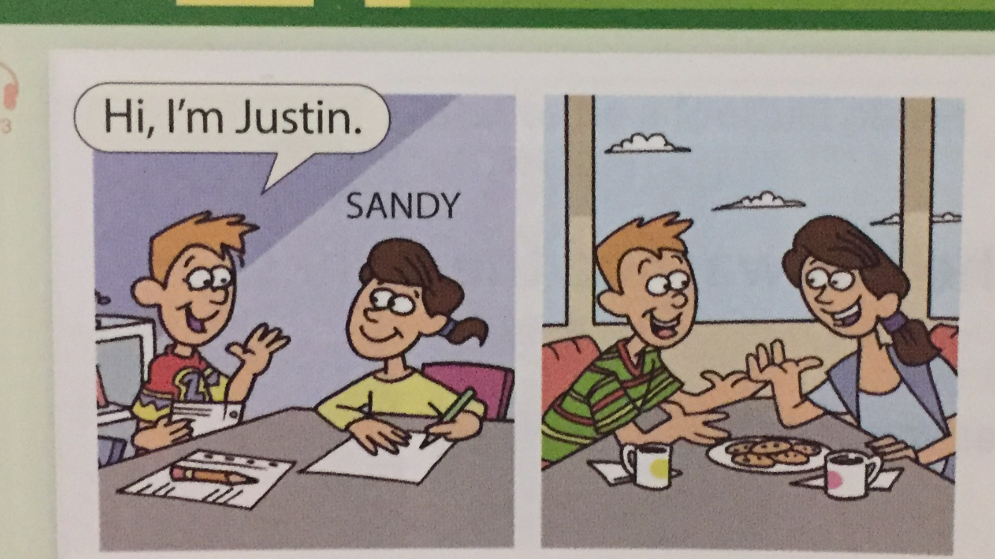
Justin met sally 5 years ago.
They are still friends.

Slide 9
He has known her for five years
Or
He has known her since 2012

Slide 10
An action or situation that started the past and continues in the present.
Tim has lived in Seoul~ vs. Tim lived in Seoul
For + A Period of Time (For 5 years, For hours)
Since + A Point in Time ( Since last week, since 2012)

Slide 11
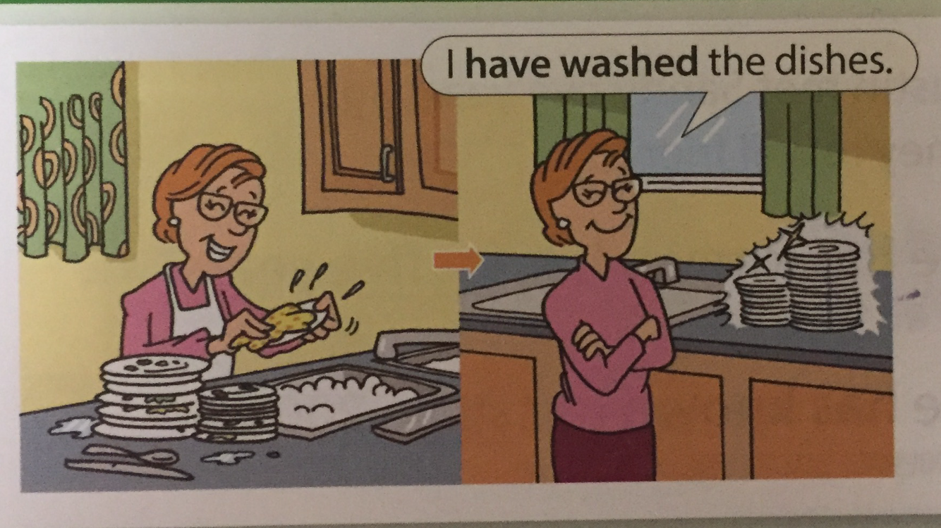
She has washed the dishes

Slide 12
Accomplishments
For the accomplishments of individuals and humanity. Can’t mention a specific time.
Ex) I have finished my duty.
An action that was completed in the very recent past, expressed by “just”.
Ex) you’ve just dropped your wallet
You can imagine….??
VS) you dropped your wallet

Slide 13
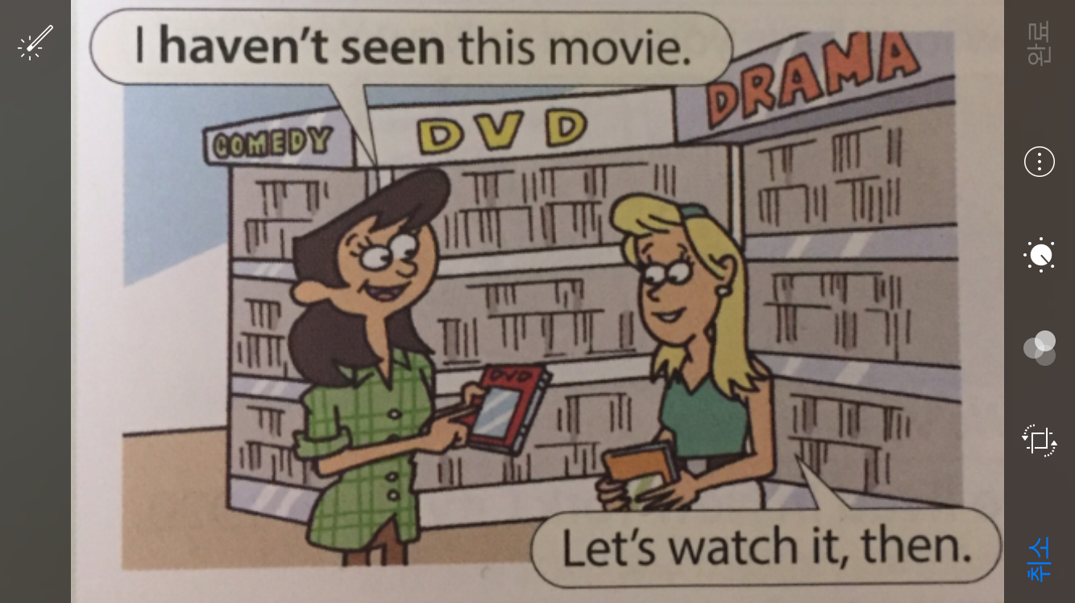
She hasn’t seen the movie

Slide 14
Experience
Actions repeated in an unspecified period between the past and now
You can use the present perfect to describe your experience.
Not used to describe a specific event
Ex) I have been to France
( you have had the experience of being in France. Maybe you have been there once, or several times)

Slide 15
I did VS I have done
What is the difference between
Ex) My best friend has gone to Canada
My best friend went to Canada
Ex) Mike changed his phone number last week
Mike has changed his phone number
Last night, two days ago, in + years

Slide 16
https://m.youtube.com/watch?v=Y0EOde6IPw8

