Slide 1
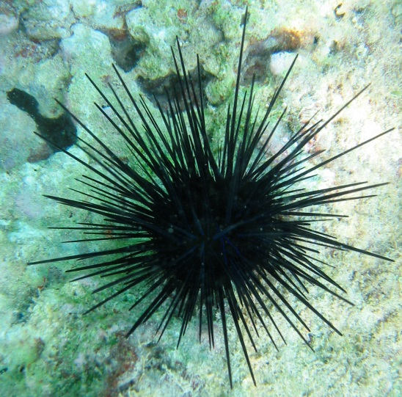
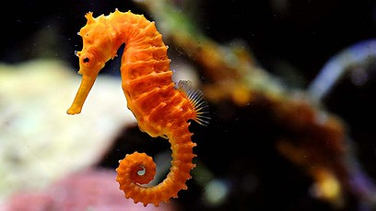
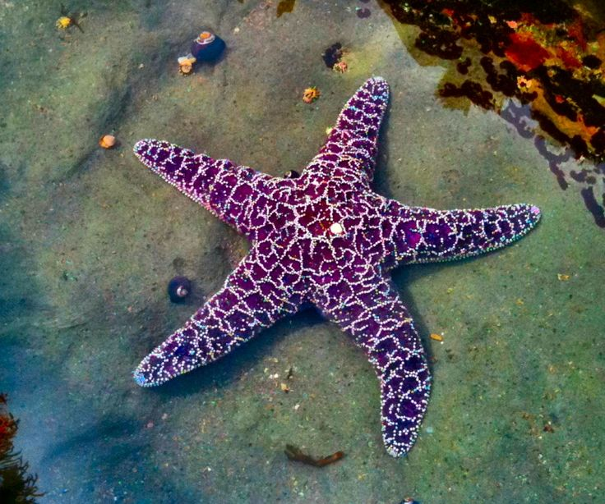
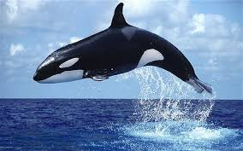
SEAHORSE
SEA URCHIN
STARFISH
WHALE

Slide 2
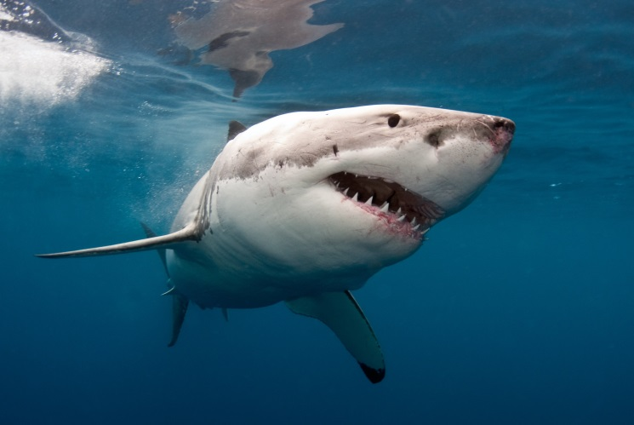
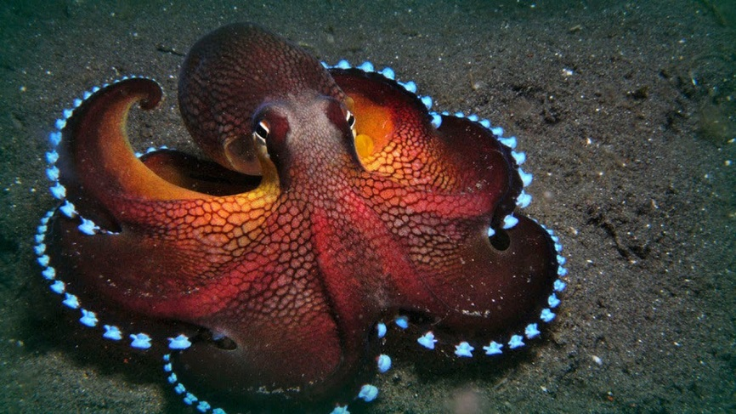
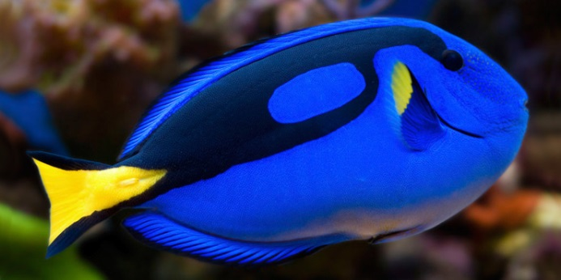
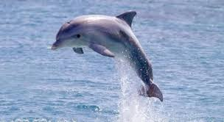
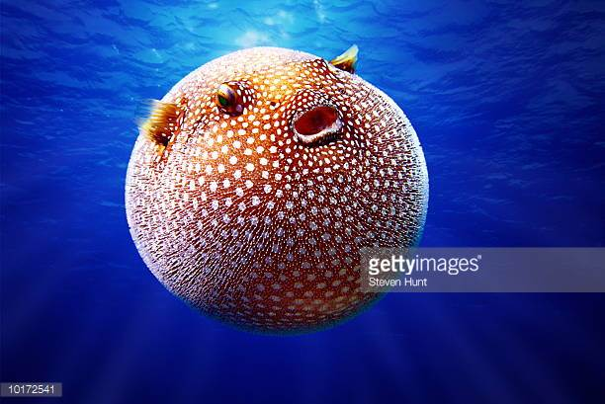
SHARK
OCTOPUS
FISH
PUFFER FISH
DOLPHIN

Slide 3
Many animals and plants live in the sea. Sea horses live in shallow water. Starfish and sea urchins live in tide pools. They are both small creatures. They come and go with the tides.
Whales can dive deep. But they are mammals. Mammals have to come up for air. Sharks are a kind of fish. They do not need to come up for air. They have gills to breathe. They swim all the time. They are always looking for fish to eat.

Slide 4
 | Whales | Sharks
What are they? | mammals | fish
How do they breathe? | come up for air | have gills
What do they do? | dive deep | swim all the time

Slide 5
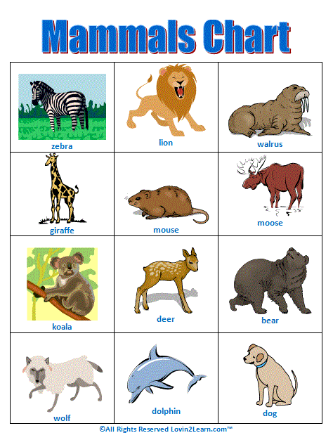
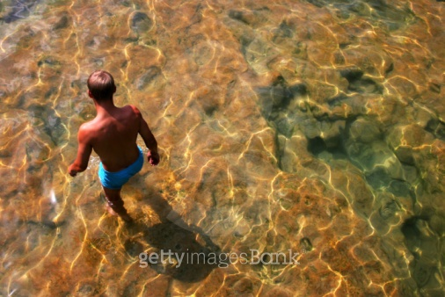
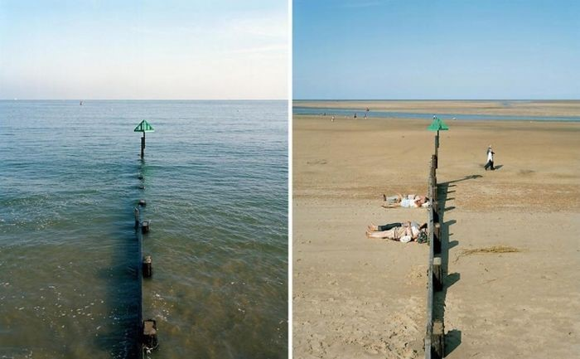
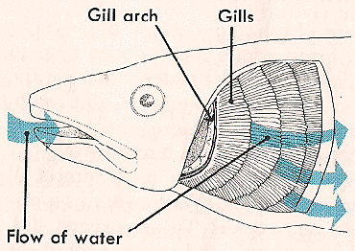

Slide 6
If I was a seahorse I could eat every minute of every day because seahorses do not have a stomach, therefore food passes through their bodies quickly.
If I was a crab I could walk sideways and squeeze into small holes.
If I was a shark I could bark like a dog, like the sharks found in New Zealand.
If I was a puffer fish I could quickly turn into a huge ball by ingesting a large amount of water.
If I was a fish I could choose from 30,000 different types of fish.
If I was an octopus I should have three hearts. Two hearts would pump blood through my gills and the third heart would pump blood through the rest of my body.
If I was a dolphin I could talk to my friends through whistling, clicking and other sounds.

Slide 7
If you could be any one of sea creatures, what would you like to be? And why?

