Slide 2
Interviewer
/
Employer
Interviewee /
Employee

Slide 3
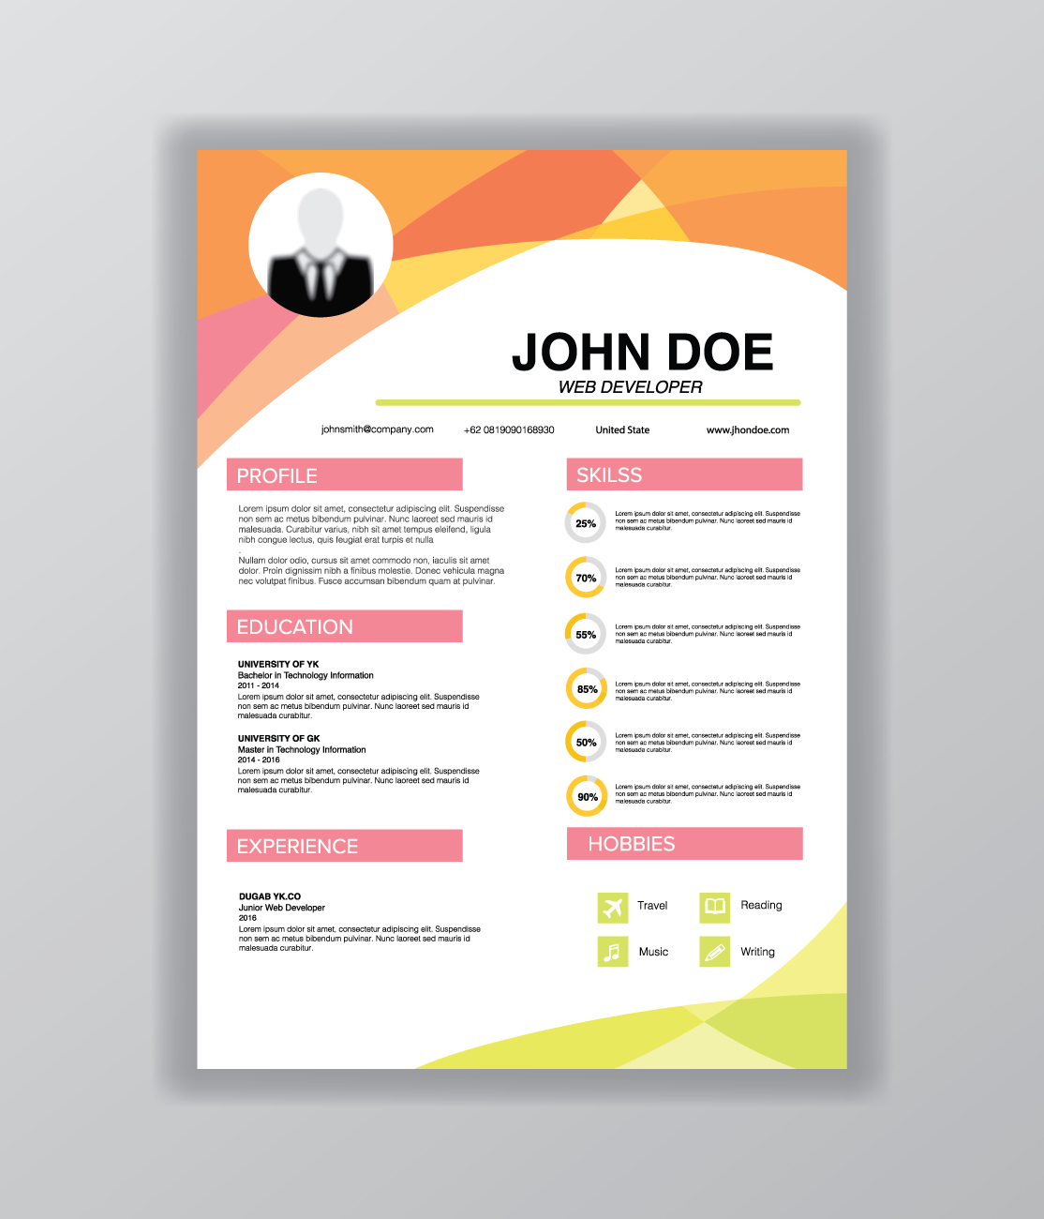
Resume

Slide 4
Bachelor's Degree

