Slide 2
Birth order

Slide 3
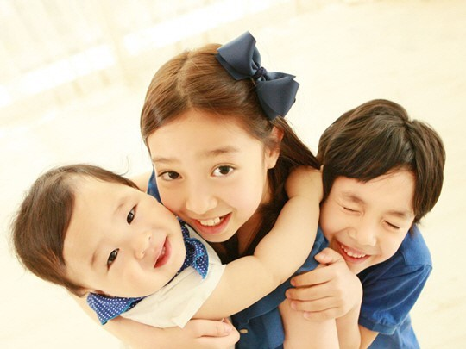

Slide 4
Have you ever considered how your birth order within your family has impacted your personality and your career?

Slide 5
What is the character of the first person born?

Slide 6
What is the character of the Middle born?

Slide 7
What is the character of the Last born?

