Slide 1
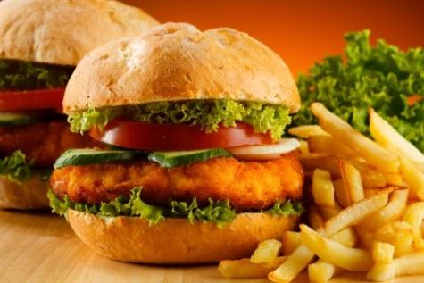
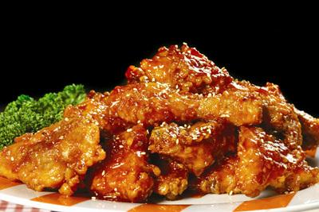
What will you have for dinner?

Slide 3
Purge

Slide 4
Purge
cleanse, remove, clear and eject

Slide 5
Purge
cleanse, remove, clear and eject
Ex. The new state governor has promised to purge the police force of corruption.

Slide 6
Culinary

Slide 7
Culinary
Ex. There are a wide variety of culinary purpose oils such as olive oil, palm oil, soybean oil, canola oil, etc.

Slide 8
Culinary
Related to or used to in kitchen
Ex. There are a wide variety of culinary purpose oils such as olive oil, palm oil, soybean oil, canola oil, etc.

Slide 9
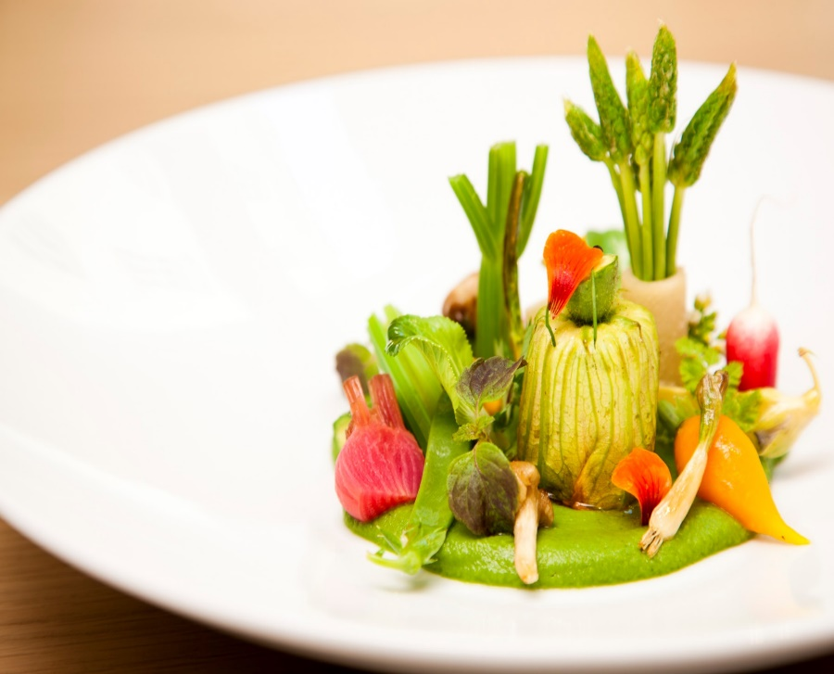
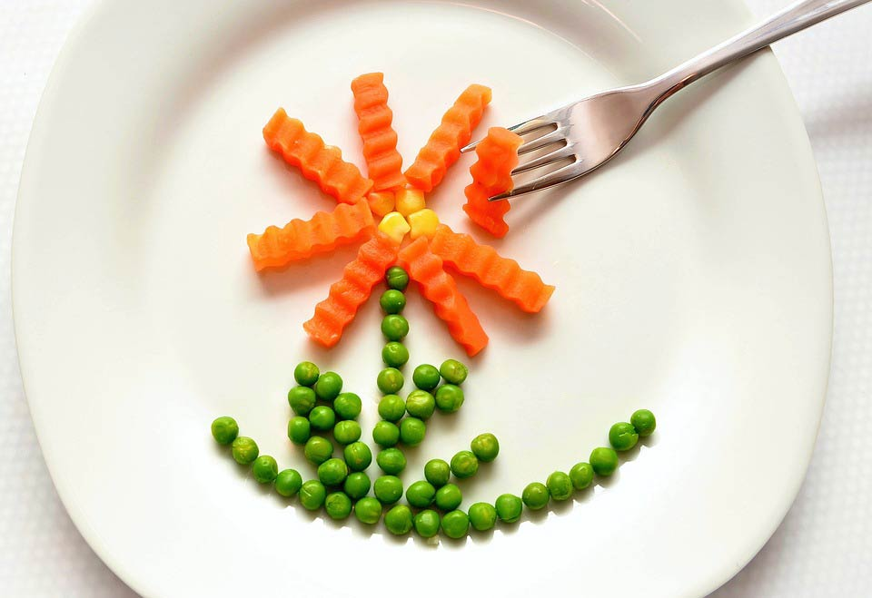
Culinary

Slide 10
Grated / Ground

Slide 11
Grated / Ground
Grate / Grind

Slide 12
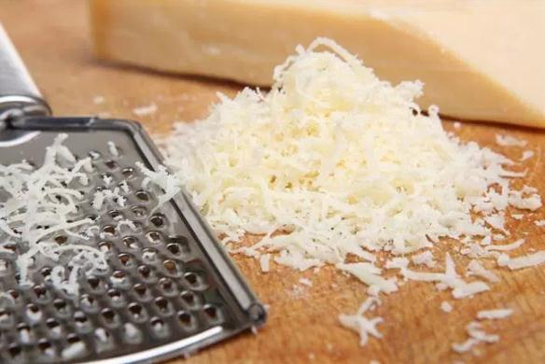
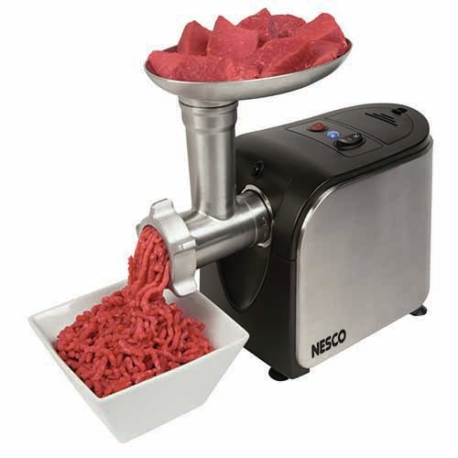
Grated / Ground

Slide 13
Crumb / Crust

Slide 14
Wheat flour

Slide 15
Skim ANIKI’S FRENCH MENU
- What kind of foods are serving?
- what kinds of ingredients are in there?

Slide 16
- Read details
- Answer the questions 1 ~ 6

