Slide 1
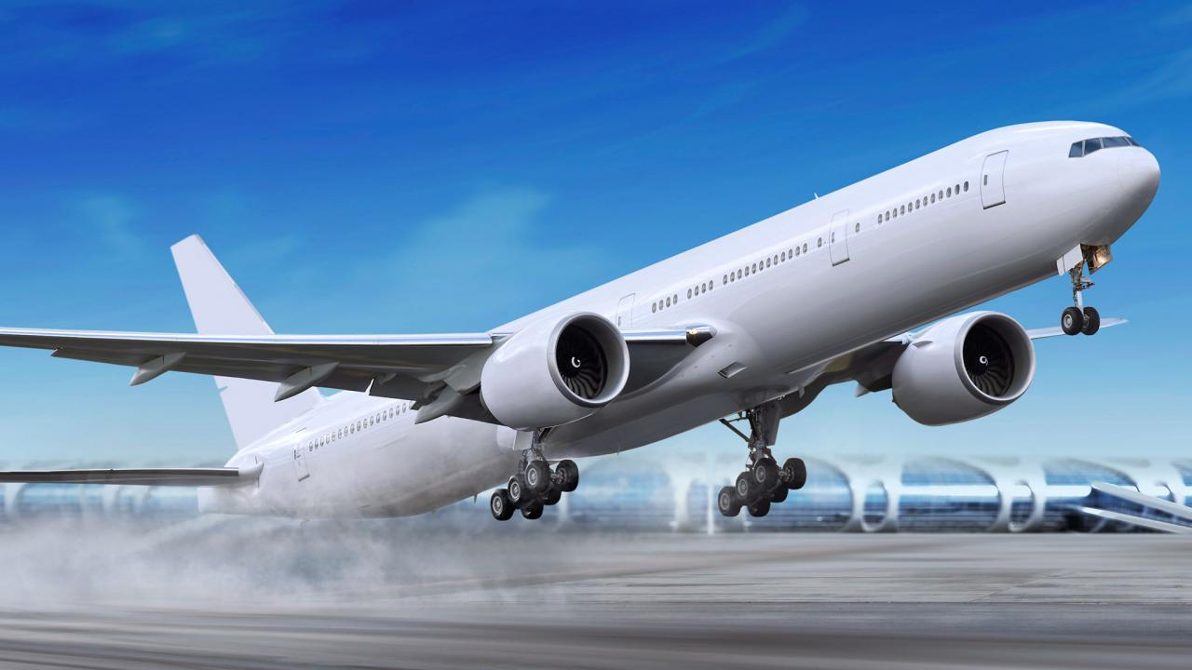
Take off

Slide 2
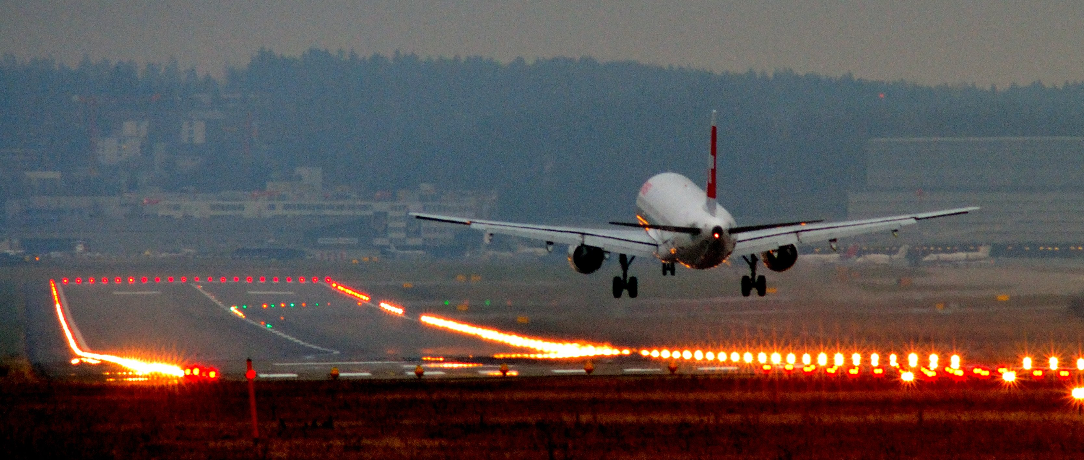
Landing

Slide 3
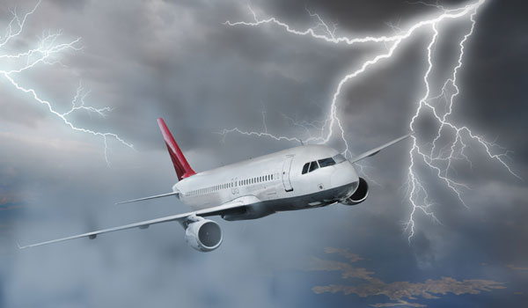
Turbulence

Slide 4
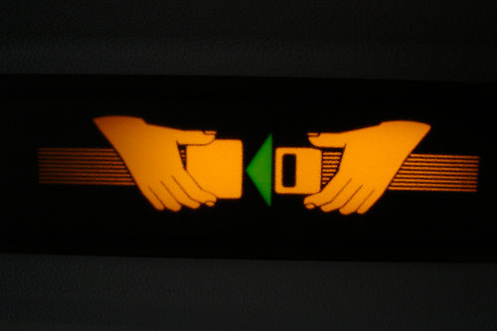
Fasten your Seat belt

Slide 5
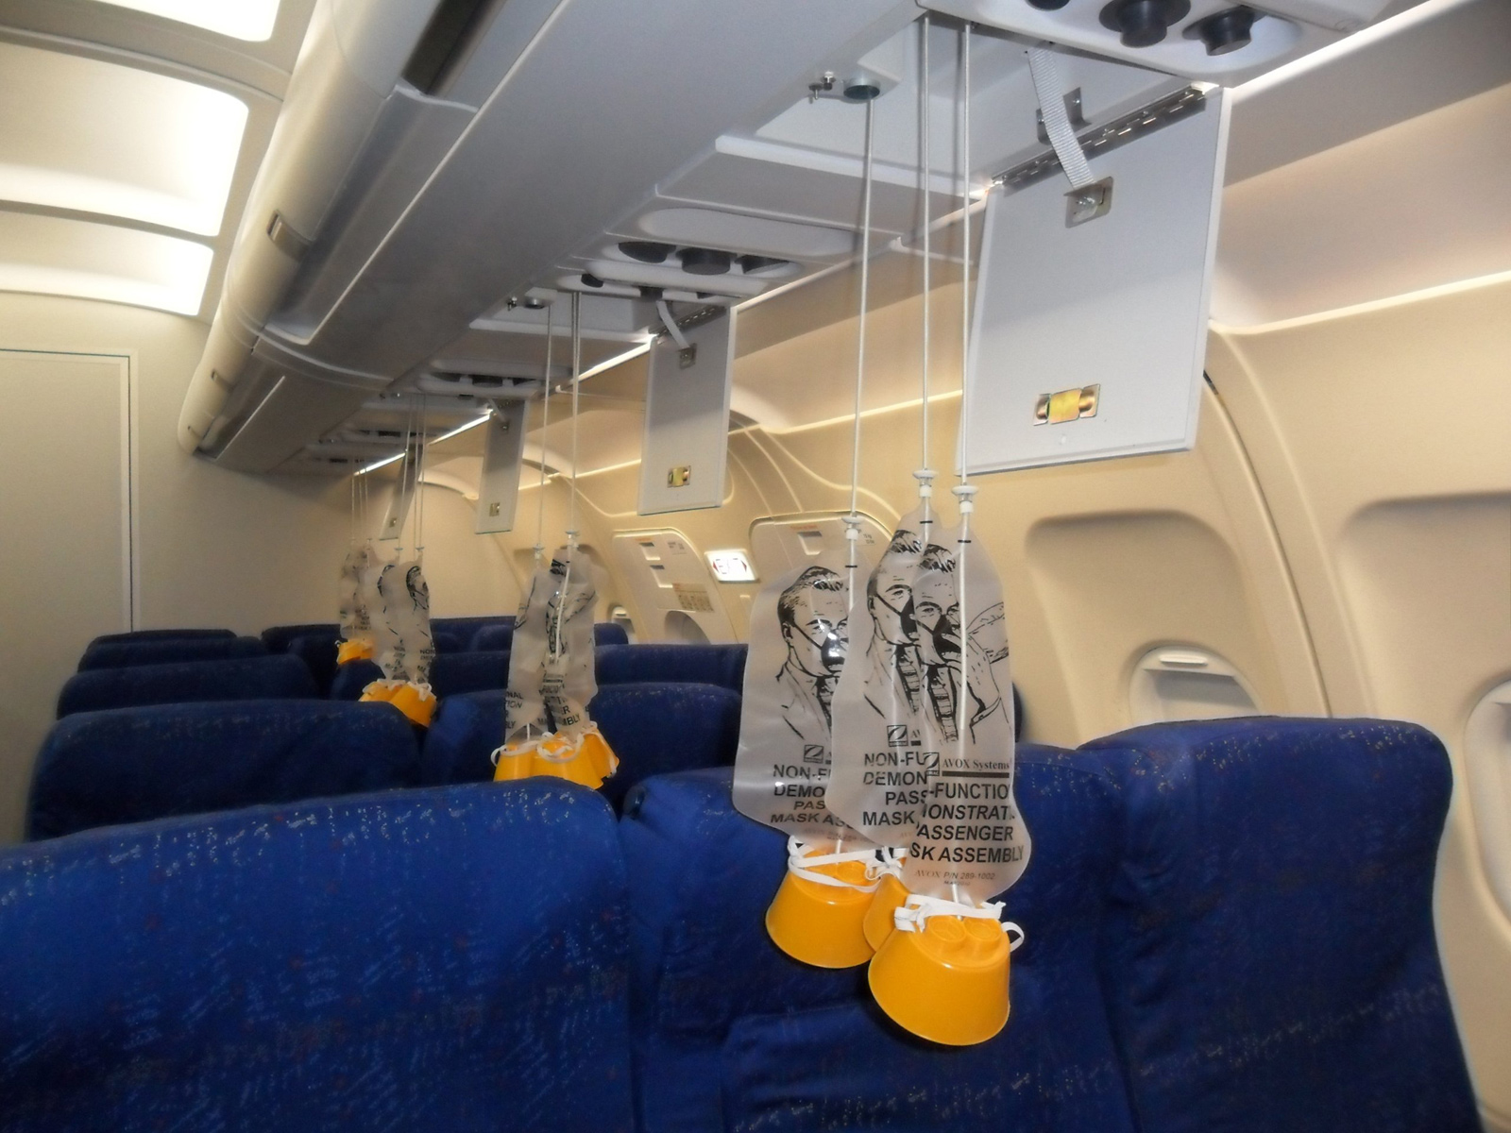
Oxygen mask

Slide 6
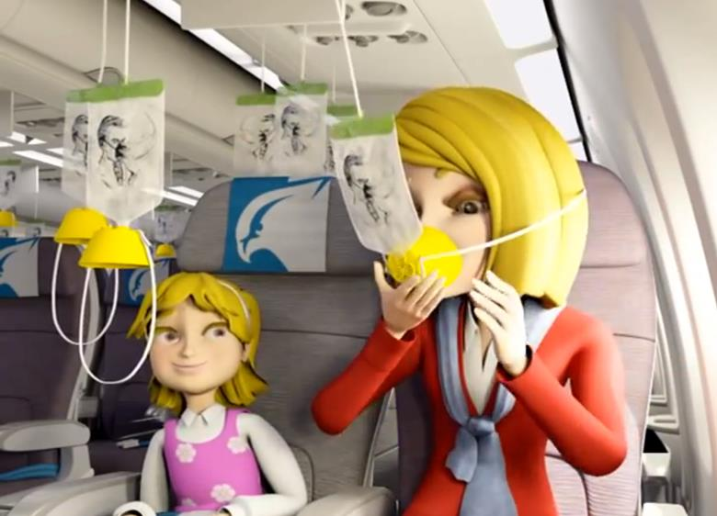
Put on your oxygen mask

Slide 7
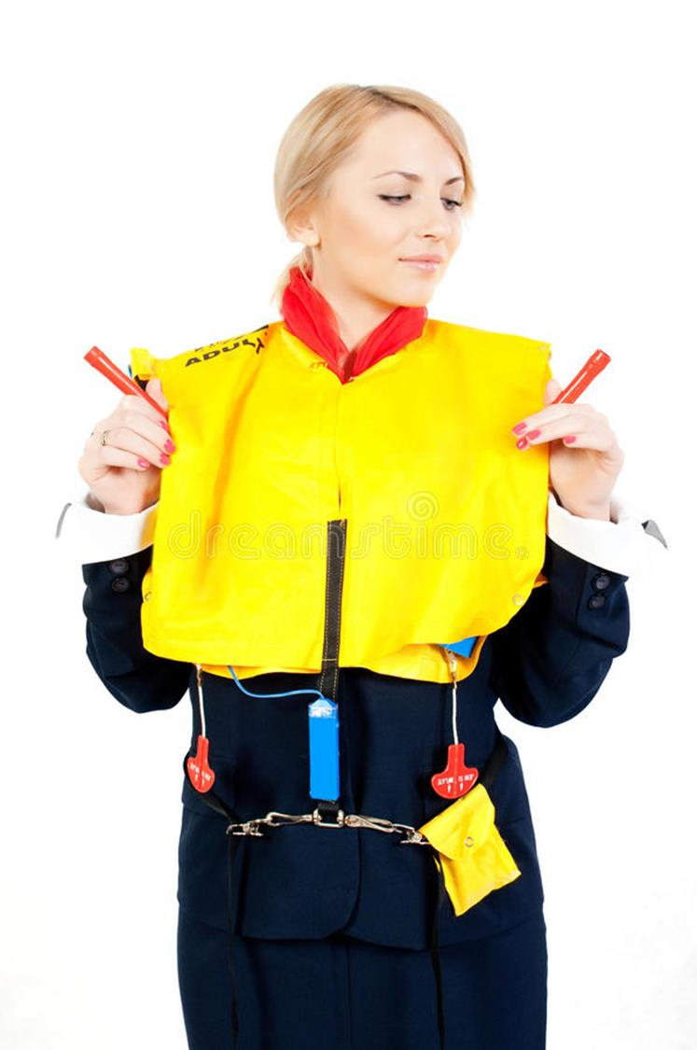
Wear your life jacket

Slide 8
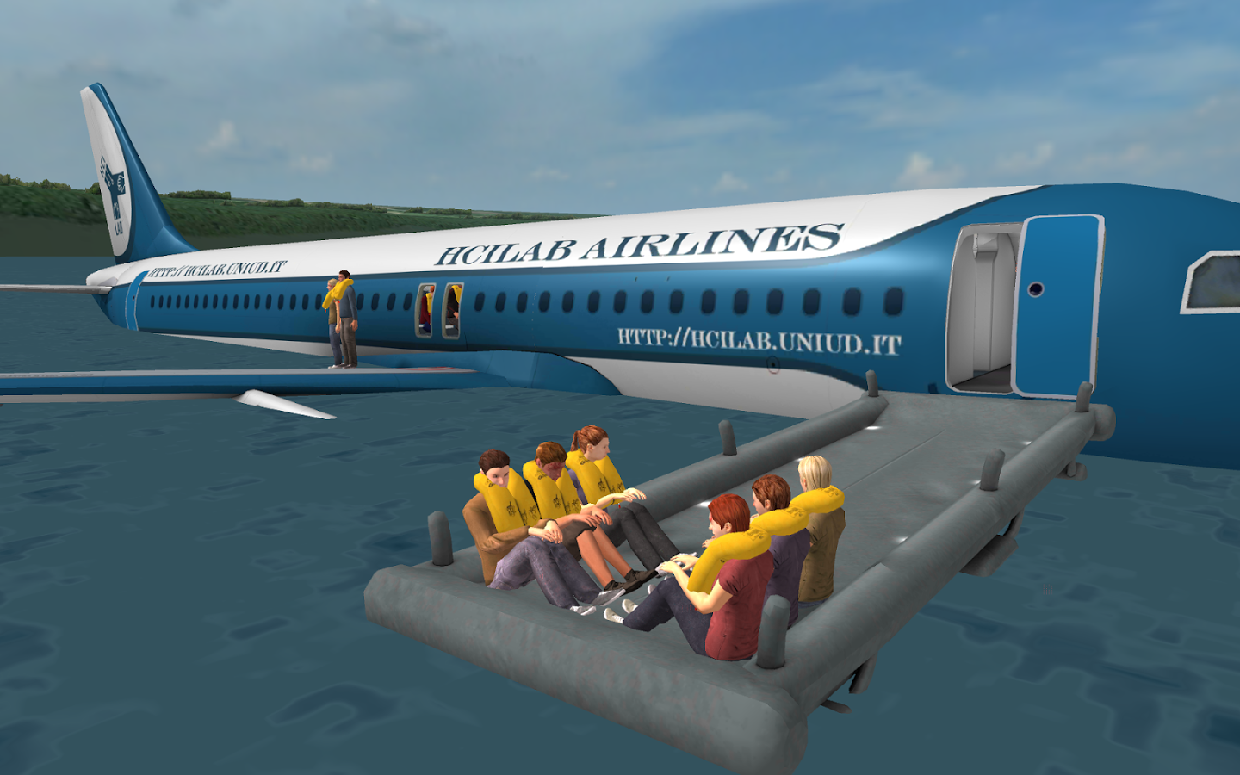
Landing on water

Slide 9
- Welcome on board this Qatar Airways flight.
- Before we depart, please pay attention as we demonstrate the safety features of the aircraft.
- Baggage should be securely stowed under the seat in front of you or in the overhead compartments.
- For safety reasons, all electronic devices will have to be switched off and stored safely for take off and landing.

Slide 10
- Please fasten your seat belts before take off and landing and whenever the seatbelt sign is illuminated.
- To unfasten, lift the flap and pull the ends apart.
- For your safety, we recommend your keep your seatbelt fastened whenever you are seated.

Slide 11
- If oxygen is required, a mask will appear from above you or you may be required to release the mask by pulling on the colored flag marked Pull.
- Pulling the mask towards you will activate the oxygen supply.
- Place the mask over your nose and mouth, adjust the bands to secure it and breathe normally.

Slide 12
-When your mask is fitted correctly, you may assist others.
-Please play close attention and take a moment to locate the emergency exit nearest to you. The emergency exits are clearly marked and located as shown on the screen.
Illuminated escape path strips will guide you to the exits.

Slide 13
- In case of emergency landing on water, evacuation slides will serve as rafts.
- Please remember to remove footwear before using the slide.
- For your safety we operate a non-smoking policy on board all our aircraft.
- Smoking in the toilet will activate the alarm.

Slide 14
- Your life jacket is located in a pouch under your seat or between the armrests.
- When instructed by the crew, remove it from its container and pull it over your head.
- Pull the tape around your waist and fasten in-front pulling firmly to secure.

Slide 15
- Only inflate your life jacket when you are leaving the aircraft by pulling the two red toggles sharply downwards.
- You can also inflate your life jacket by blowing into the mouthpiece.
- The life jacket has a whistle to attract attention and the light will automatically illuminate when in water.

Slide 16
- In the unlikely event of an emergency, please adopt the brace position as demonstrated by our cabin crew.
- Can we please remind you to make sure your seat is fully upright, your tray table is stowed and your window blinds fully up.

Slide 17
- To remind yourself of the safety features of this aircraft, please read the safety card which is located in your seat pocket.
- If you have any questions. our cabin crew will be happy to help.
- Thank you for your attention and enjoy your flight with Qatar Airways.

