Slide 1
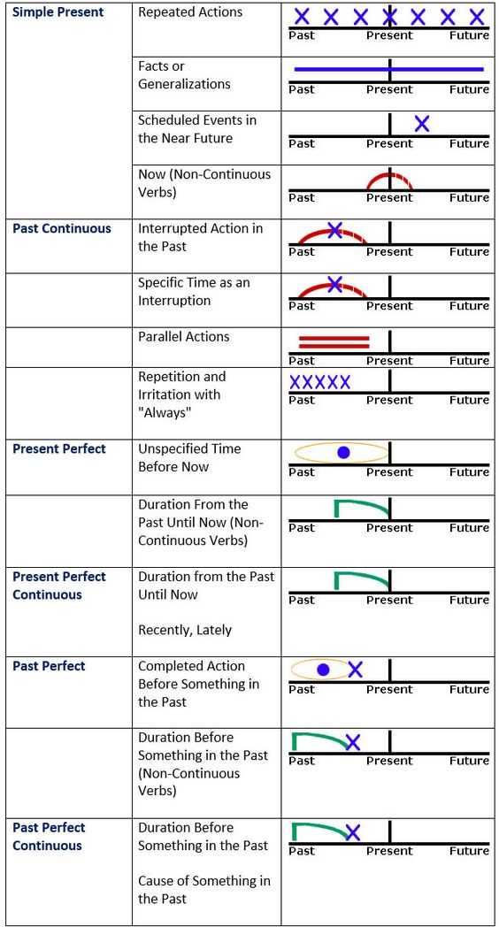
Simple Present tense
It is used to signal the following meanings:
1. Routines(Repeated Actions)
He walks to class every day.
Jane goes to school every morning at 8 am.
2. Future(Scheduled events in the near future)
The train arrives at 6:00 am.
The next term begins on the Monday.
3. Facts or Generalizations
(General truths: Action verbs can be used.)
The sun rises in the east.
Seoul is the capital of South Korea.
4. Now(Stative verbs; non-action verbs: sense, mental activity, possession, feeling, wish, and so on.)
I see a sign in the corner.
I know that Charlotte is a teacher.
1
2
3
4

Slide 2
Simple Present Tense
(Change of Verbs)
I, You, We, They vs.
He, She, It, singular nouns
Spelling rules(He, she, it, single)
I,You,We,They He, She, It

Slide 3
Facts (General truths)
-Water( ) at 100 degrees Celcius.
boils
-Plants ( ) us oxygen.
-The Earth ( ) around the Sun.
give
goes
-The President of the United States ( ) in the White House.
-Paris ( ) the capital of France.
is
run
lives
-Superman and Flash ( ) faster than Usain Bolt.

Slide 4
Now
(Stative verbs: sense, mental activity, possession, feeling, wish, and other verbs)
-Sense
See, hear, smell, taste, sound, look
-Mental activity
Know, believe, think, understand,
recognize, guess, mean, doubt, agree
-Possession
Have, belong, own, possess
-Feeling
Like, dislike, feel, hate, prefer, love
-Wish
Want, wish
-Other verbs
Be, seem, cost, matter, appear
😃 Tiffany’s idea great.
😄 Daniel henney Sunny.
😃 This Maybach to KayC.
🤗 Jin her husband.
😊 Bo soju.
☺️ Karan happy.
sounds
knows
belongs
loves
wants
is
Worksheet 1

Slide 5
Answersheet 1 (Top, Practice)
*Create the sentences for ‘facts(general truths)’ by using simple present tense. (3-5 sentences)
-Facts
1. People depend on earth’s resources.
2. The south pole has strong winds.
3. Plants grow in soil.
4. The eagle flies in the sky.
5. The land moves on plates.
6. The moon orbits the earth.
….
*Fill in the blanks with verbs that completes the sentences.
1. I ( want ) a picture. (want)
2. KayC ( thinks ) about the tree. (think)
3. Bo ( has ) butter on her toast. (have)
4. Sunny ( likes ) a painting. (like)
5. I ( love ) my puppy. (love)
6. Karen ( owns ) the kitchen.(own)
7. The dog ( hates ) the cat. (hate)
8. We ( have ) flowers for our friends. (have)
9. She ( understands ) her husband. (understand)
10. The kittens ( seem ) to be hungry.(seem)
11. It ( smells ) good. (smell)
12. Tiffany ( recognizes ) the sweet potatoes. (recognize)

Slide 6
Simple Present Tense
(Positive & negative forms for auxiliary Be & general verbs)
<Verb be(am, is, are)>
Positive Negative(positivie+not)
<General verb (R.V., R.V.+s/es)>
Worksheet 2

Slide 7
Answersheet 2 (Production)
Grammar Error Correction
Positives and Negatives
*Find and correct the mistakes below.
They love America.
She doesn’t like tennis.
He knows the answer.
Robert prefers baseball to soccer.
They have lots of free time.
Jenny appears at a restaurant.
She doesn’t possess the studio.
My father wants to travel to Spain.
I agree with his opinion.
He doesn’t believe her.

Slide 8
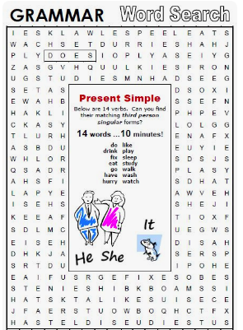
SOS activity answers
At least 7 words in 5 minutes

