Slide 1
Asking and Giving directions Prepared by YuJin Kwak

Slide 2
Prepositions of directions
Above
On
Behind
Next to / On the left (of)
In / Inside
Next to / On the right (of)
On the corner (of)
Under
Below

Slide 3
Giving Directions

Slide 4
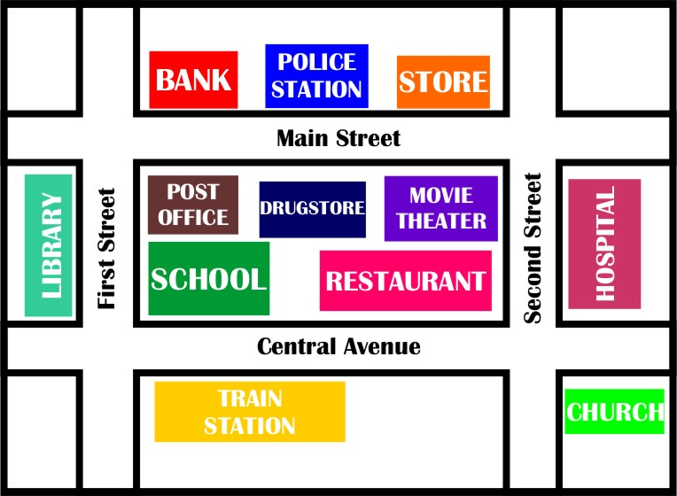
Between
The Drugstore is ________ the Post Office and the Movie Theater.
The Police station is ____________ the Drugstore.
The Hospital is _______ from the Library.
The Train Station is _____________ the Bank.
To go to First Street, _____ _______ from Central Avenue.
The Bank is _________ the Police Station.
The Church is __________ the Second Street.
The Restaurant is ________ the School.
On
Across from
Far
Near
Turn Right
Between
Next to
Opposite
Opposite
Far
Across From
Turn Right
Next to
On
Near

Slide 5
Activity 1
Create full sentences with prepositions using the given hints
Use a worksheet #1.

Slide 6
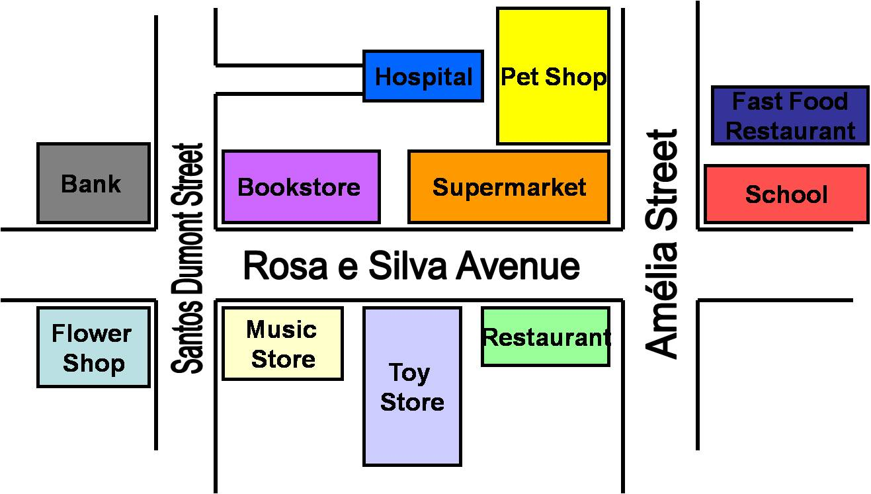
Worksheet#1
Create full sentences with prepositions using the given hints:
Example:
Hospital/Pet Shop: ....The Hospital is next to the Pet Shop....
1. Bank/ Flower Shop: ...................................................................................................
2. Restaurant/Rosa e Silva Avenue: ................................................................................
3. Toy Store/Music Store/Restaurant: ............................................................................
4. Fast Food Restaurant/School: .....................................................................................
5. Bookstore/Supermarket: ............................................................................................

Slide 7
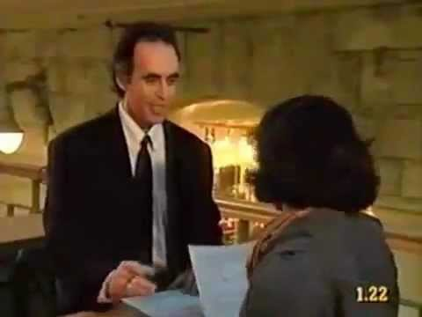
Dialogue for asking & giving directions

Slide 8
Activity 2- Role Play
For example
A: Excuse me?
B: Yes?
A: How do I get to the post office?
B: Go past the hotel and turn left onto Main street.
Go one block and turn right.
A: Thank you.

Slide 9
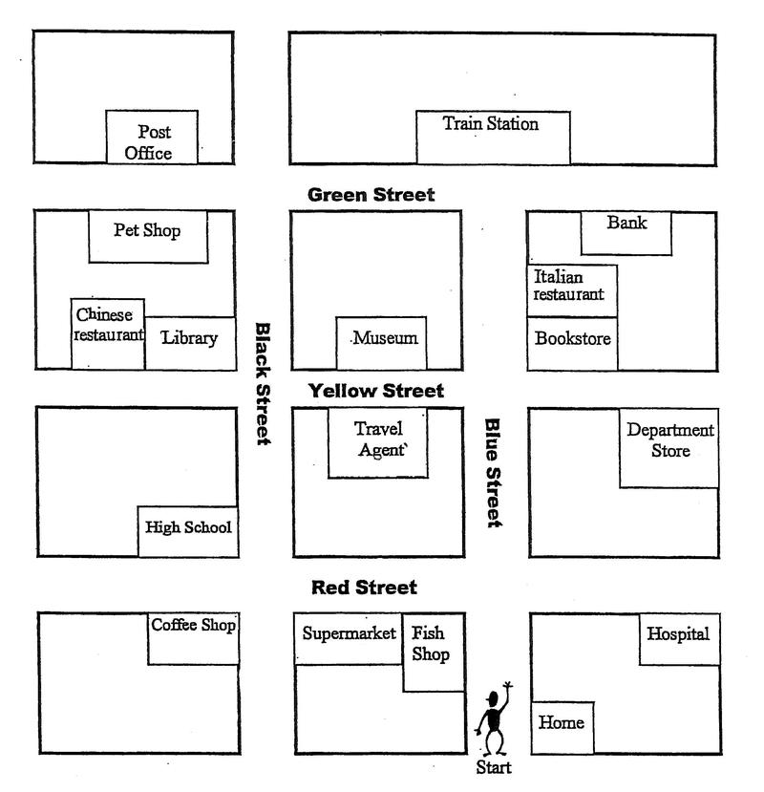
Worksheet#2.
Take a role with your partner
Create the dialogue in about 4 or 5 sentences
Explain the directions of the map to your partner
Asking for directions
Excuse me, could you tell me the way to ……please?
Giving directions
Go straight on, take the first turning on the right, turn right, turn left, walk down the corridor. Don’t turn left.

