Slide 1
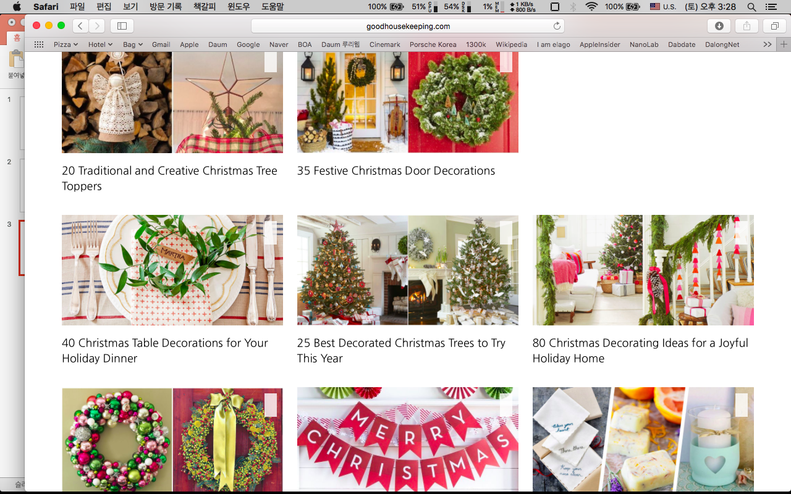
Christmas Party

Slide 2
I
Invite
You
The weather outside may be frightful but our party will be so delightful!
Please join the 164th WD TESOL family.
Date: Wednesday, December 13th
Time: 9:00 a.m.
Place: Times TESOL
RSVP younsungeui@gmail.com
RSVP: Répondez s'il vous plaît
https://www.youtube.com/watch?v=B7u6bMBlCXw (love actually 2:19)

Slide 4
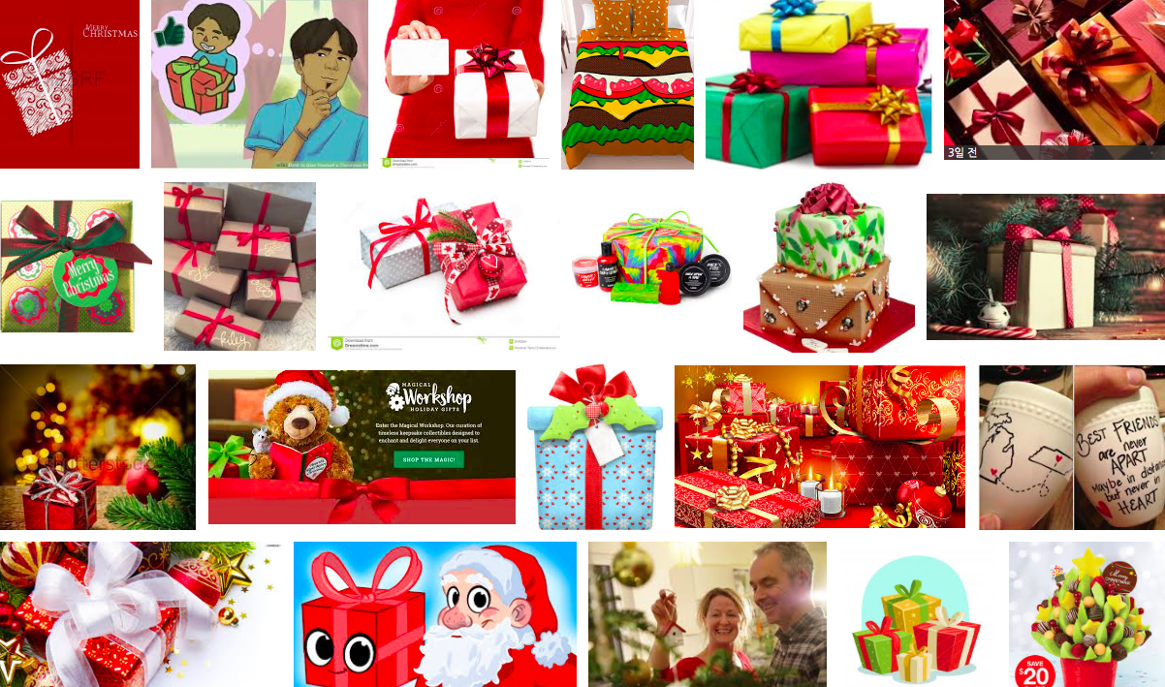
-Dinner&Presents-
https://www.youtube.com/watch?v=nDENEsIcYz4

Slide 6
- SOS activity -

Slide 7
- SOS activity -
https://www.youtube.com/watch?v=cs-LUm_VClU

