Slide 1
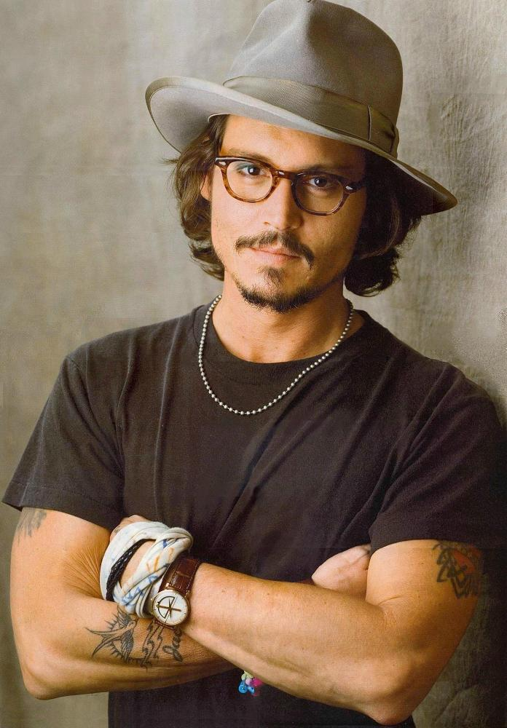
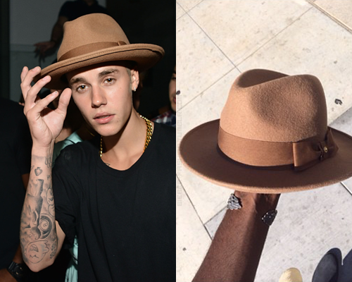
Fedora

Slide 2
Military Jacket

Slide 3
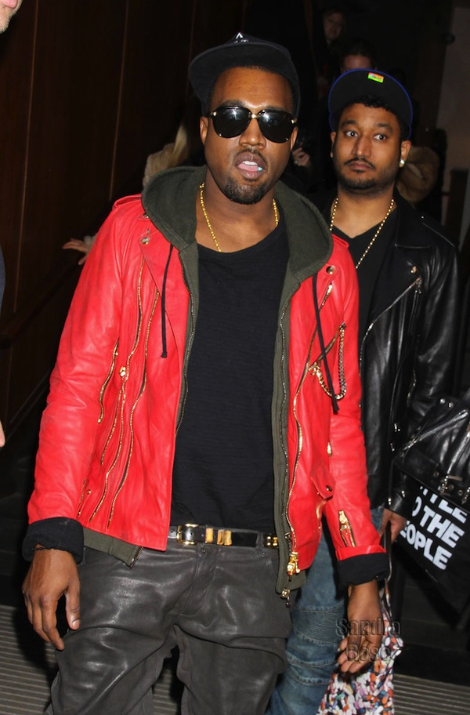
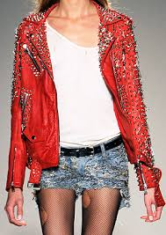
Red leather jacket

Slide 4
Moto
Jacket

Slide 5
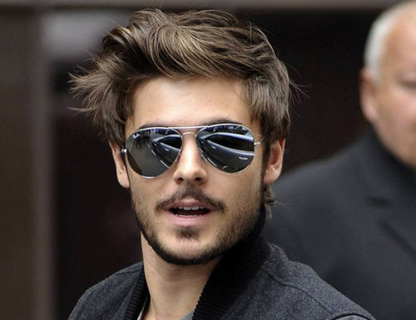
Aviator sunglasses

Slide 6
