Slide 1
Coffee Reading Lesson Plan Prepared by YuJin Kwak

Slide 2
Heading with a paragraph
What is the Bean Belt?
Who ship, roast and retail the coffee?
How did it all begin?
What made Kaldi's goats dance?
How did it spread?
Is it harvested by man or machine?
Who were the first coffee addicts?

Slide 3
The correct order of headings
c. How did it all begin?
g. Who were the first coffee addicts?
e. How did it spread?
d. What made Kaldi's goats dance?
a. What is the Bean Belt?
f. Is it harvested by man or machine?
b. Who ship, roast and retail the coffee?

Slide 4
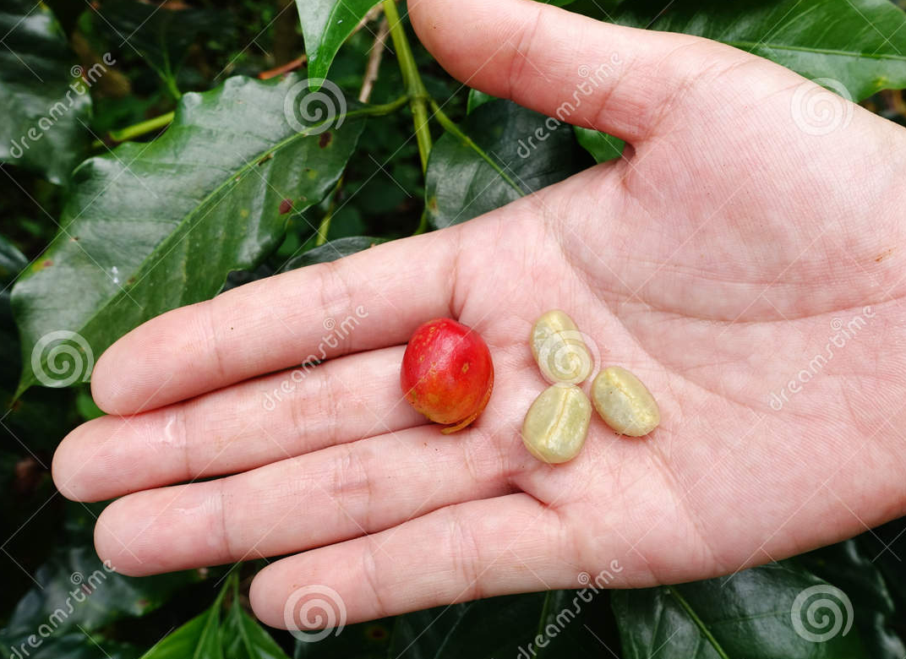

Slide 5
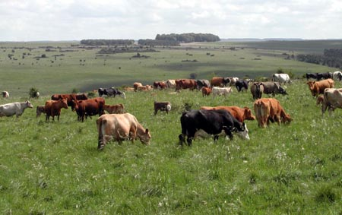
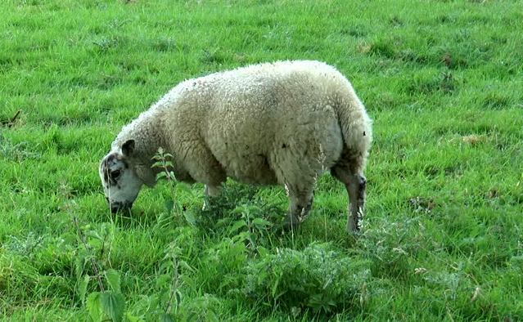

Slide 6
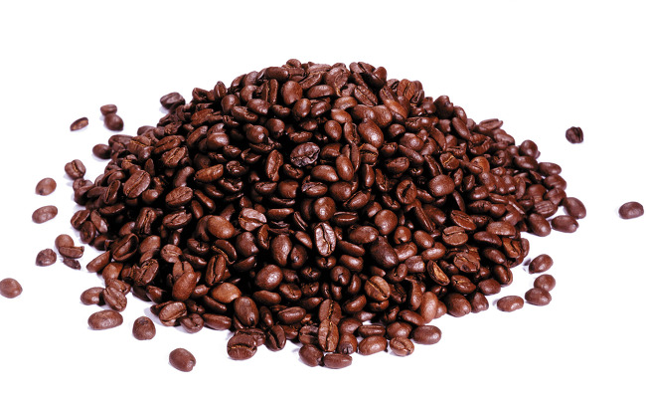
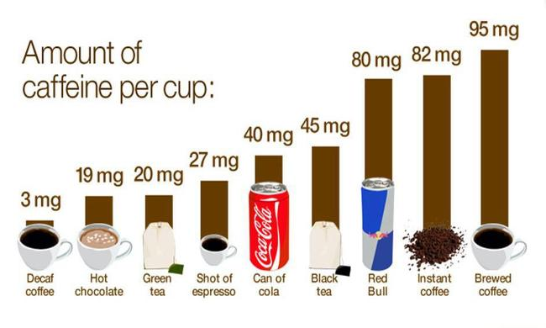

Slide 7
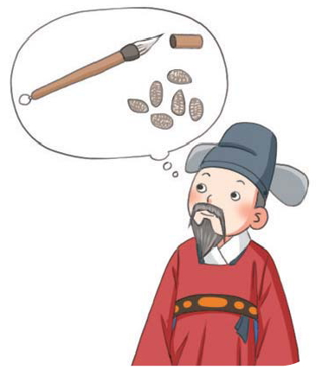
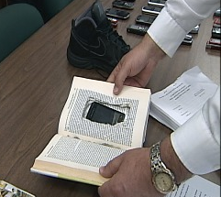
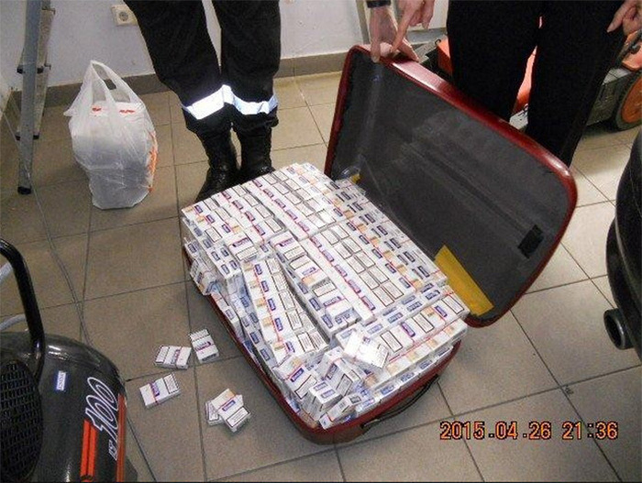

Slide 8
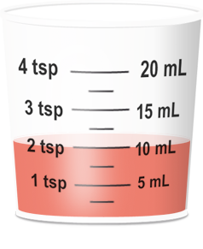
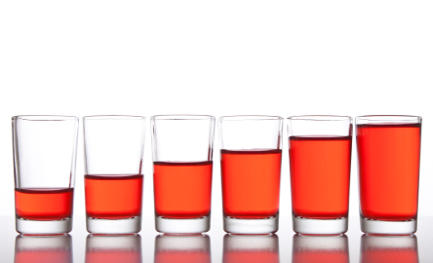

Slide 9
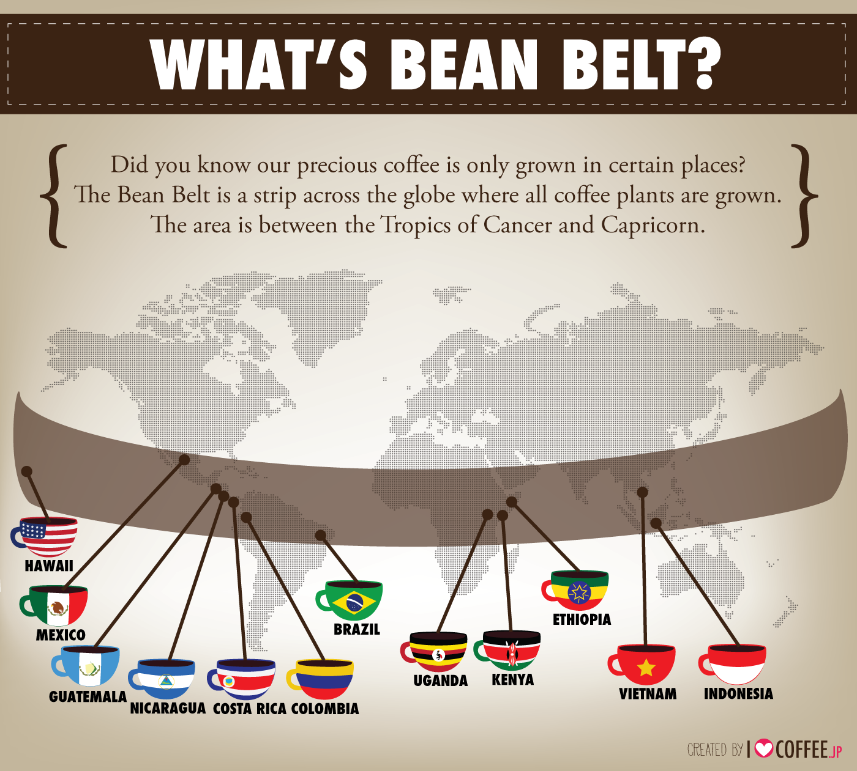
The tropic of cancer: North
The tropic of Capricorn: South
the tropics that part of the earth's surface between the tropics of Cancer and Capricorn; the Torrid Zone

