Slide 1
How to compare? Describe adjective between 2 nouns; People, Things, Places

Slide 2
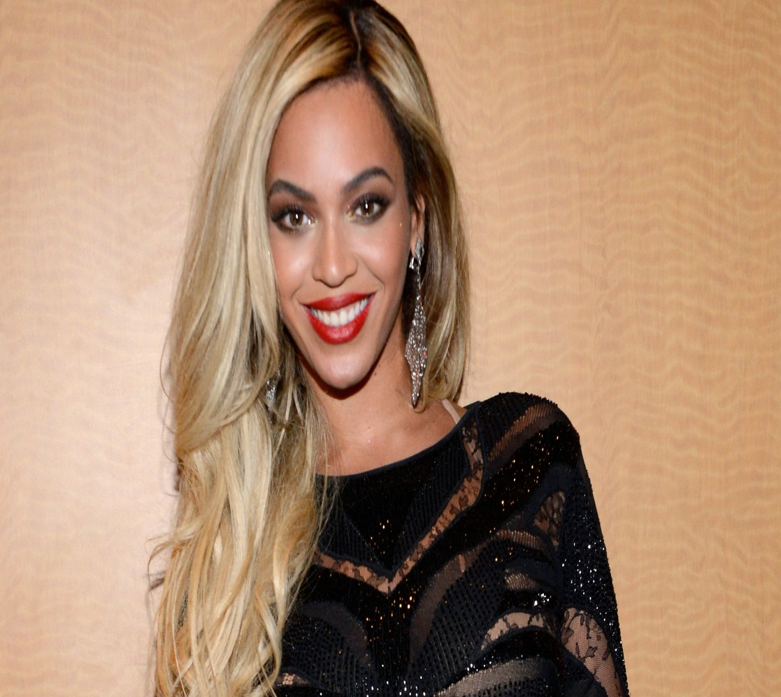
Here are 2 women
Beyonce
Whoopi goldberg

Slide 3
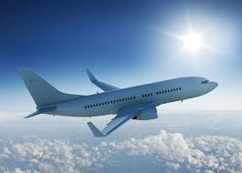
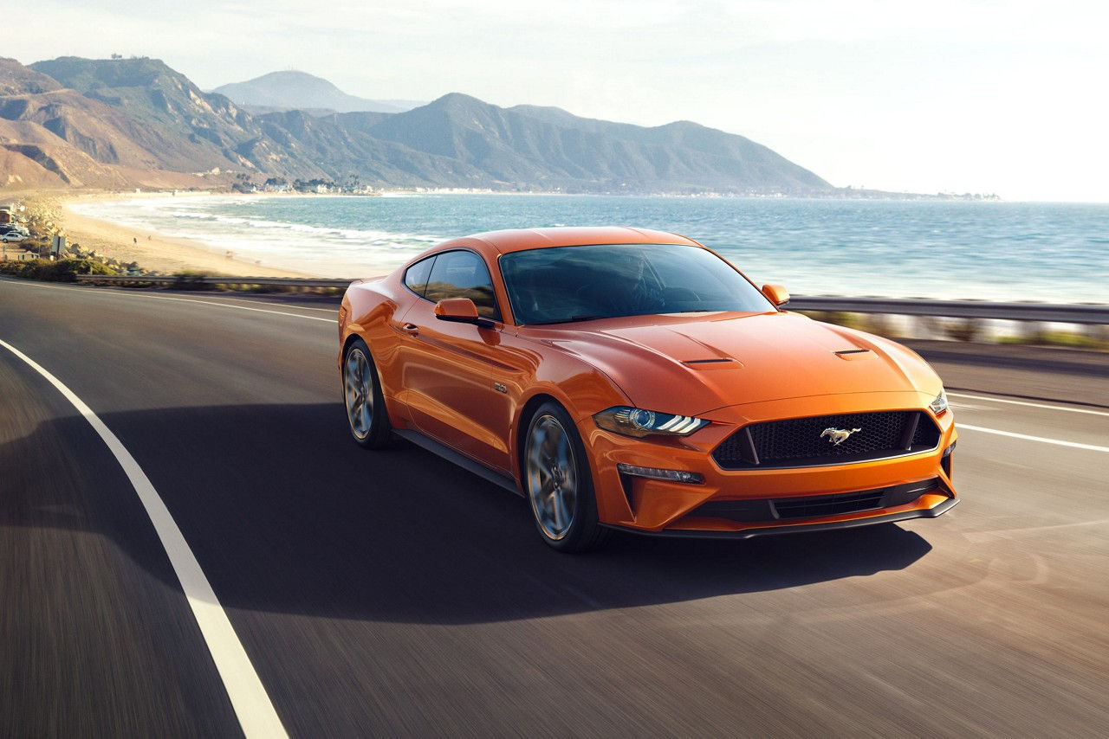
Which one is fast in those?
Airplane
Car

Slide 4
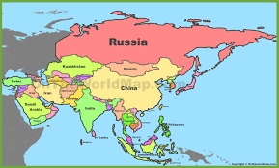
What country is big between Russia and China?

Slide 6
THE COMPARATIVE FORM
is used to establish difference between
two objects or people.
https://www.youtube.com/watch?v=qwrSgTCbg7Q

Slide 7
COMPARATIVES Objective: Applying the comparative form of adjectives.

Slide 8
RULES

Slide 9
RULES

Slide 10
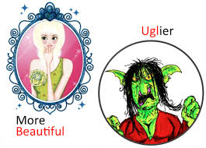
Example Rules
Ugly->Uglier

Slide 11
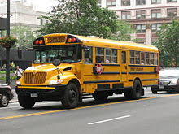
CCQ.1

Slide 12
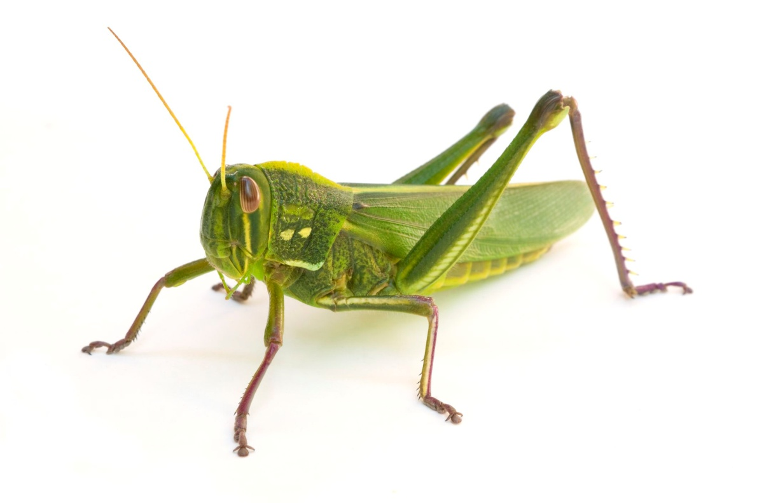
CCQ. 2

