Slide 1
I wake up at 10 a.m. in the morning

Slide 2
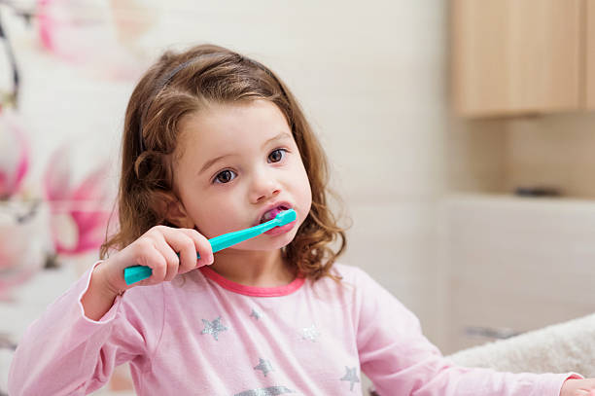
I brush my teeth in the morning

Slide 3
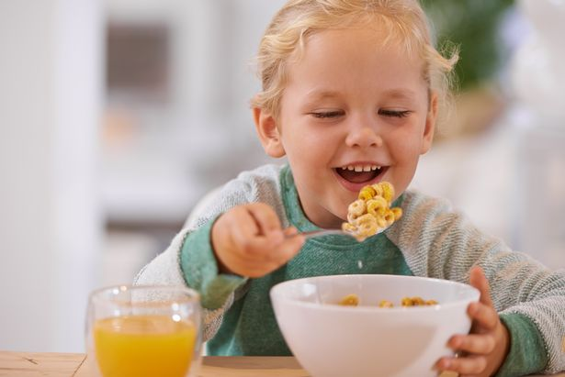
I eat breakfast at 11 a.m. in the morning

Slide 4
I take a nap at 12 p.m.

Slide 5
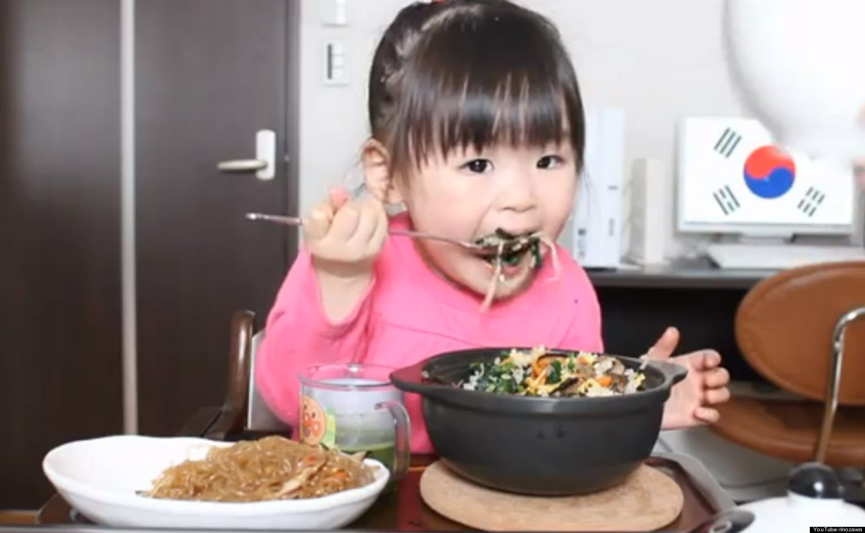
I eat lunch at 2 p.m. in the afternoon

Slide 6
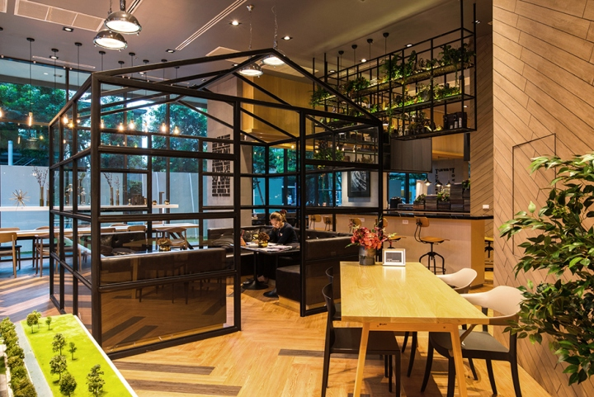
I go to café at 3 p.m. in the afternoon

Slide 7
I listen to music in the afternoon

Slide 8
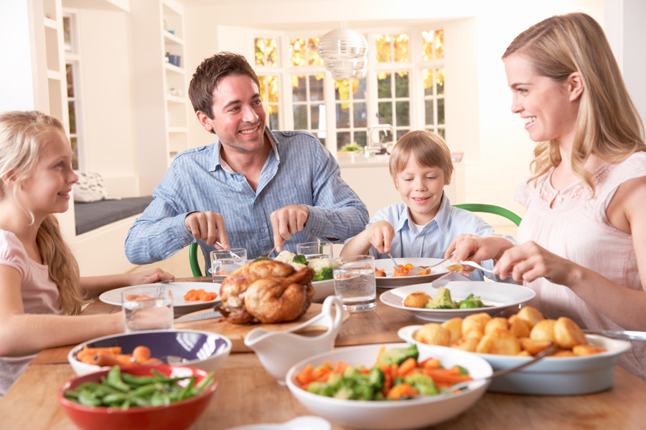
I eat dinner at 6 p.m. in the evening

Slide 9
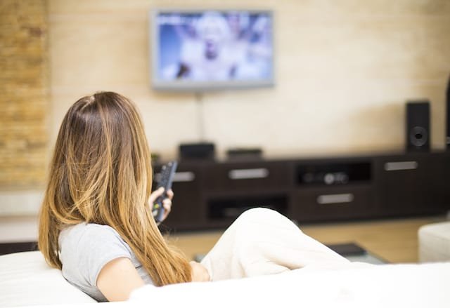
I watch TV in the evening

Slide 10
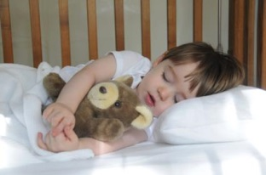
I go to sleep at 11 p.m. in the evening

