Slide 1
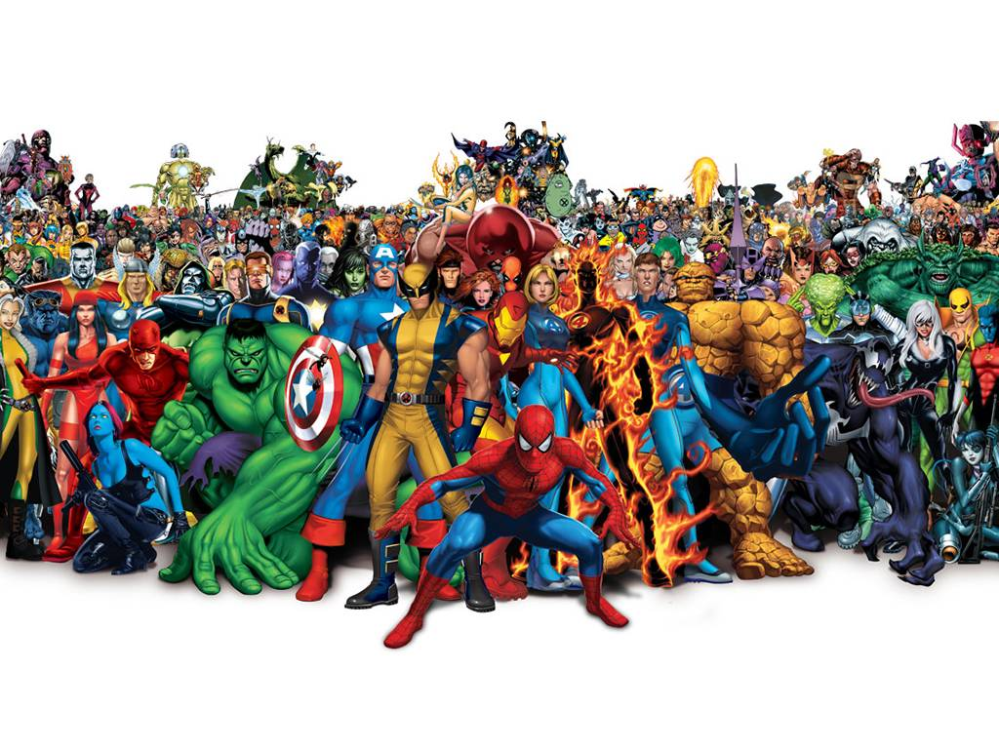

Slide 2
Elicitation
This boy was a hero and he could do anything he wanted when he was just a boy.
But then he became an adult and realize that he isn’t hero anymore, and he figured out that the gods are not real. The things are not perfect in the real life.
He is also looking or find for someone like him or maybe with someone who has a same social status like him now. Or he’s looking for an ordinary love. And want to have a good enough relationship.
Now, I want you to tell me what situation do you think the singer is at?
1. What feeling do you think he has?
2. What is lyrics telling people?
Have discussion with your partner.

Slide 3
(The answer 1: The song shows he wants to be something more without realizing that he is good enough. Also, it shows the strength of true love and a woman’s heart which will always love him no matter how less he is.)
(The answer 2: Yet he believes he is not enough. He ignores her and compares himself with the Superman. Again he fails to be him. Yet her love for him doesn't change. She knows what he is and is completely happy with him and says: I want Something just like this).

Slide 4
Can and cannot expresses the idea that It can be used to express ability or opportunity, to request or offer permission, and to show possibility or impossibility.
When we learn a simple present tense.
1.To express habits, general truths, repeated actions or unchanging situations, emotions and wishes: ...
2.To give instructions or directions: ...
3.To express fixed arrangements, present or future: ...
4.To express future time, after some conjunctions: after, when, before, as soon as and until.
The use of simple present.
The simple present is a verb tense with two main uses. We use the simple present tense when an action is happening right now, or when it happens regularly (or unceasingly, which is why it's sometimes called present indefinite).

Slide 5
Forming the simple present tense: to play
Affirmative | Interrogative | Negative
I can play tennis | Can I play tennis? | I cannot play tennis
You can play baseball | Can you play baseball? | You cannot play baseball
He can play basketball | Can he play basketball? | He cannot play basketball
She can play hockey | Can she play hockey? | She cannot play hockey
It can play music | Can it play music? | It cannot play music
We can play violin | Can we play violin? | We cannot play violin
They can play soccer | Can they play soccer? | They cannot play basketball

Slide 6
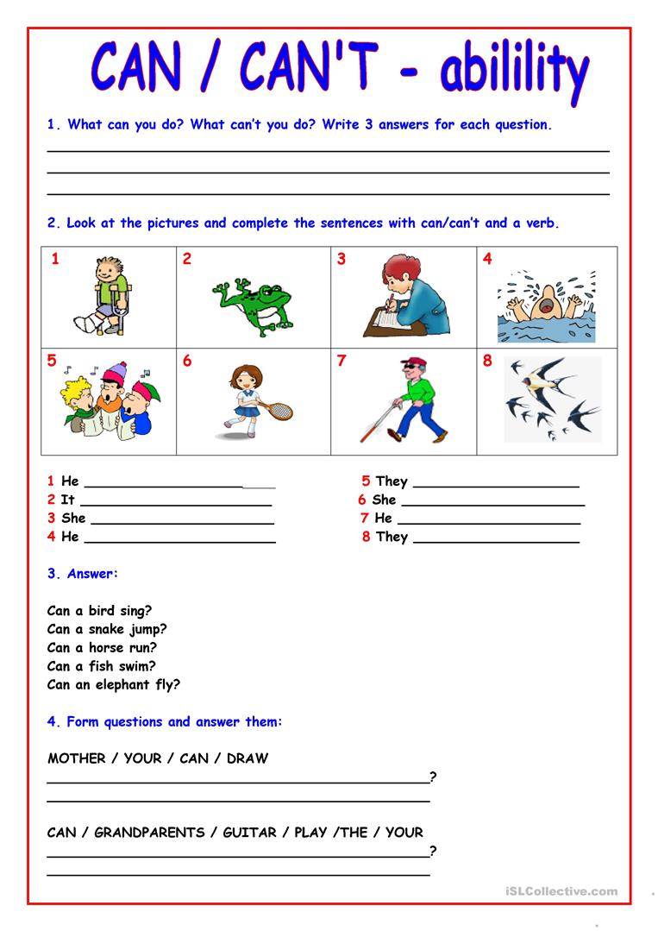

Slide 7
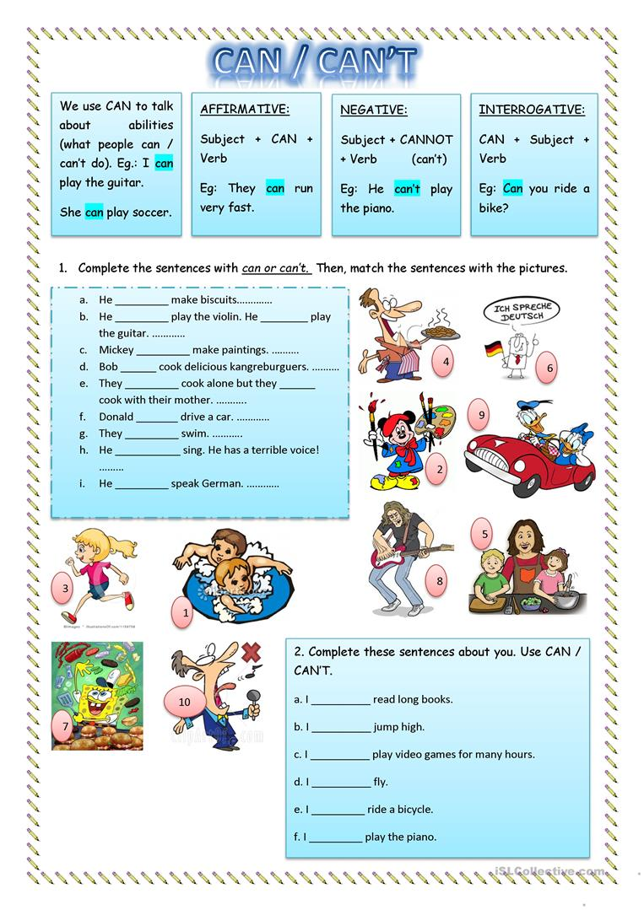

Slide 8
The End Thank you all very much

