Slide 1
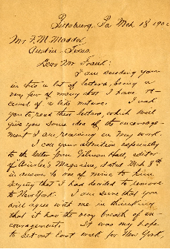
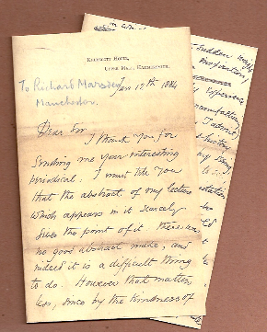

Slide 2
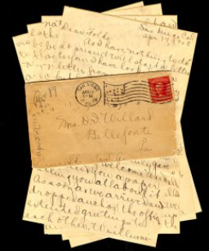
.

Slide 3
The letters
.

Slide 4
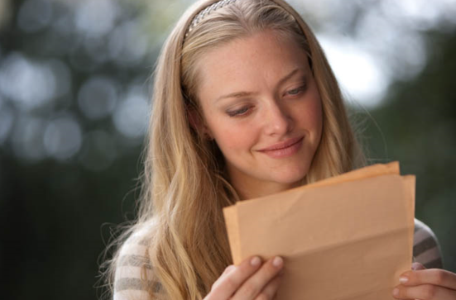
What is she doing ?

Slide 5
What kinds of Letters did you get so far?
.

Slide 6
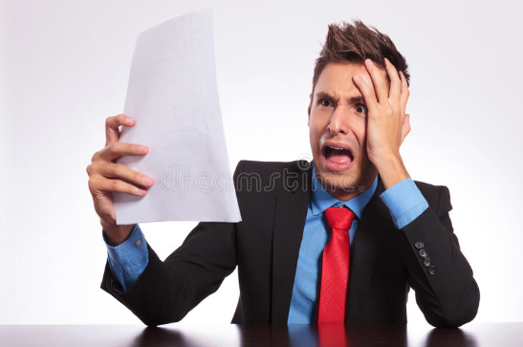

Slide 7
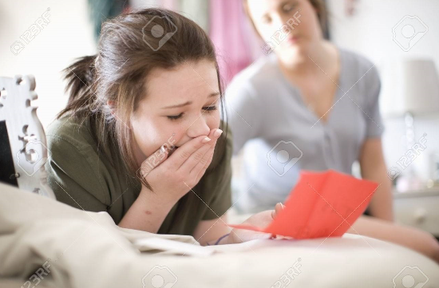

Slide 8
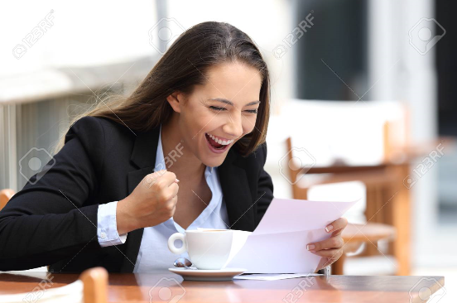

Slide 9
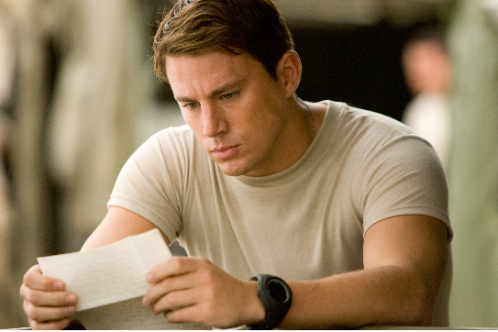

Slide 12
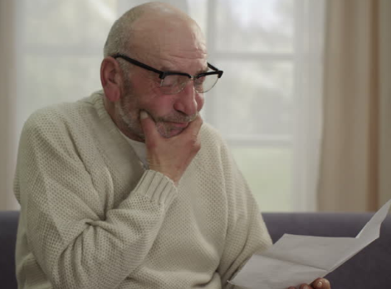

Slide 13
Today’ topic A friendly letter
.

Slide 14
Friendly, dear, write back, sincerely, date, capital letter, greeting, capitalization, question mark, closing
.

Slide 15
Two words vocabulary
w
r
i
t
e
b
a
c
k
e a c w
t b i k r
Write back

Slide 16
A Friendly Letter
Date: Begin with the date at the top. Use a capital letter for the name of the month.
Greeting: Start your greeting with “Dear”.
Use a capital D.
Capitalization: Use capital letters to begin a sentence.
Question: Use question marks at the end of questions.
Names: Capitalize the names of people, places, and things.
Closing: End the letter with a closing and your name.
Use a capital letter to begin the closing and put a comma after the closing.
Don’t forget that your name should start with a capital letter, too.
February 22, 2018
Dear Chris,
My name is Lisa.
I live in Seoul, Korea.
Where do you live?
I go to Central Elementary School.
I like to ride my bike.
Please write me back and tell me about yourself.
Sincerely,
Lisa

