Slide 1
https://www.youtube.com/watch?v=PX3k11lAwc8 https://www.youtube.com/watch?v=zS0BA8FnnKc

Slide 4
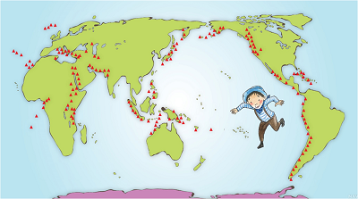

Slide 7
Cliched
based on frequently repeated phrases

