Slide 1
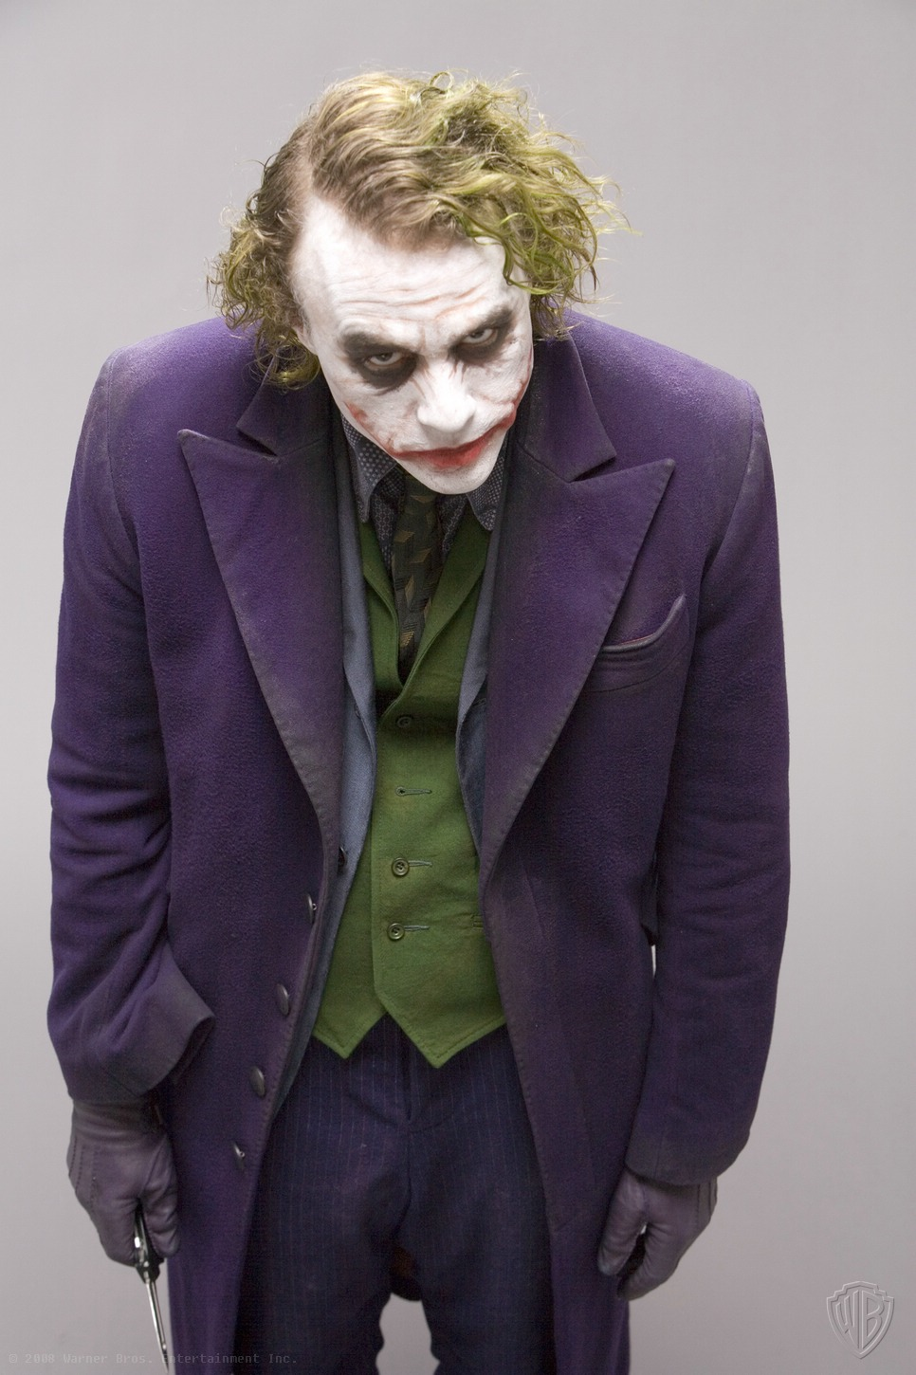
Joker’s
social experiment

Slide 2
Tonight you're all gonna be part of a social experiment. Through the magic of diesel fuel and ammonium nitrate, I'm ready right now to blow you all sky high. Anyone attempts to get off their boat, you all die. Each of you has a remote... to blow up the other boat.

Slide 3
At midnight, I blow you all up. If, however, one of you presses the button, I'll let that boat live. So, who's it going to be: Harvey Dent's most wanted scumbag collection, or the sweet and innocent civilians? You choose... oh, and you might want to decide quickly, because the people on the other boat might not be so noble.

Slide 4
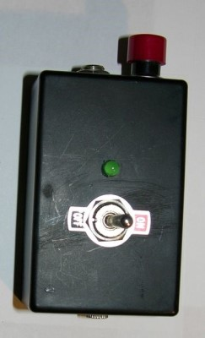
Detonator
It is a small amount of explosive or a piece of electrical or electronic equipment which is used to explode a bomb or other explosive device.

Slide 5
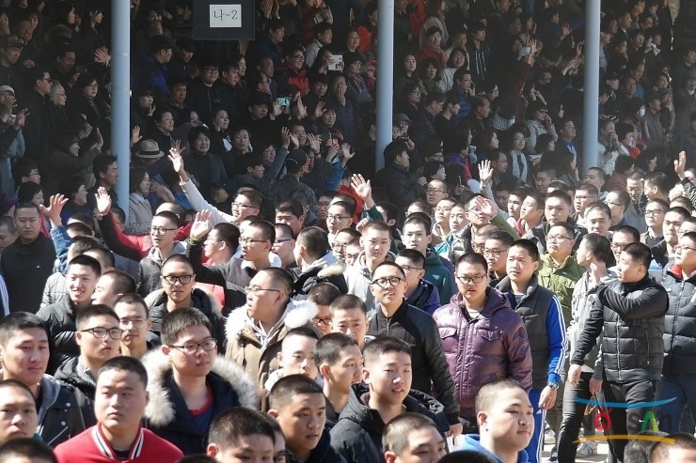
Civilian
In a military situation, a civilian is anyone who is not a member of the armed forces.

Slide 6
Precaution
-Taking notes will help you
-Do not interrupt other person while they’re talking
-We will vote after the discussion

Slide 7
This experiment was for...
1. Liberal spirit
2.Equality
3.Fraternity

Slide 8
“Haha, you see? I said that if the dark comes, these civilized people will eat each other”

Slide 9
“Oh, how innocent civilians you are.
But I’ll keep make other experiments to prove that my belief is right!!!!! ”

