Slide 1
Vocabulary Review
Presented by Jean Yoo

Slide 2
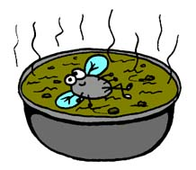
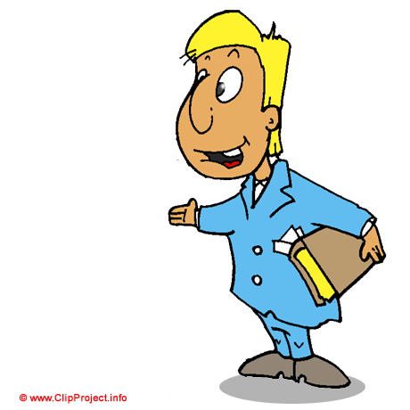
1. Complaining
Expressing pain or dissatisfaction of anger
Synonyms: Shouting, blaming, not enjoying, tempered
Antonyms: appreciating, enjoying, even-tempered, praising
Sentence: I was complaining for serving me a soup with fly in it.

Slide 3
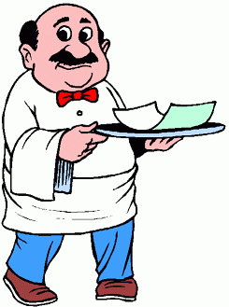
2. Poor Service
Served poorly, in a bad manner, below the expected service
Synonyms: poor: unsatisfactory, weak, pitiful
Antonyms: abundant, satisfactory, strong, good, great
Sentence: I had poor service at a restaurant I went last night that the waiter spoke to me with unfriendly manner.

Slide 4
3. Persuade
Cause somebody to adopt a certain position
Synonyms: convince, influence, induce, satisfy, assure
Antonyms: stop, stay, dissuade, prevent
Sentence: Since I really wanted to watch last part of the movie, I had to persuade
Mom for sleeping late.

Slide 5
4. Evade
Avoid fulfilling, answering, or performing
Synonyms: avoid, escape, sidestep, skirt
Antonyms: accept, be honest, clear up, confront
Sentence: They tend to evade their responsibilities to end the 1st semester of the school.

Slide 6
5. Slacker
A person who shirks his work or duty
Synonyms: good-for-nothing, quitter, lazybones , lazy
Antonyms: hard worker
Sentence: I never went to school on right time, I know that I am a slacker.

Slide 7
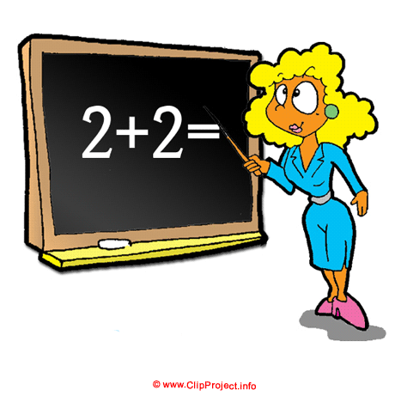
6. Cheat
Engage in deceitful behavior ; practice trickery or fraud
Synonyms: deceive, lie, dishonest
Antonyms: honest, frankness, truthfulness
Sentence: When I looked at Tom and I saw him cheating during an exam.

Slide 8
7. Irresponsible
Show lack of care for consequences
Synonyms: unthinking, childish, careless, immature
Antonyms: responsible , careful
Sentence: I saw many people when they face big problems that cannot be solved, by just leaving the company which seems to be irresponsible for their work.

Slide 9
Vocabulary Review
Complaining
Poor Service
Persuade
Evade
Slacker
Cheat
Irresponsible

