Slide 1
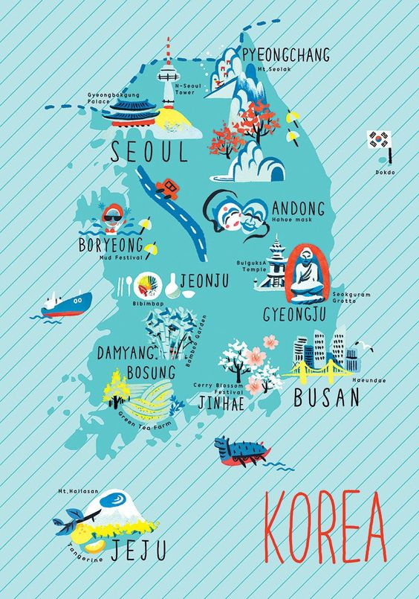
Grammar Lesson Worksheet 1)
Have you been to______ ?
1.Interview Question: Have you been to _____?
2. Check the box with √if the answer is YES.
Name | BO RYEONG | PYEONG CHANG | ANDONG | BUSAN | JEJU | OTHERS

Slide 2
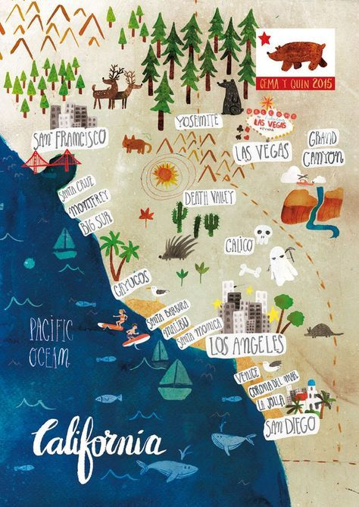
Grammar Lesson Worksheet 1)
Have you been to______ ?
1.Interview Question: Have you been to _____?
2. Check the box with √if the answer is YES.
Name | SANFRANCISCO | LAS VEGAS | LOS ANGELES | SAN DIEGO | GRAND CANYON | OTHERS

Slide 3
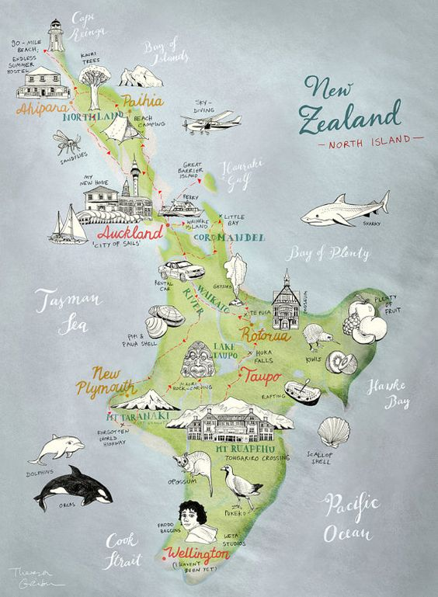
Have you been to______ ?
1.Interview Question: Have you been to _____?
2. Check the box with √if the answer is YES.
Name | New Playmouth | Wellington | Taupo | Rotorua | Mt Ruapehu | Auckland

Slide 4
Grammar Lesson Worksheet 1-2)
Interview answers:
1. Yes. I have been to Pyeongchang few years ago.
2. ________________________________________
3. ________________________________________
4. ________________________________________
5. ________________________________________
6. ________________________________________
7. ________________________________________
8.________________________________________
9.________________________________________
10._______________________________________
11._______________________________________
12._______________________________________
13._______________________________________
14._______________________________________

Slide 5
Grammar Lesson Worksheet 2)
Write your own question by “Have you been to_________”
Write 3 questions per person.
1. Have you been to Alaska?
2. ________________________________________
3. ________________________________________
4. ________________________________________
5. ________________________________________
6. ________________________________________
7. ________________________________________
8.________________________________________
9.________________________________________
10._______________________________________
Answer:
No. I haven’t . I would like to one day.
_______________________________________
_______________________________________
_______________________________________
_______________________________________
_______________________________________
_______________________________________
_______________________________________
_______________________________________
_______________________________________

Slide 6
Grammar Lesson Worksheet 3)

Slide 7
Irregular verbs
Rank | Base Form | Past Tense Form | Past Participle
1 | say | said | said
2 | make | made | made
3 | go | went | gone
4 | take | took | taken
5 | come | came | come
6 | see | saw | seen
7 | know | knew | known
8 | get | got | got/gotten (US)
9 | give | gave | given
10 | find | found | found
11 | think | thought | thought
12 | tell | told | told
13 | become | became | become
14 | show | showed | shown
15 | leave | left | left
16 | feel | felt | felt
17 | put | put | put
18 | bring | brought | brought
19 | begin | began | begun
20 | keep | kept | kept

