Slide 1
Traveling the World
Kang Jeon Gil (Joseph)

Slide 2
Do you ever feel tired from your life, and wish you could just get away from it all? Do you ever plan on going on a get away?
https://www.youtube.com/watch?v=vI7cV6jlv-M

Slide 3
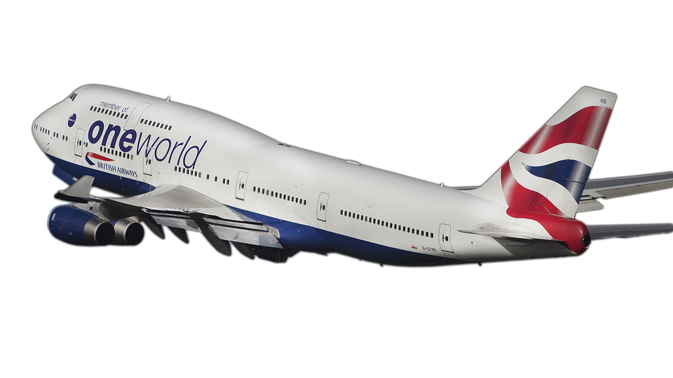
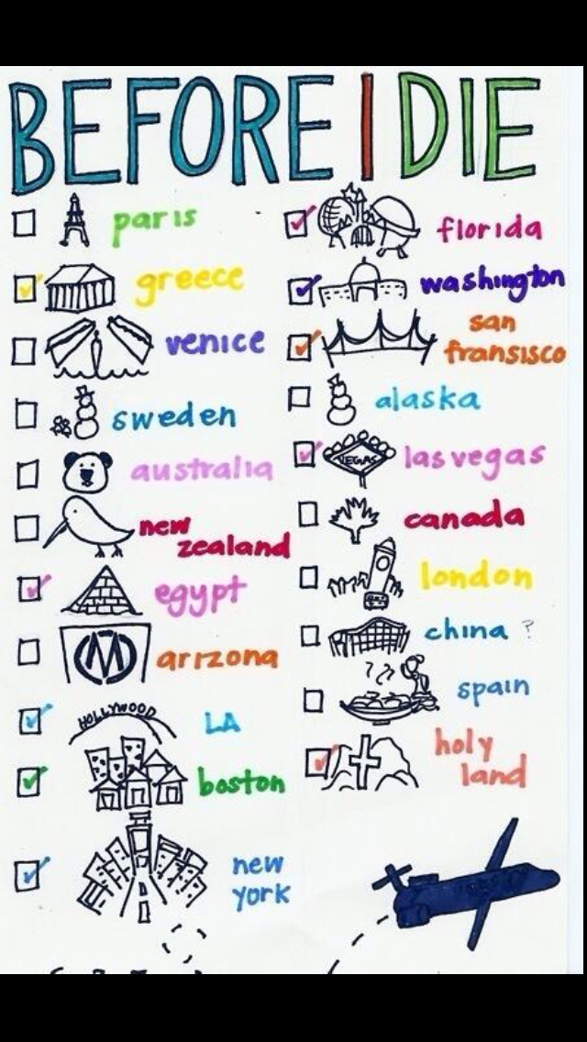
My Travel Bucket List

Slide 4
Simple future tense
In English grammar, the simple future is a form of the verb that refers to an action or event that has not yet begun.
Will + verb

Slide 5
contractions
I will = I’ll
We will = we’ll
you will = you’ll
He will = he’ll
She will = she’ll
they will = they’ll

Slide 6
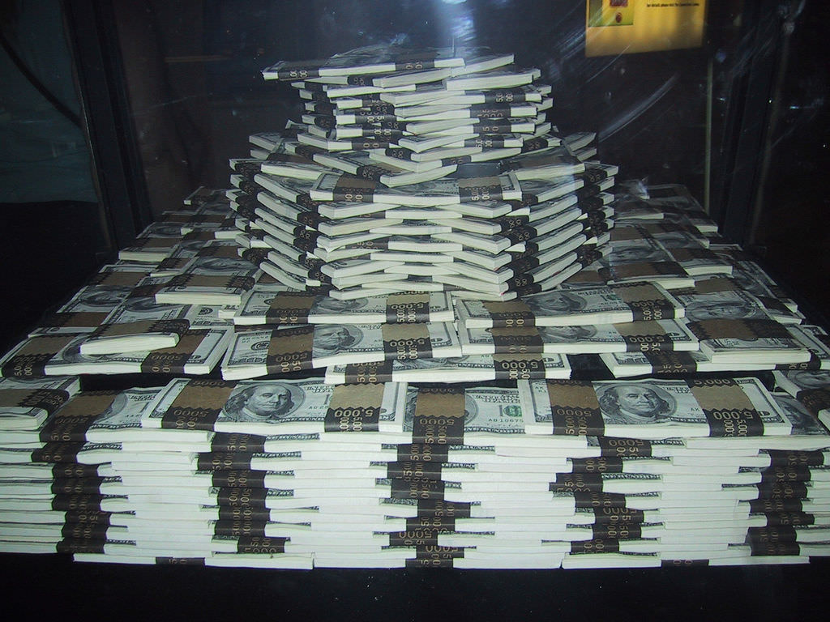
If you had a million dollars...
Where would you travel, and when?
Plan a travel plan using the worksheet

Slide 7
Free Practice!
I will eat……
I will see a movie…..
I will walk…..
I will cook…..
etc….

Slide 8
Work Citation
https://pixabay.com/ko/%ED%95%AD%EA%B3%B5%EC%82%AC-%EB%B9%84%ED%96%89%EA%B8%B0-b-747-%EB%B9%84%ED%96%89%EA%B8%B0-%ED%95%AD%EA%B3%B5%EA%B8%B0-%EB%82%A0%EA%B0%9C-%EC%9D%B4%EB%AF%B8%EC%A7%80-%ED%88%AC%EB%AA%85%ED%95%9C-2943435/
https://www.youtube.com/watch?v=vI7cV6jlv-M
https://www.flickr.com/photos/mmarchin/40261352
https://www.pinterest.co.kr/pin/459226493223813277/

