Slide 1
Reading Review
Presented by Jean Yoo

Slide 2
Let’s READ
To stay healthy you need to eat healthy food throughout your day according to the best meal plan according to your bodies requirement .you should not to forget to include some kinds of food daily in your diet like fruits ,veggies, cereals ,dairy products ,nuts etc to stay healthy
So here we have come up some of the different healthy eating plans for you to choose from and eat to remain healthy and free from disease and good body throughout your life .
*review blue highlighted vocab.
Serving, calories, diary

Slide 3
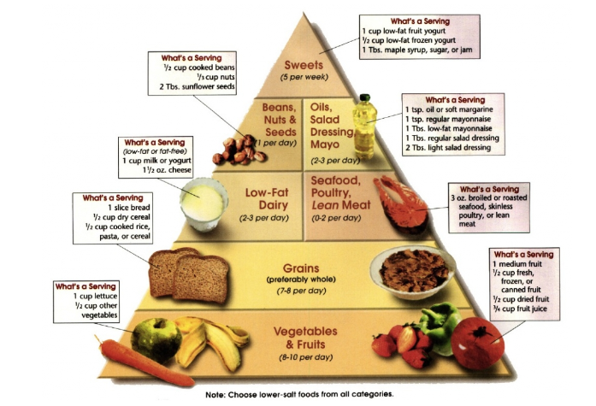
Some of the diet plan charts and pyramids for healthy eating plan are given below for you to take a look and follow the plan to see the desired result in the desired time period .

Slide 4
True & False Questions
True
False
Vegetables are good to have 8-10per a day
Low Fat Diary is good to have 5per a day
Beans and Nuts are good to have 1per a day
Grains are good to have 15per a day
Seafood, poultry, lean meat is preferred to have
5times a day
Sweet is preferred to have 2-3 per week
Choose foods from all categories lower-salt

Slide 5
 | MON | TUES | WED | THURS | FRI | SAT | SUN
BREAKFAST | - Cinnamon Streusel Muffins - Poached Eggs - Fruit Smoothie | - Toad-n-the-Hole - French Berries w/ Vanilla Yogurt | - Fruit & Yogurt Parfaits - Boiled Eggs | - Homemade Granola w/Fresh Diced Cherries & Almond Milk | - Soaked Oatmeal w/Ripe Pear & Raw Honey - Boiled Eggs | - French Toast Casserole - Nitrate-Free Bacon - Fresh Berries | - Fluffy Almond Flour Pancakes Scrambled Eggs - Mixed Berries
LUNCH | - Carrot Cheddar Sandwich - Pineapple Slices | - Leftover Caprese Pasta - Raw Veggies w/Ranch Dip | - Grilled Chicken Salad Wrap - Strawberries | - Avocado Egg Salad Sandwich - Cultured Pickies | - Tuna Salad w/ Whole Grain Cracker - Fresh Cherries | - Leftover Italian Sausage Soup - Sourdough rolls w/Bitter | - Grilled Turkey Reuben - Cultured Sauerkraut -Apple Slices
DINNER | - Caprese Pasta - Mesclun Salad w/Homemade Balsamic Vinaigrette | - Grilled Chicken w/ Pineapple Salsa - Black Beans -Brown Rice | - Turkey-Veggie Burgers - Caribbean Carrat Salad - Healthy Fries | - Strawberry-Feta Salad with Grilled Chicken - Almond Flour Biscuits w/Butter | - Italian Sausage, Kale & White Bean Soup - Sourdough Rolls w/Butter | - Grilled Fish Provencal w/Wild Rice & Asparagus - Dessert: Strawberry Shortcakes | - Grilled Veggie Quesadillas -Black Beans & Brown Rice - Guac, Salsa & Sour Cream
Do Ahead | - Save extra caprese pasta for tomorrow's lunch - Soak beans and rice for tomorrow's dinner | - Grill extra chicken to make chicken salad & for Thurs' dinner -Save extra black beans and rice for Sun's dinner | - Boil extra eggs to make egg salad for tomorrow's lunch | - Soak oats for tomorrow's breakfast | - Save extra soup for tomorrow's lunch - Prepare French toast casserole and refrigerate overnight | - Make meal plan for next week - Go to market | - Prep Day (Prep ahead as needed for next week's meal plan)

Slide 6
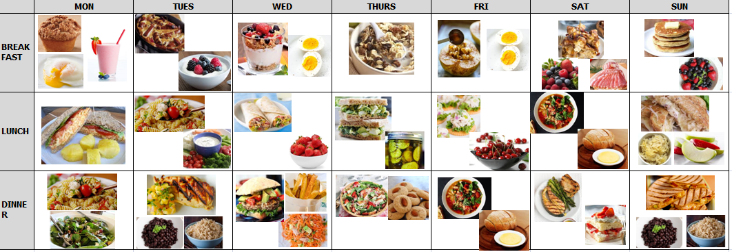

Slide 7
MY HEALTY EATING PLAN
 | MON | TUES | WED | THURS | FRI | SAT | SUN
BREAKFAST
LUNCH
DINNER
Preparation

