Slide 1
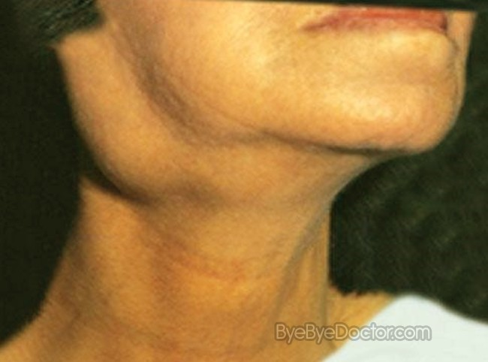
Mononucleosis
An infectious disease that causes swelling in throat, also shorten as Mono

Slide 2
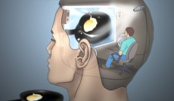
Lucid Dream
When dreamer is aware that they are dreaming

Slide 3
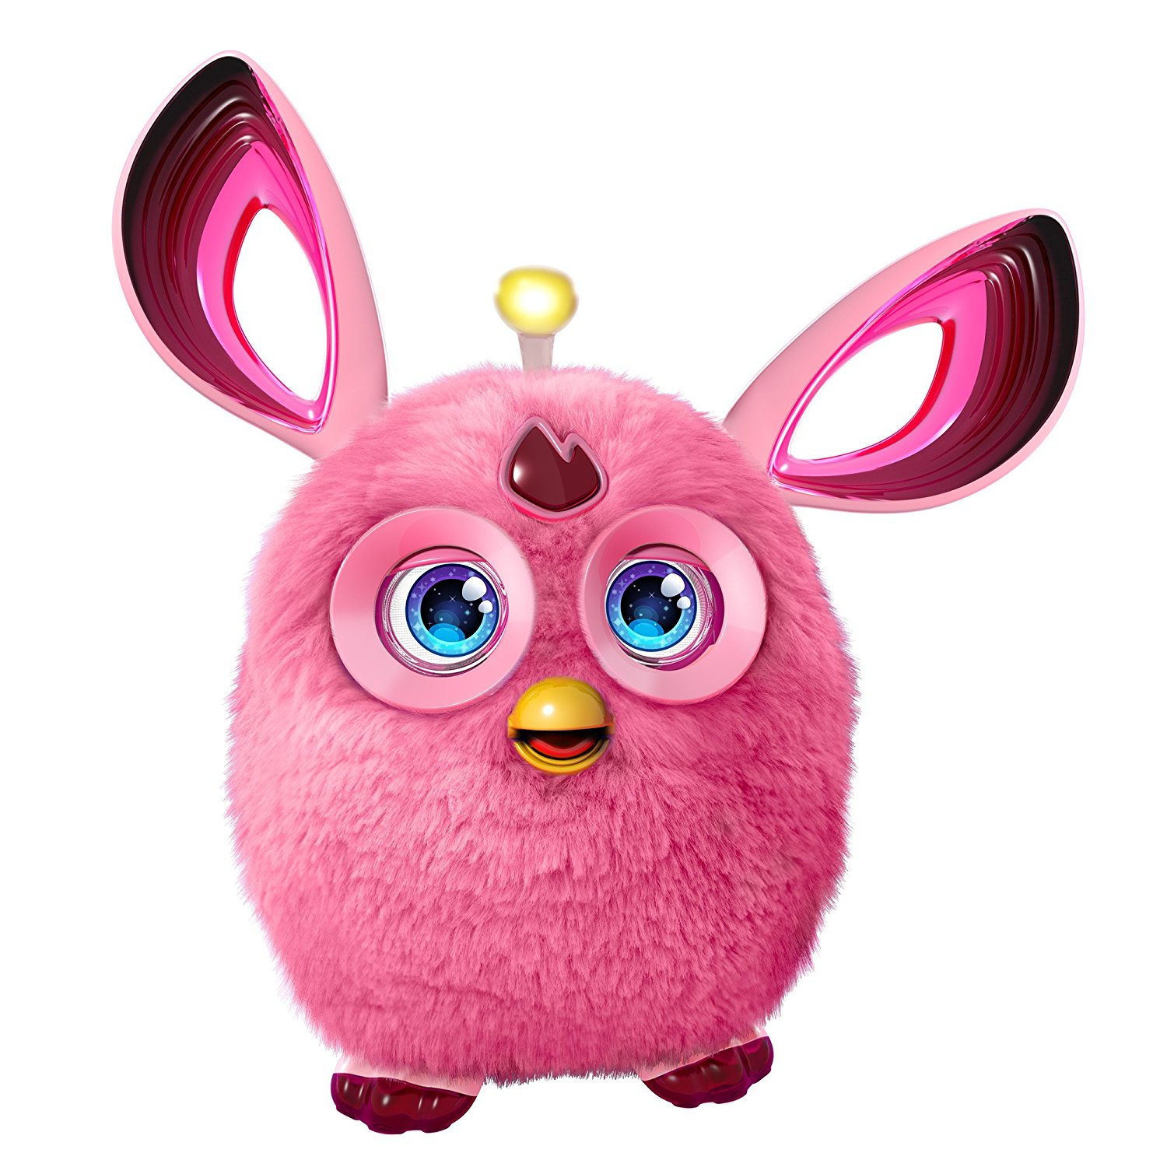
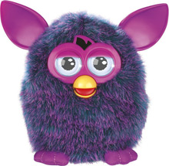
Furby
Popular toy from 1990s and 2000s

Slide 4
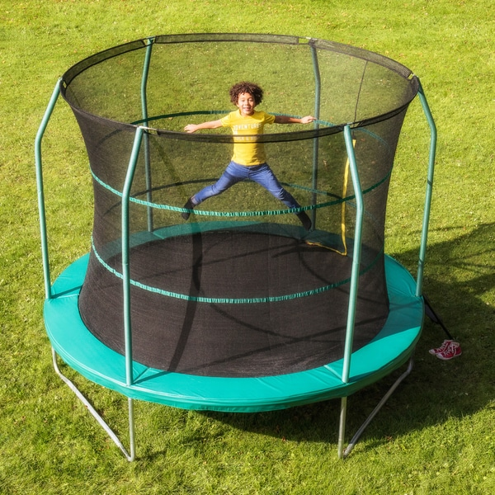
Trampoline
Bouncy sport equipment that you can jump up and down on

Slide 5
Juggle
Act of continuously tossing several objects into the air and catching them at a time

Slide 6
Ecstatic
Feeling or expressing overwhelming happiness or joyful excitement

Slide 7
Silhouette
Dark shape or outline of someone or something against brighter background

