Slide 1
Who Started World War I ?
Kang Jeon Gil
(Joseph)

Slide 2
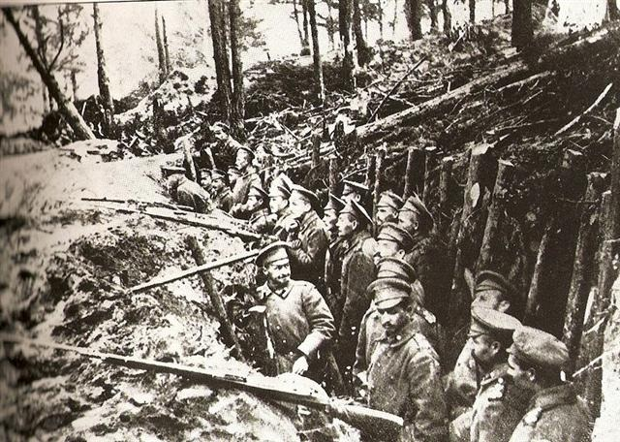
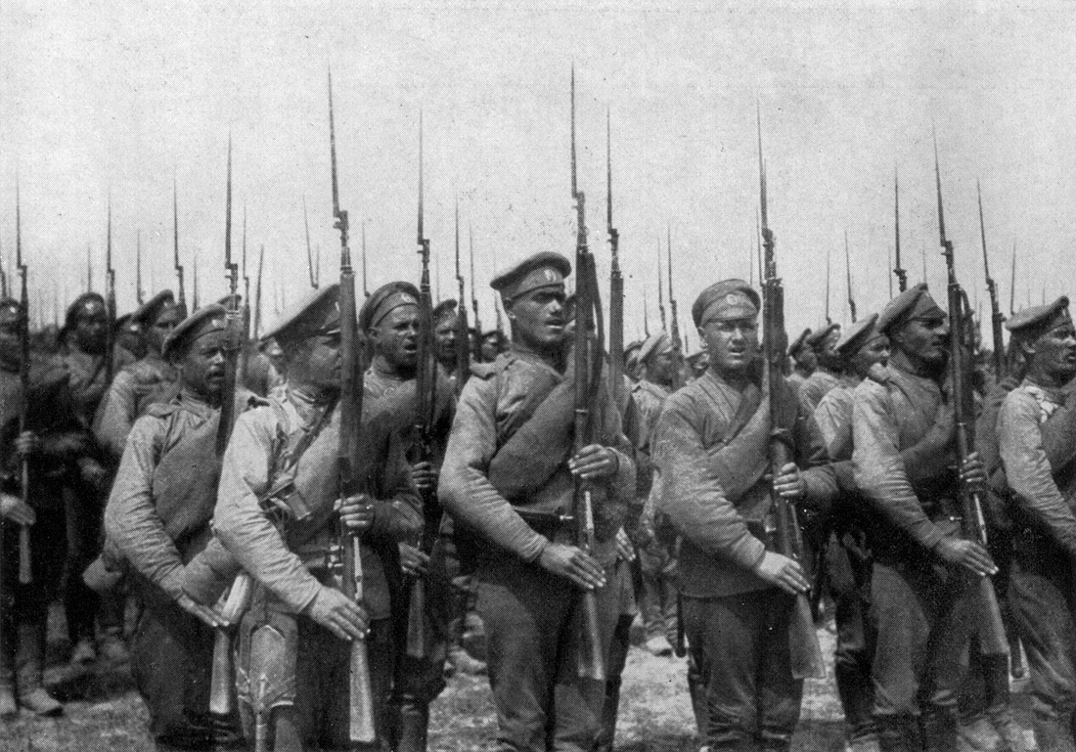
What do you know?
Have you ever heard about World War One?
Did you learn about it in school?
Did you ever learn who actually started the War?
Do you think every war Have a cause?
Are wars inevitable?

Slide 3
Key Vocabulary
Empires
War
Denunciation
Assassination
Inevitable

Slide 4
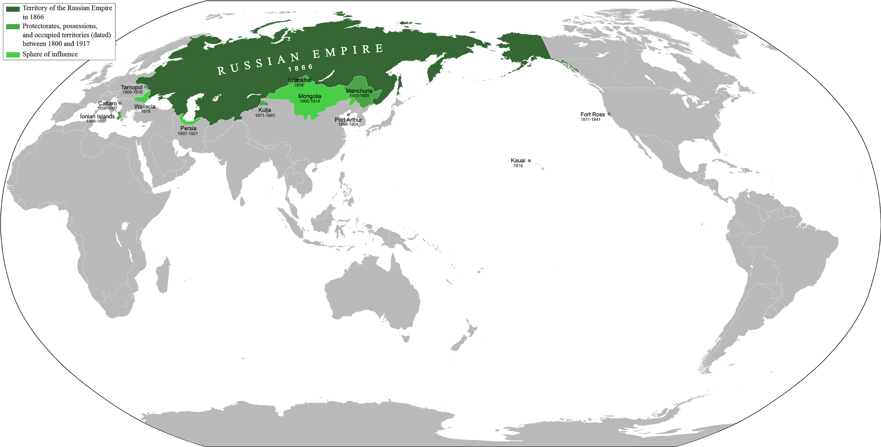
Empire
a group of nations or peoples ruled over by an emperor, empress, orother powerful sovereign or government: usually a territory of greater extent than a kingdom

Slide 5
War
a conflict carried on by force of arms, as between nations or between parties within a nation; warfare, as by land, sea, or air.

Slide 6
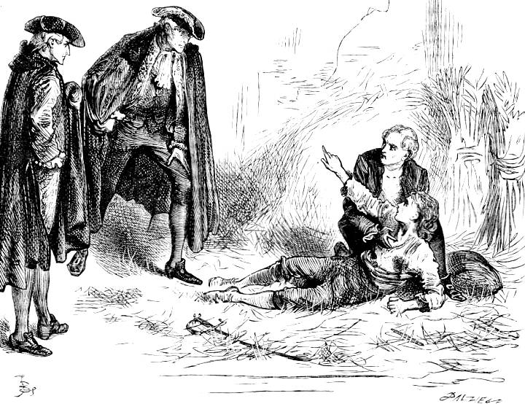
Denunciation
an accusation of crime before a public prosecutor or tribunal.

Slide 7
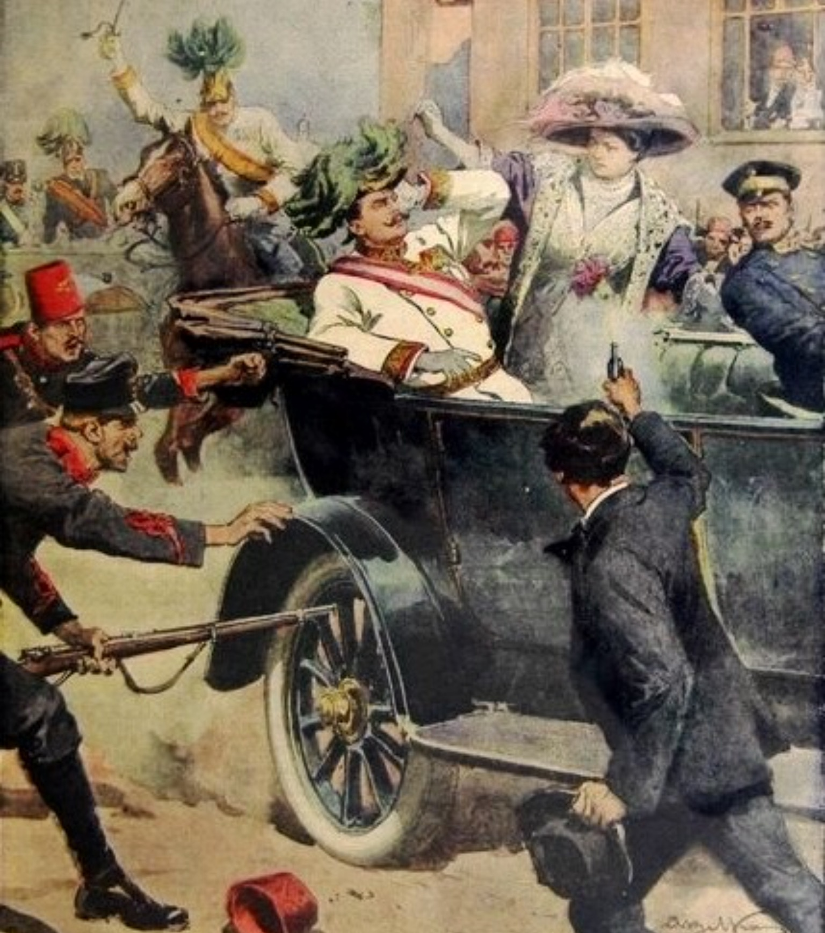
Assassination
to kill suddenly or secretively, especially a politically prominent person; murder premeditatedly and treacherously.

Slide 8
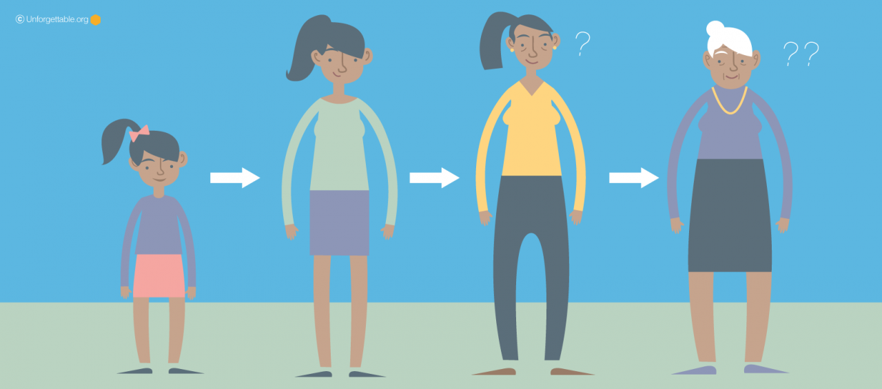
Inevitable
unable to be avoided, evaded, or escaped; certain; necessary:
sure to occur, happen, or come; unalterable:

Slide 9
Introduction
“from the assassination of Archduke Franz Ferdinand and his wife in Sarajevo on June 28, 1914, to the Austro-Hungarian declaration of war on Serbia on July 28 – Europe went from peaceful prosperity to a conflict that would bring down four empires and cost more than 15 million lives.”

Slide 10
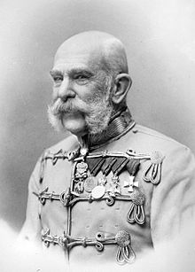
Key Historical Figure 1: Emperor Franz Joseph I of Austria-Hungary
Emperor of Australia
King of Hungary
Monarch of Austria-Hungary Empire
Declared war on Serbia
Asked Germany to aid them in the war

Slide 11
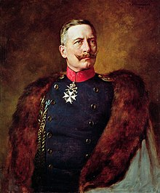
Key Historical Figure 2: Kaiser Wilhelm II of Germany
Last emperor of German Empire
King of Prussia
Offered to support Austria-Hungary - Serbia War
He knew a large scale War was inevitable

Slide 12
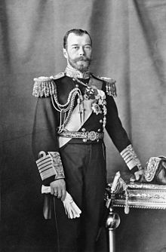
Key Historical Figure 3: Tsar Nicholas II of Russia
Last Emperor of Russian Empire
They had “affinity” with Serbia
Mobilized the Russian Empire’s army for their own safety
Saw the War as an opportunity

Slide 13
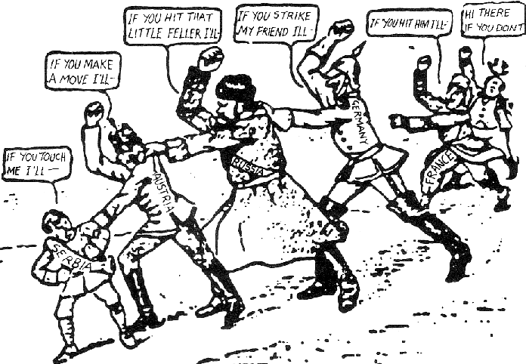
Class Discussion

Slide 14
Class Discussion
The causes of the war in 1914 are therefore immensely significant.
Was the war inevitable? Or did Europe’s monarchs and politicians have an element of choice in their decisions?
Which nation had the most influence
in starting World War I ?

Slide 15
Work Citation
References:
https://www.telegraph.co.uk/history/world-war-one/inside-first-world-war/part-one/10271886/who-started-world-war-one.html
http://www.bbc.com/news/magazine-26048324
https://en.wikipedia.org/wiki/Franz_Joseph_I_of_Austria#The_German_Question
https://en.wikipedia.org/wiki/Wilhelm_II,_German_Emperor
https://en.wikipedia.org/wiki/Nicholas_II_of_Russia
https://communismforthewin.weebly.com/why-did-russia-enter-the-war.html
http://www.dictionary.com/browse
https://en.wikipedia.org/wiki/Russian_Empire
https://commons.wikimedia.org/wiki/File:T2C,_Fred_Barnard,_Dr_Manette%27s_epistolary_denunciation_of_the_Evr%C3%A9mondes_brothers_(III,8).jpeg
https://commons.wikimedia.org/wiki/File:DC-1914-27-d-Sarajevo-cropped.jpg
https://www.unforgettable.org/blog/is-memory-loss-inevitable/
https://commons.wikimedia.org/wiki/File:Chain_of_Friendship_cartoon.gif

