Slide 1
Food

Slide 2
What is this?

Slide 3
Food

Slide 4
New vocabulary lesson
Find the best match from suggested answers
junk food
healthy / unhealthy
unhealthy

Slide 5
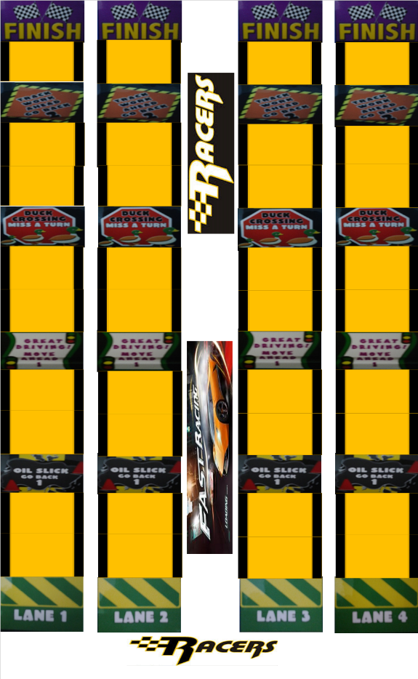
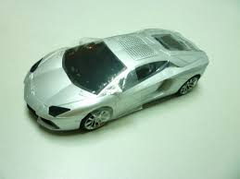
Car Race Game

Slide 6
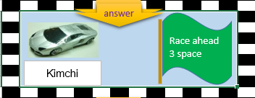
Car Race Game

Slide 7
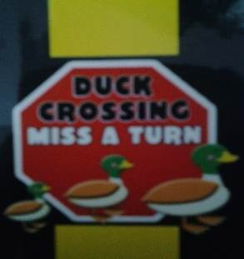
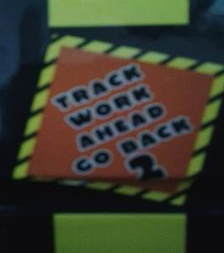
Car Race Game
Great Driving
One space move forward
Duck Crossing
Miss a turn
Track work
Go back to 2 spaces
Oil Slick
Go back to 1 space

Slide 8
Sentence Structure
May I take your order?
Are you ready to order?
Function
Would you like to order now?
Taking Order for food.
Ready to order?

Slide 9
Sentence Structure
May I have the bill, please?
Could you bring us the bill, please?
Function
Check, please?
Pay the bill at the restaurant.
Bring me the bill, please?

Slide 10
Let’s play a game.

Slide 11
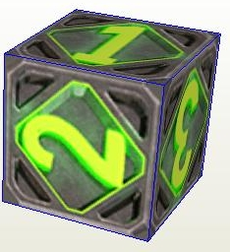
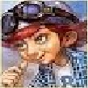
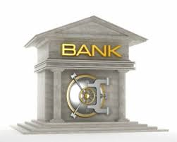
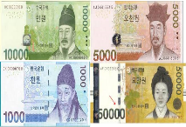
How to play monopoly
What’s your favorite food?
My favorite food is taco. It is Mexican food.

Slide 12
Find Someone Who.
Move abound the classroom and ask your friends some questions below.
While you ask some questions to your friends, if the answer from your friends is matched, please, write your friend’s name. Then, stop asking it and move to another friends to ask it.
Friend’s name | I find my friend who ~~~
 | I find my friend who is a good cook.
 | I find my friend who prefer to drink tea.
 | I find my friend who likes spicy food.
 | I find my friend who is allergic to food.
 | I find my friend who eats healthy food.
 | I find my friend who prefer drinking coffee.
 | I find my friend who likes to eat fish.
 | I find my friend who likes to put topping on pizza?
 | I find my friend who can cook bulgogi.
 | I find my friend who likes to eat ice cream.
 | I find my friend who ate McDonald’s this week.
 | I find my friend who does not like kimchi.
 | I find my friend who like eating hamburger.
 | I find my friend who can like to eat bread.

