Slide 1
There is / are

Slide 2
Visiting your friend’s house.

Slide 3
In the kitchen for dinner

Slide 4
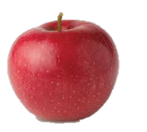
On the table for dessert

Slide 5
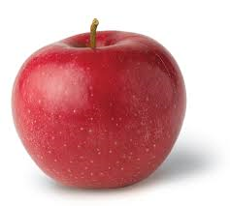
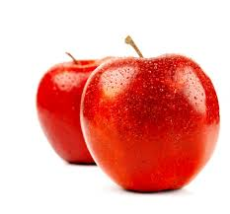
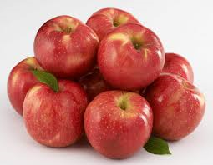
There is / are
There is / are : The specified thing exists, physically or abstractly.
There is an item.
There is an apple.
There are several items.
There are two apples.
There are many apples.

Slide 6
There is an apple.
There are two apples.
There are many apples.

Slide 7
Substitution table
there | is | an | apple | on | the | table
 |  | a | tree | in | The | garden
 |  | a | window | in | the | room
 | are | apples |  | on | the | table
 |  | trees |  | in | the | garden
 |  | windows |  | in | the | room

Slide 8
There is / are
Match the words into the right order.
1.
are, in the bag, a camera, there
are
There
a camera
in the bag.
2.
many, guests, at, party, are, there, the
There
are
many
at
party.
guests
the

Slide 9
negative / question for there is / are
To make the negative sentence, you should put “not” behind be verb.
When you want to make question sentence, you should switch there and be verb.
There aren’t many students in the classroom.
There isn’t a glass on the table.
There isn’t a camera in the bag.
Is there a gas station near here?
Is there a post office on this street?
Are there many comic books in this library?
Are there buildings in the middle of the pond?

Slide 10
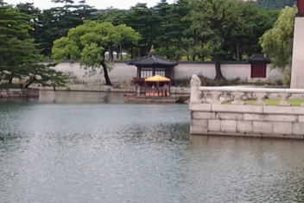
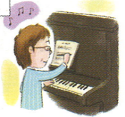
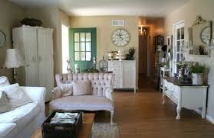
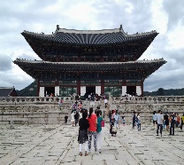
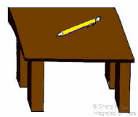
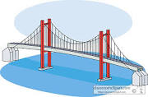
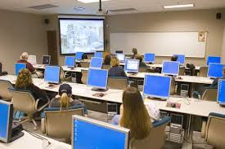
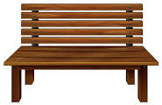
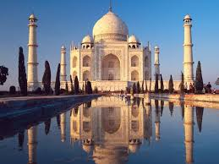
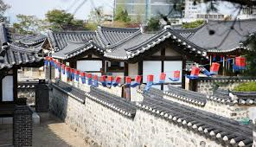
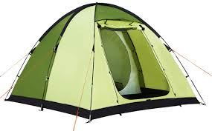
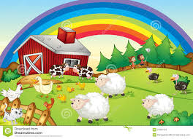
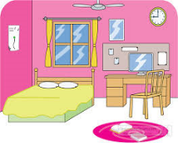
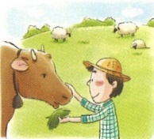
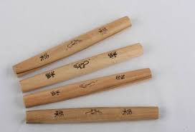
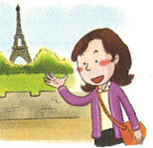
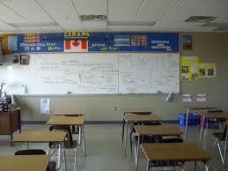
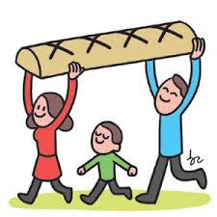
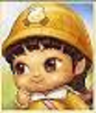
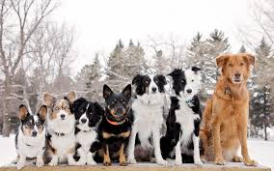
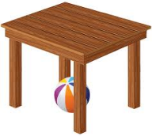
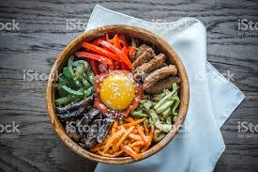
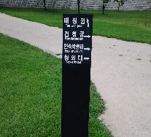
Go back to 2 squares
Go back to 2 squares
Speak using one of these structures.
There is __________.
There are __________.
Start

Slide 11
How to play board game
Move one step forward
Move two step forward
Move three step forward
Move four step forward
Move five step forward

Slide 12
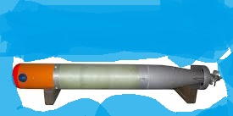
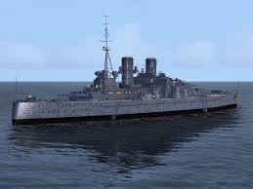
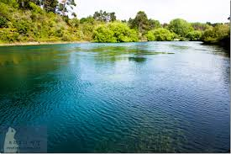
SOS: Grammar Battleship Game
Team A : Place 5 battleship (three-square long ships ) on the grid
 | 1 | 2 | 3 | 4 | 5 | 6 | 7
A
B
C
D
E
F
G

Slide 13
Grammar Checkup
1.
They are walking around the pond.
Grandfather : Wow, how wonderful! There are a building in the middle of the pond.
Dad : Yes, that’s Gyeonghoeru. They usually held parties here on special days like the king’s birthday.
Mom : I see. Look! There’s an old boat.
Aram : Here's the sign. They rode boats on the pond.
is

Slide 14
Grammar Checkup
2.
There aren’t many students in the classroom.
There isn’t a glass on the table.
There isn’t cameras in the bag.
a camera
3.
Is there a gas station near here?
Is there a post office on this street?
Are there many comic book in this library?
Are there buildings in the middle of the pond?
many comic books

Slide 15
Grammar Checkup
4.
There are many pupils in class.
There is TV sets in the shop.
There is a fish in the green bowl.
are or TV set
5.
There is a table in the forest
There is a bed in the room.
There are a book in the bag. .
Is or books

