Slide 1
City of Stars
Lydia Kang

Slide 2
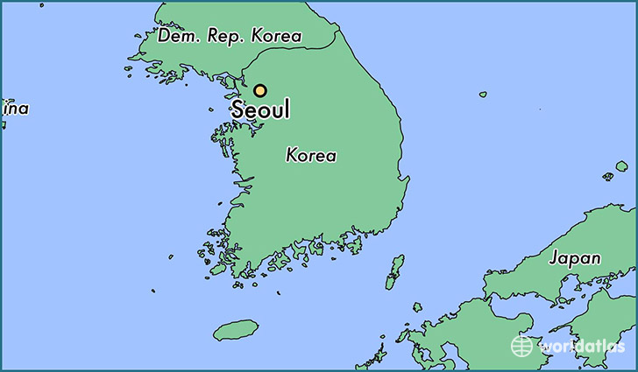
Where is this?

Slide 3
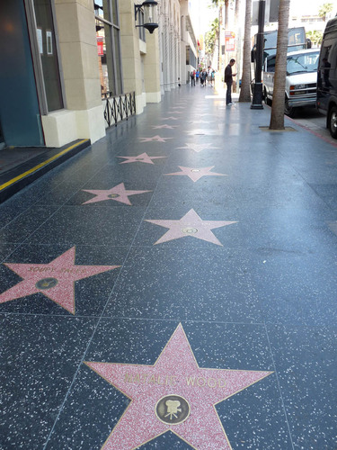
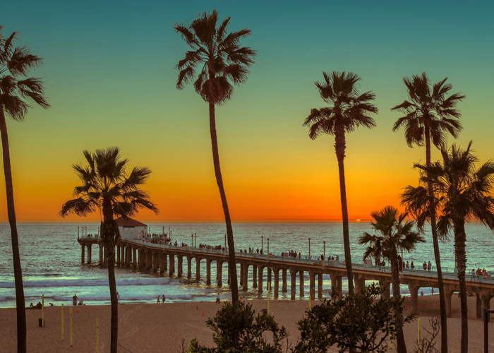
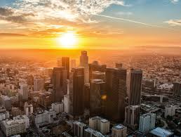
Where is this?

Slide 4
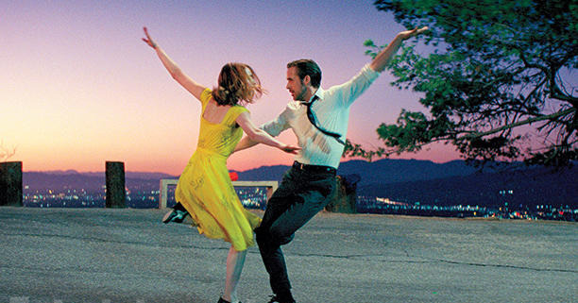

Slide 5
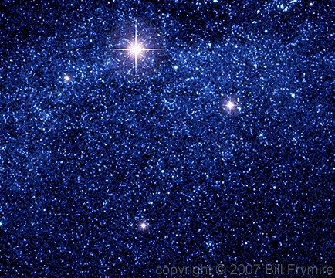
New Vocabulary
Stars
Shining

Slide 6
New Vocabulary
Knows

Slide 7
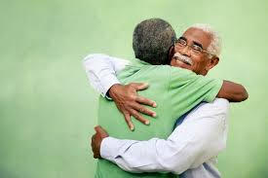
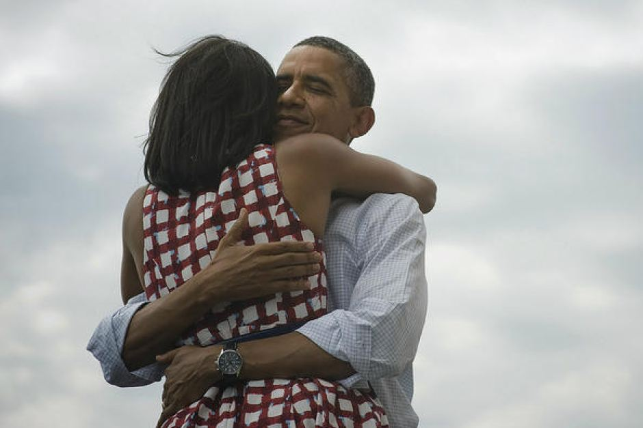
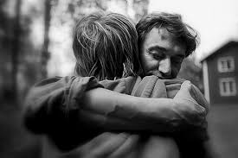
New Vocabulary
Embrace

Slide 8
New Vocabulary
Share

Slide 9
New Vocabulary
Dreams

Slide 10
Video Clip from Youtube
https://www.youtube.com/watch?v=VFUos9sYbHs&t=201s

