Slide 1
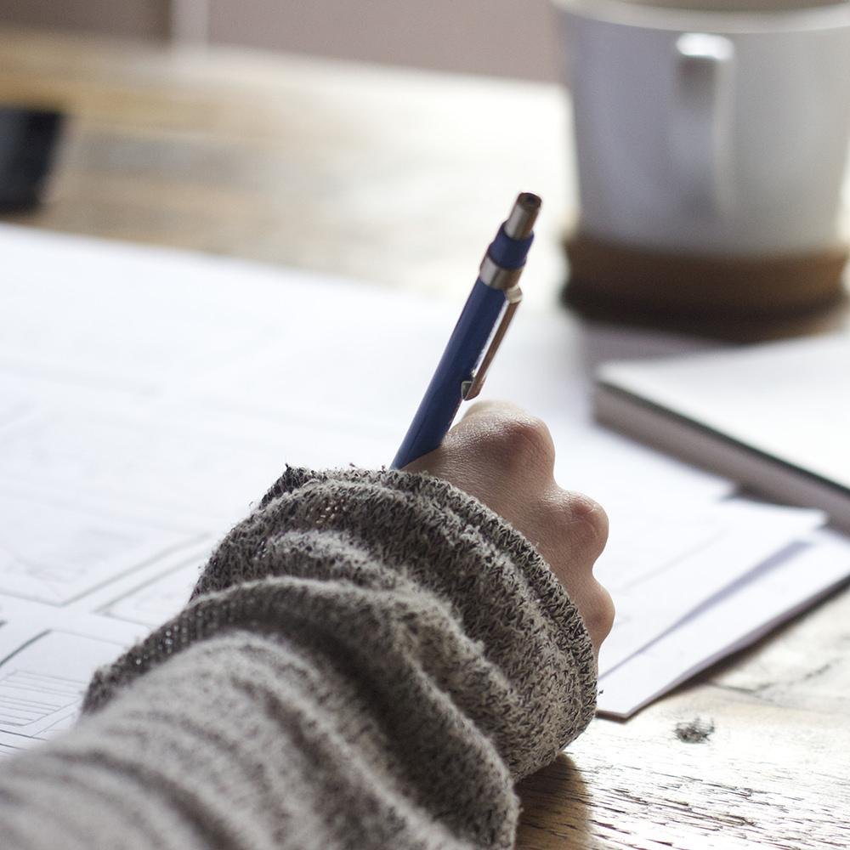
Hello!
I am Jenny ☺
I am here because I love to give presentations.

Slide 2
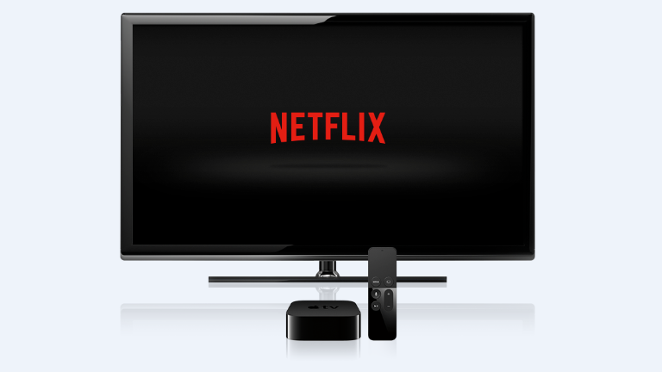
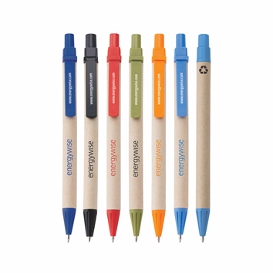
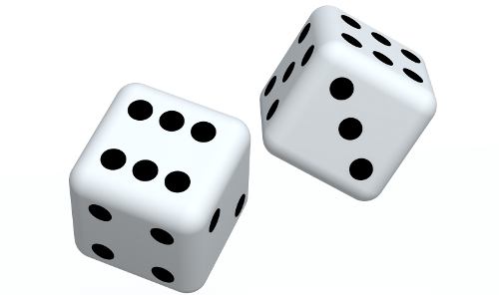
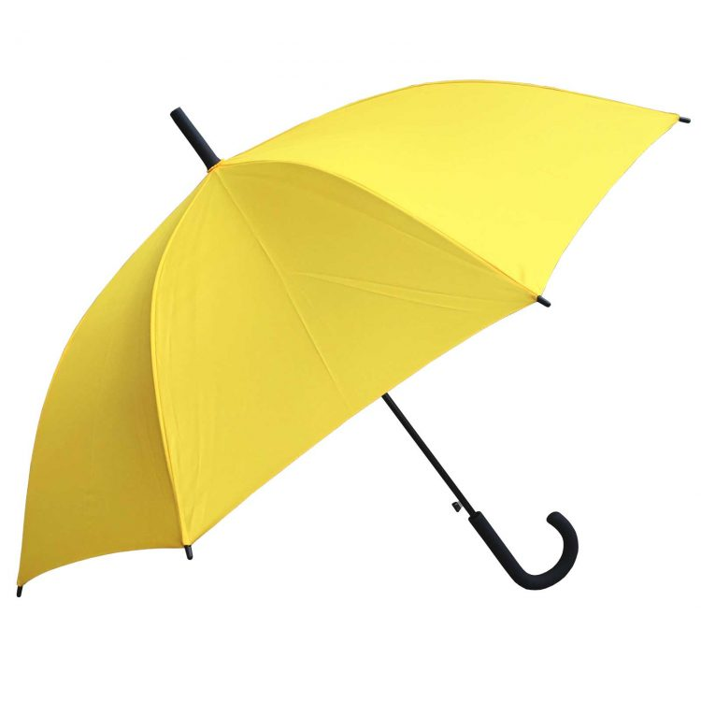
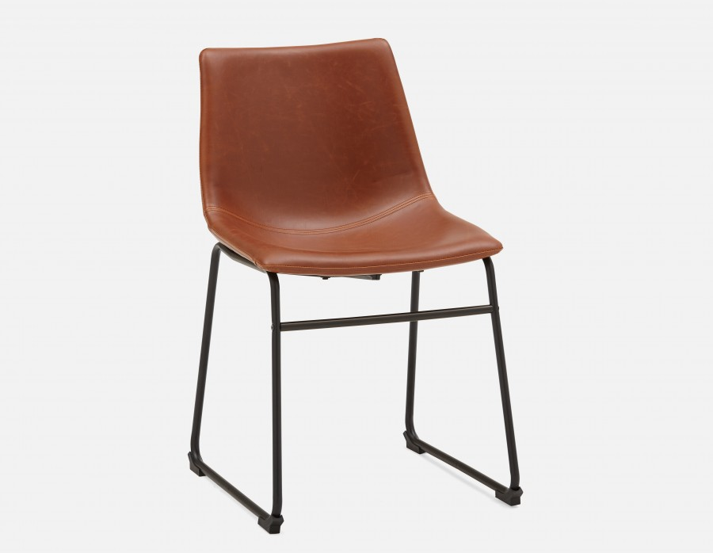
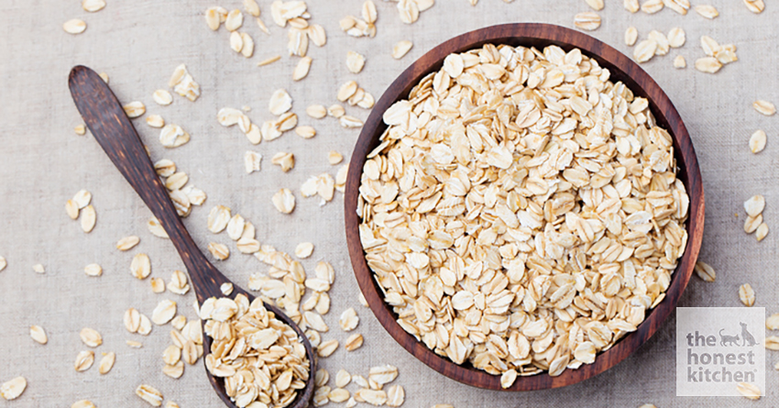

Slide 3
PRODUCT

Slide 4
NAME GAME WITH DICE

Slide 5
Products we use in our daily life

Slide 6
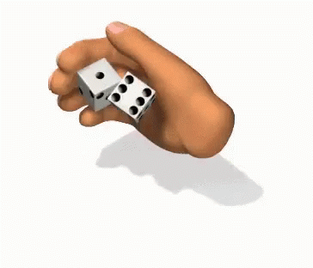
1. Throw the dice.

Slide 7
2. Name any products that comes out on the dice.
Bath-room
Kitchen
Home appliances
Furniture
Entertainment
School

Slide 8
Have you ever think of a new must item or product that we will definitely need in the future?
What it is? Why?

Slide 9
WEIRD BUT CREATIVE PRODUCTS

Slide 10
LIST OF WORDS
hybrid
weird
creative
boost
innovative
enhancer

Slide 11
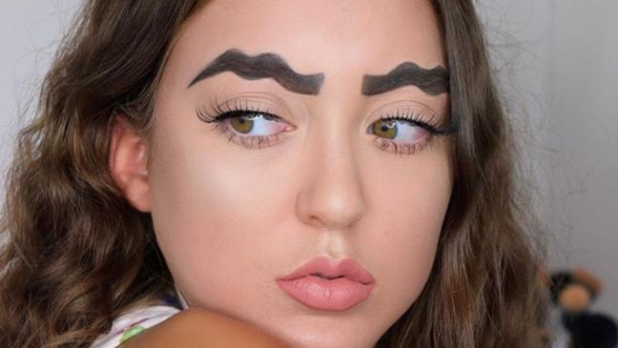
VOCABULARY
WEIRD /adj/
unusual
strange
unfamiliar

Slide 12
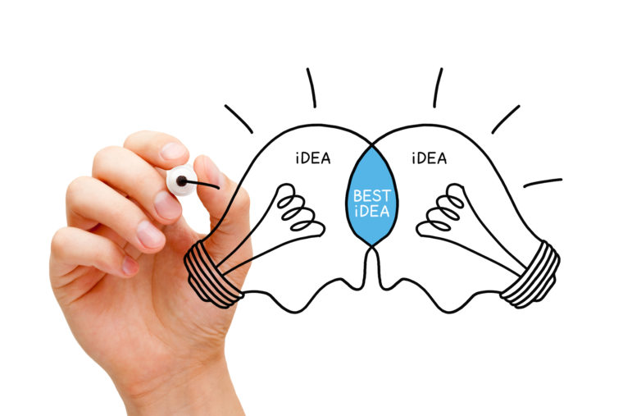
VOCABULARY
INNOVATIVE /adj/
change
newness
transformation

Slide 13
VOCABULARY
BOOST /verb/
help
improve
encourage

Slide 14
VOCABULARY
ENHANCER /n/
improver
increaser
strengthener

Slide 15
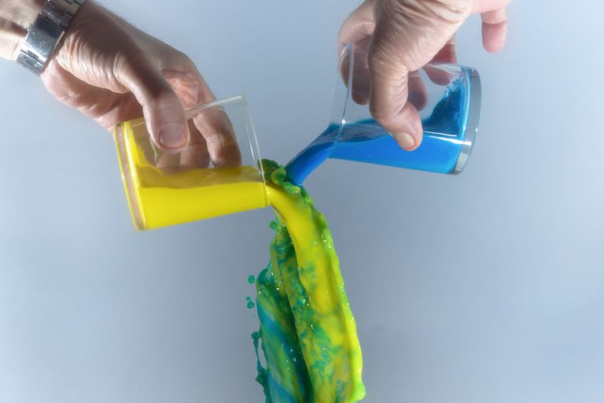
VOCABULARY
HYBRID /n/
mash-up
blend
combination

Slide 16
VOCABULARY
CREATIVE /n/
artistic
innovative
imaginative

Slide 17
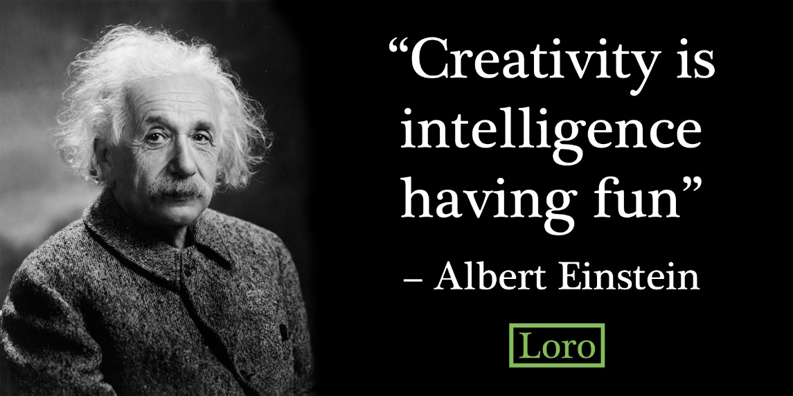

Slide 18
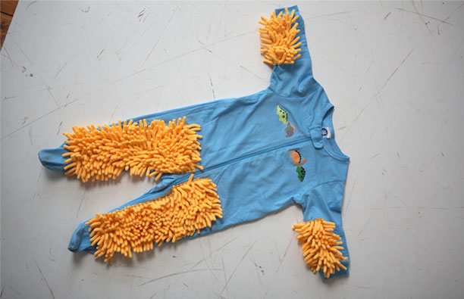
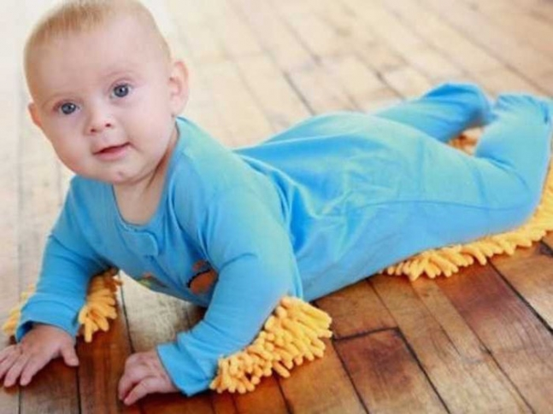
BABY MOOP
Cleaning Tool
- a baby outfit with a mop attached so that parents could send little crawlers out to clean their floors.

Slide 19
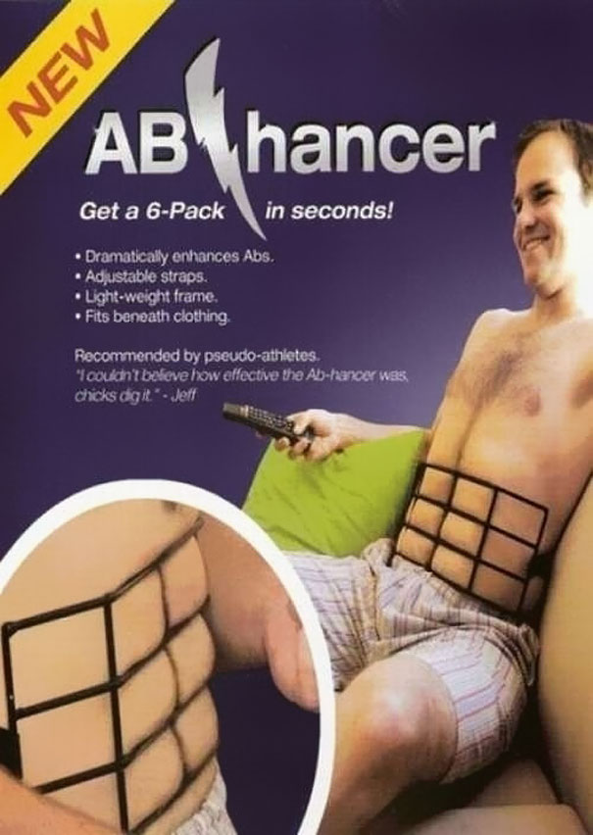
AB HANCER
- The Ab Hancer is a quick way to complete a set of abs in minutes, without the work-out.

Slide 20
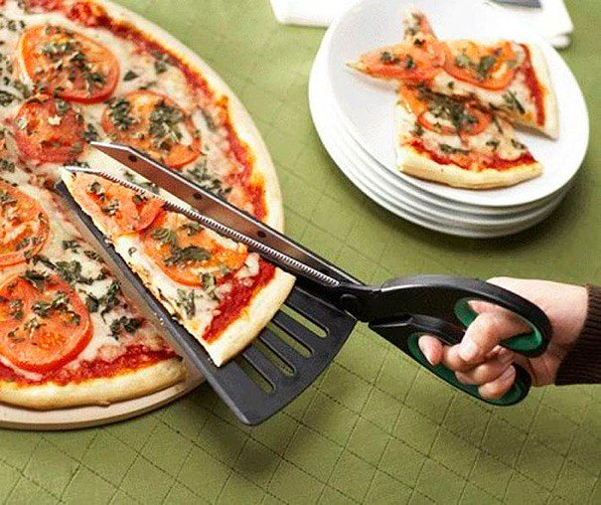
PIZZA SCISSOR
Kitchen Tool
- Use these for perfectly cut and even pizza slices, w/c means everybody gets the same amount of food.

Slide 21
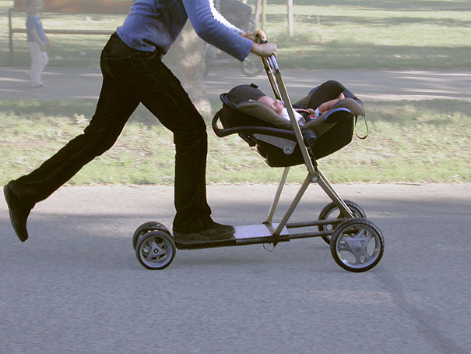
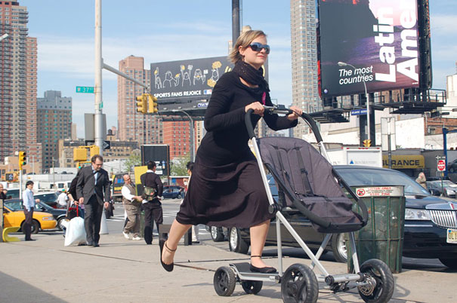
ROLLER BUGGY
Baby stroller & Scooter hybrid
- is a multi-functional baby carriage transformable into a scooter.

Slide 22
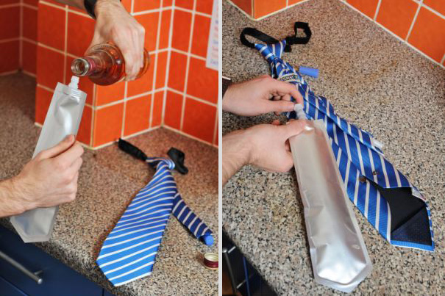
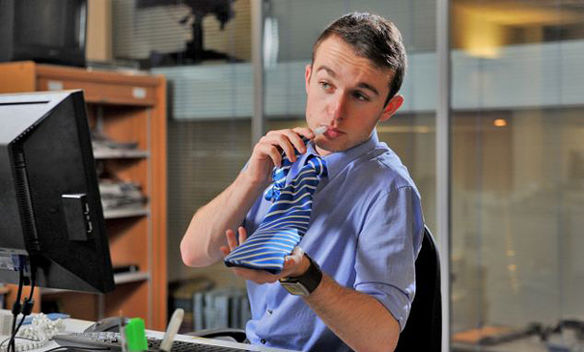
FLASK TIE
- it comes with a hidden pouch inside the fabric where you can hold your favorite beverage of choice.

Slide 23
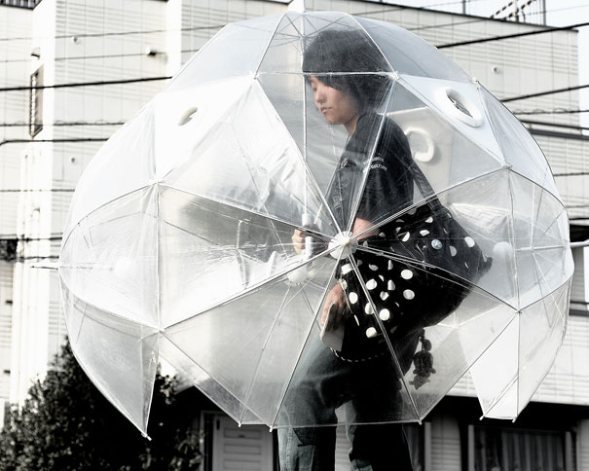
FULL BODY UMBRELLA
- the awesome ‘full-body’ umbrella looks like five umbrellas put together, with some extra material to fill up gaps, and is held by a handle in the center—so the umbrellas surround its user keep him/her dry.

Slide 24
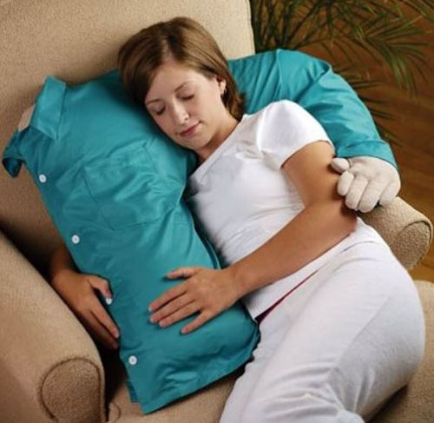
HUG ME PILLOW
- Use the pillow as a body pillow; as a neckroll; unique pillow shape; great for snuggling

Slide 25
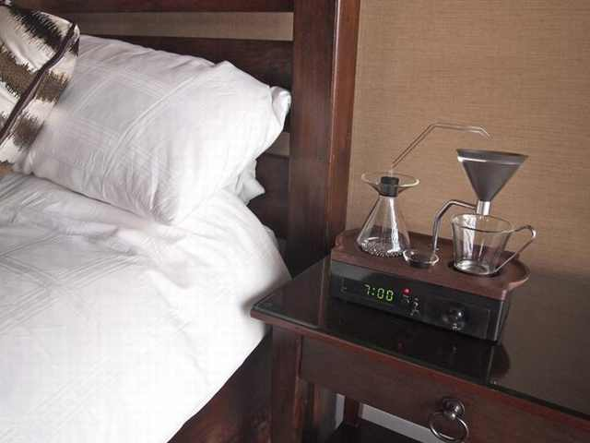
THE BARISIEUR
COFFEE
Alarm Clock
- it will serve you a cup of coffee in the morning. Imagine what it will be like to be awakened by the smell of your favorite drink.

Slide 26
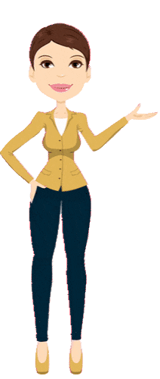
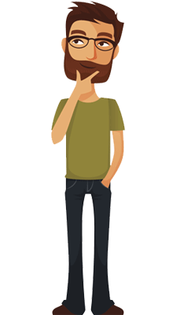
ADVERTISEMENT ROLE-PLAY
If you are going to advertise or sell these kind of products , how would you do it?

Slide 27
Do you remember?
What do we call things that we need and use and sometimes we also make?
Can you give me some synonyms of the word creative?
How about synonyms of the word weird?
What is the thing that will wakes us in the morning with refreshing drink?

