Slide 3
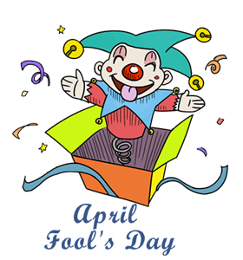
Facts about April’s fool day

Slide 4
April’s fool day’s facts
1. The origins of April Fools' Day still remain a mystery, although it has being celebrated for a very long time now.
2. Some historians believe that the tradition of April Fools' Day dates back to 1582.
3. The Britons made this annual tradition popular by playing jokes and pranks on each other.
4. The April Fools' Day is also linked to the ancient Roman festival of Hilaria.
5. It was also linked to the first day of spring, when the weather is unpredictable.
6. The April Fools' Day is a two-day event in Scotland -- when people make fun of each other by sending their friends on phony errands and play pranks.
7. In modern times, people play different tricks on this Day like reporting outrageous fictional claims in order to fool people.

Slide 5
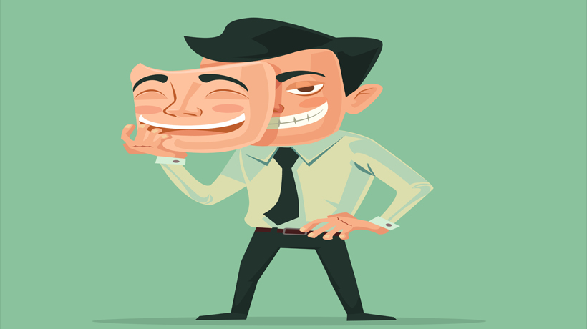
vocabulary
Phony
false, fake

Slide 6
vocabulary
Errand
Task, job

Slide 7
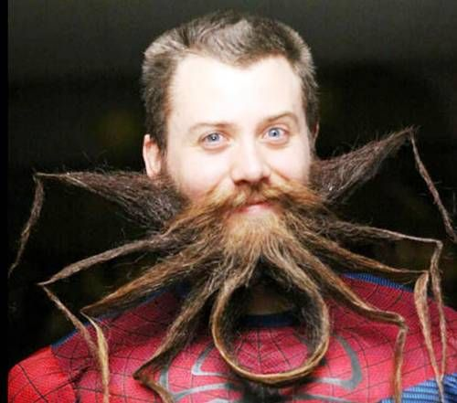
vocabulary
Outrageous
Shocking
disgraceful

Slide 8
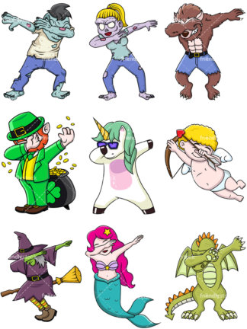
vocabulary
Fictional
Un-real imaginary

