Slide 1
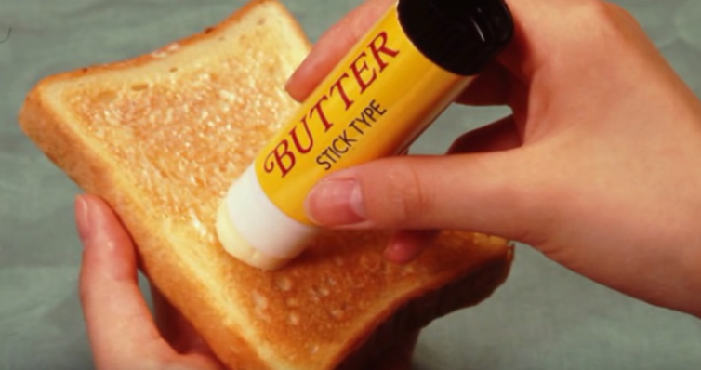

Slide 2
Pairs
Desk Plan
Team | one | two
A | Rosa | Jinny
B | Young | Carli
C | Daniel | Jin
D | Diane | Eli
Part 2
Part 3
Part 1
Part 4
board

Slide 3
smartphone | sunglasses | puppy doll | jewelry set (ring,necklace, bracelet) | hand mirror | lip stick
hat | chocolate | jelly | ear phone | USB | bluetooth speaker

