Slide 1
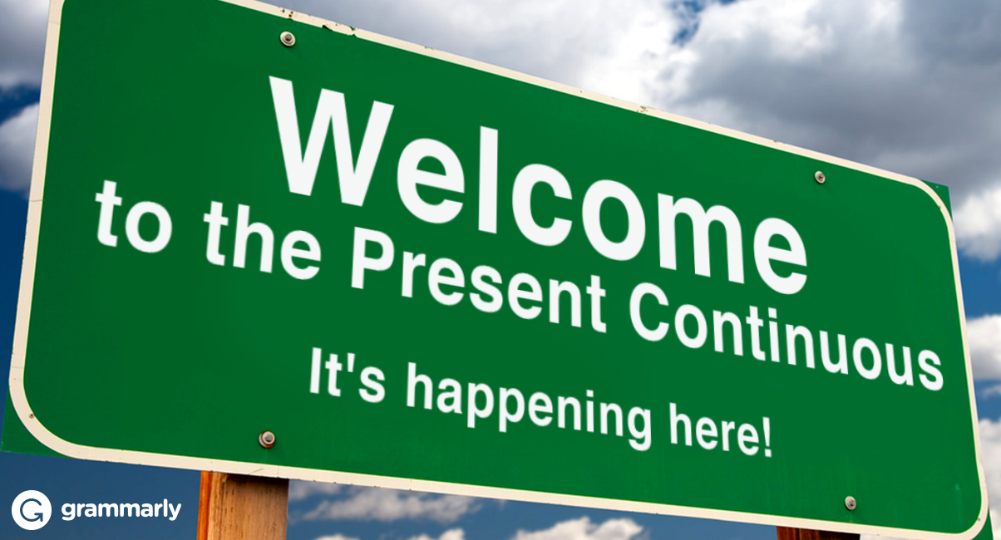

Slide 2
Let’s talk more with it
these days
nowadays
this year
this week

