Slide 1
What is it?

Slide 2
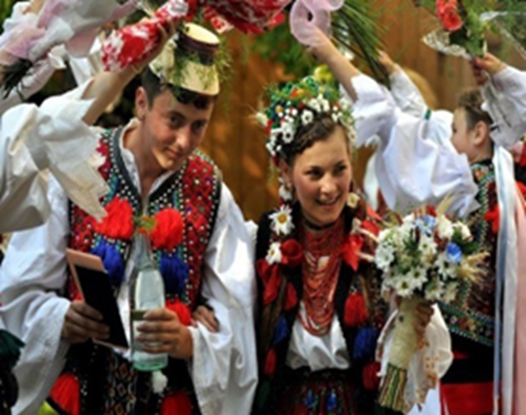
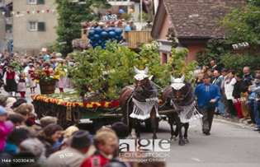
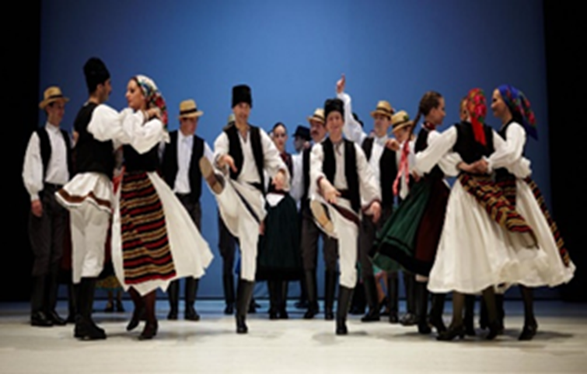

Slide 3
Folklore [foʊklɔ:^{r}]
It is the traditional beliefs and customs of
certain communities or nations.
People told one another over the years

Slide 4
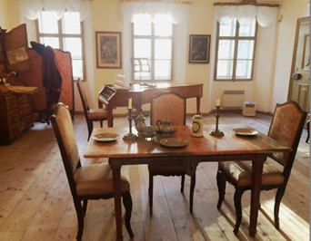
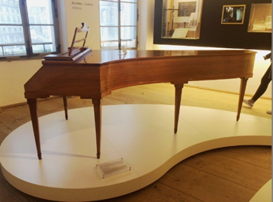

Slide 5
Preserve [prɪzɜ:^{r}v]
If you preserve something, maintain it its
original

Slide 6
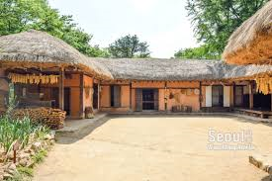
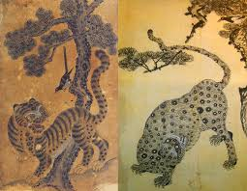
Where would you take people to see ..

Slide 7
Let’s talk more
If you have two options in your major event…
Which type would you choose
between traditional and modern way and why?
2.If you would make your own museum..
What would you display and why?

Slide 8
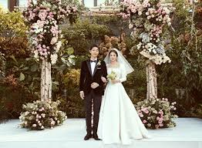
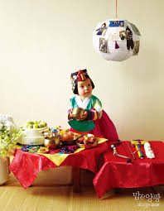
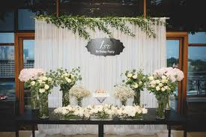
Which type would you choose and why?

Slide 9
MY OWN MUSEUM?

