Slide 1
Hello

Slide 2
Have you ever received a letter from someone?
When and why?

Slide 3
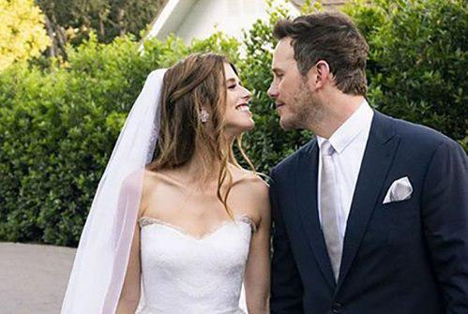
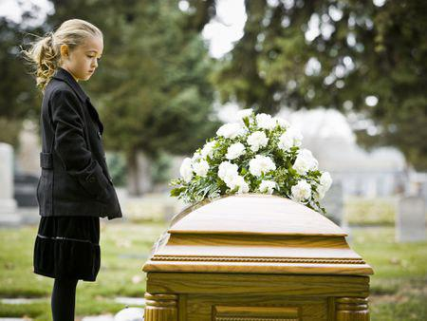

Slide 4
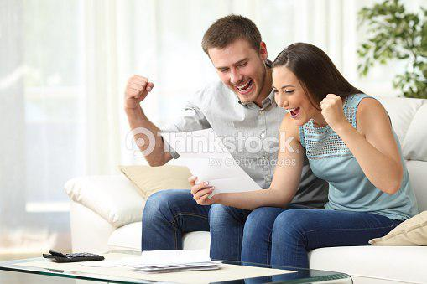
1. What are they reading?
2. How do they feel?
3. Why do you think they feel this way?

Slide 5
1. What is Ken Jones’ address?
Sunnyville ART #12 760 W 25th street
New Town, CA 33457

Slide 6
2. What time does fist team practice begin?
4:00 p.m.

Slide 7
3. When is the first basketball game?
Nov. 21st

Slide 8
4. Where should Ken go if he has any questions?
Coach Park’s office

Slide 9
5. Wh0 sent the letter to ken?
Coach Park

Slide 10
A: Congratulations on making the basketball team!
B: Thank you. I will play on the senior team this year.
A: You must be very good. Will you practice a lot?
B: Yes, we will practice every day.
A: When do you play?
B: We play teams from other schools every Friday.

