Slide 1
Speaking lesson
with Julie

Slide 2
What’s the meaning of the color

Slide 3
What’s the meaning of the color

Slide 4
What’s the meaning of the color

Slide 5
The French Flag

Slide 6
What if we make a our
class flag

Slide 7
How about we make a class flag?

Slide 8
Let’s make our own
class flag

Slide 9
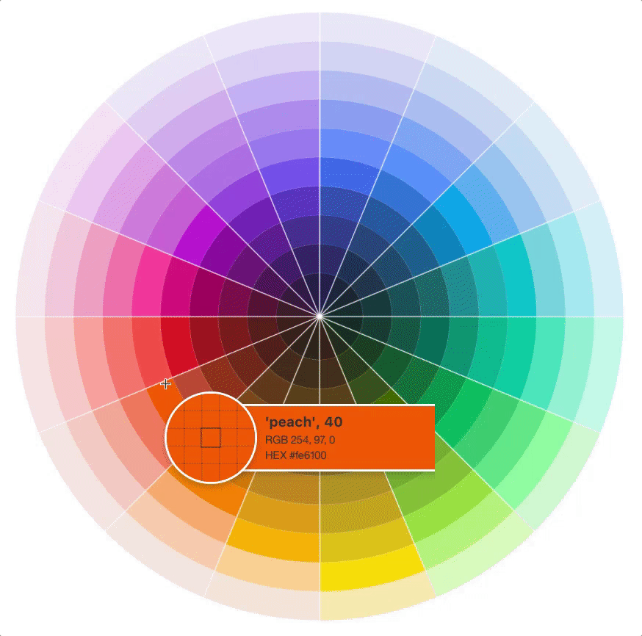
If you’d be a color, which one would you choose

Slide 10
Thanks
with Julie

