Slide 1
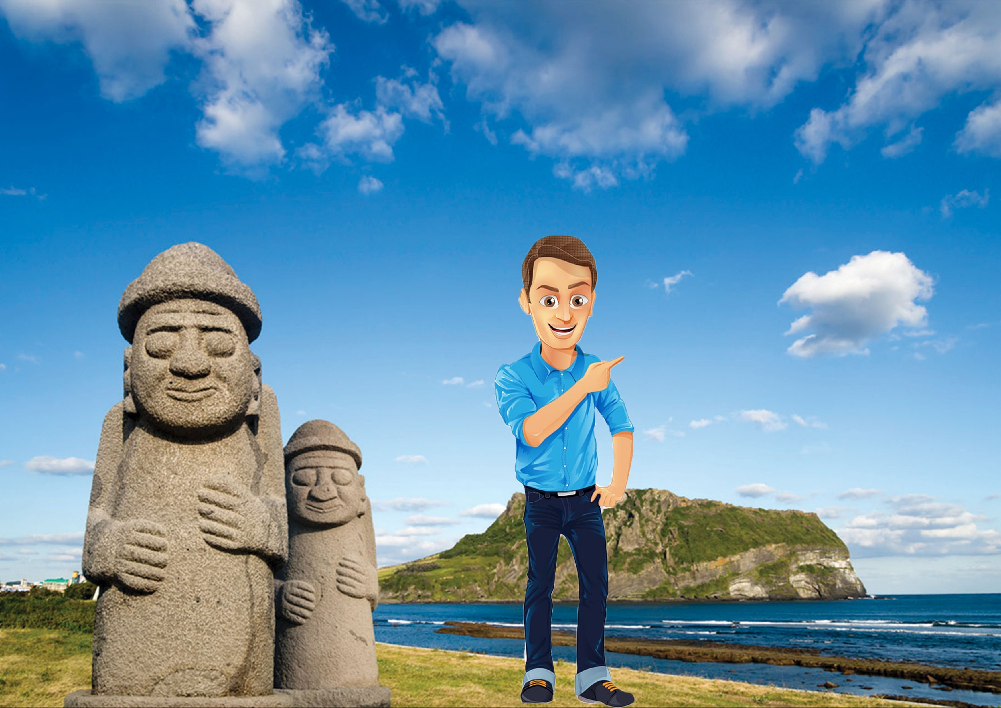

Slide 2
Some time later

Slide 3
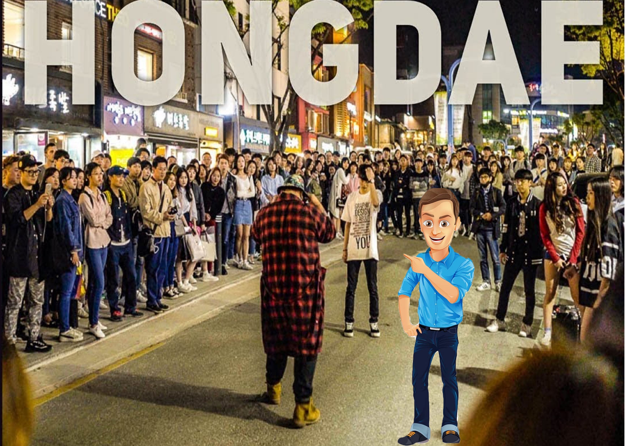

Slide 4
Some time later

Slide 5
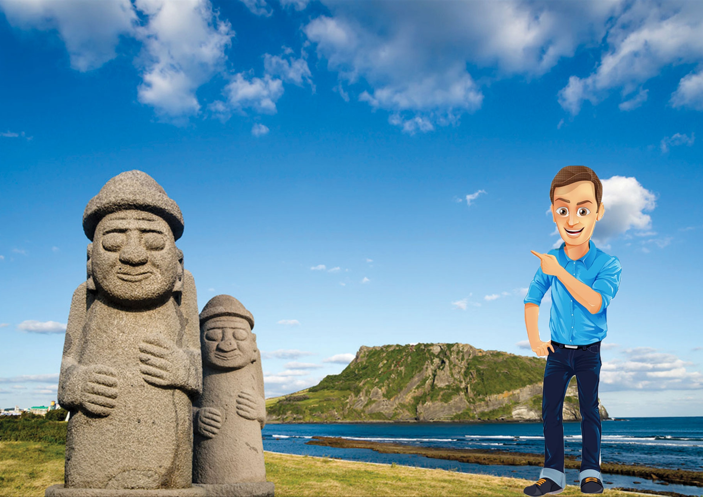

Slide 6
Some time later

Slide 7
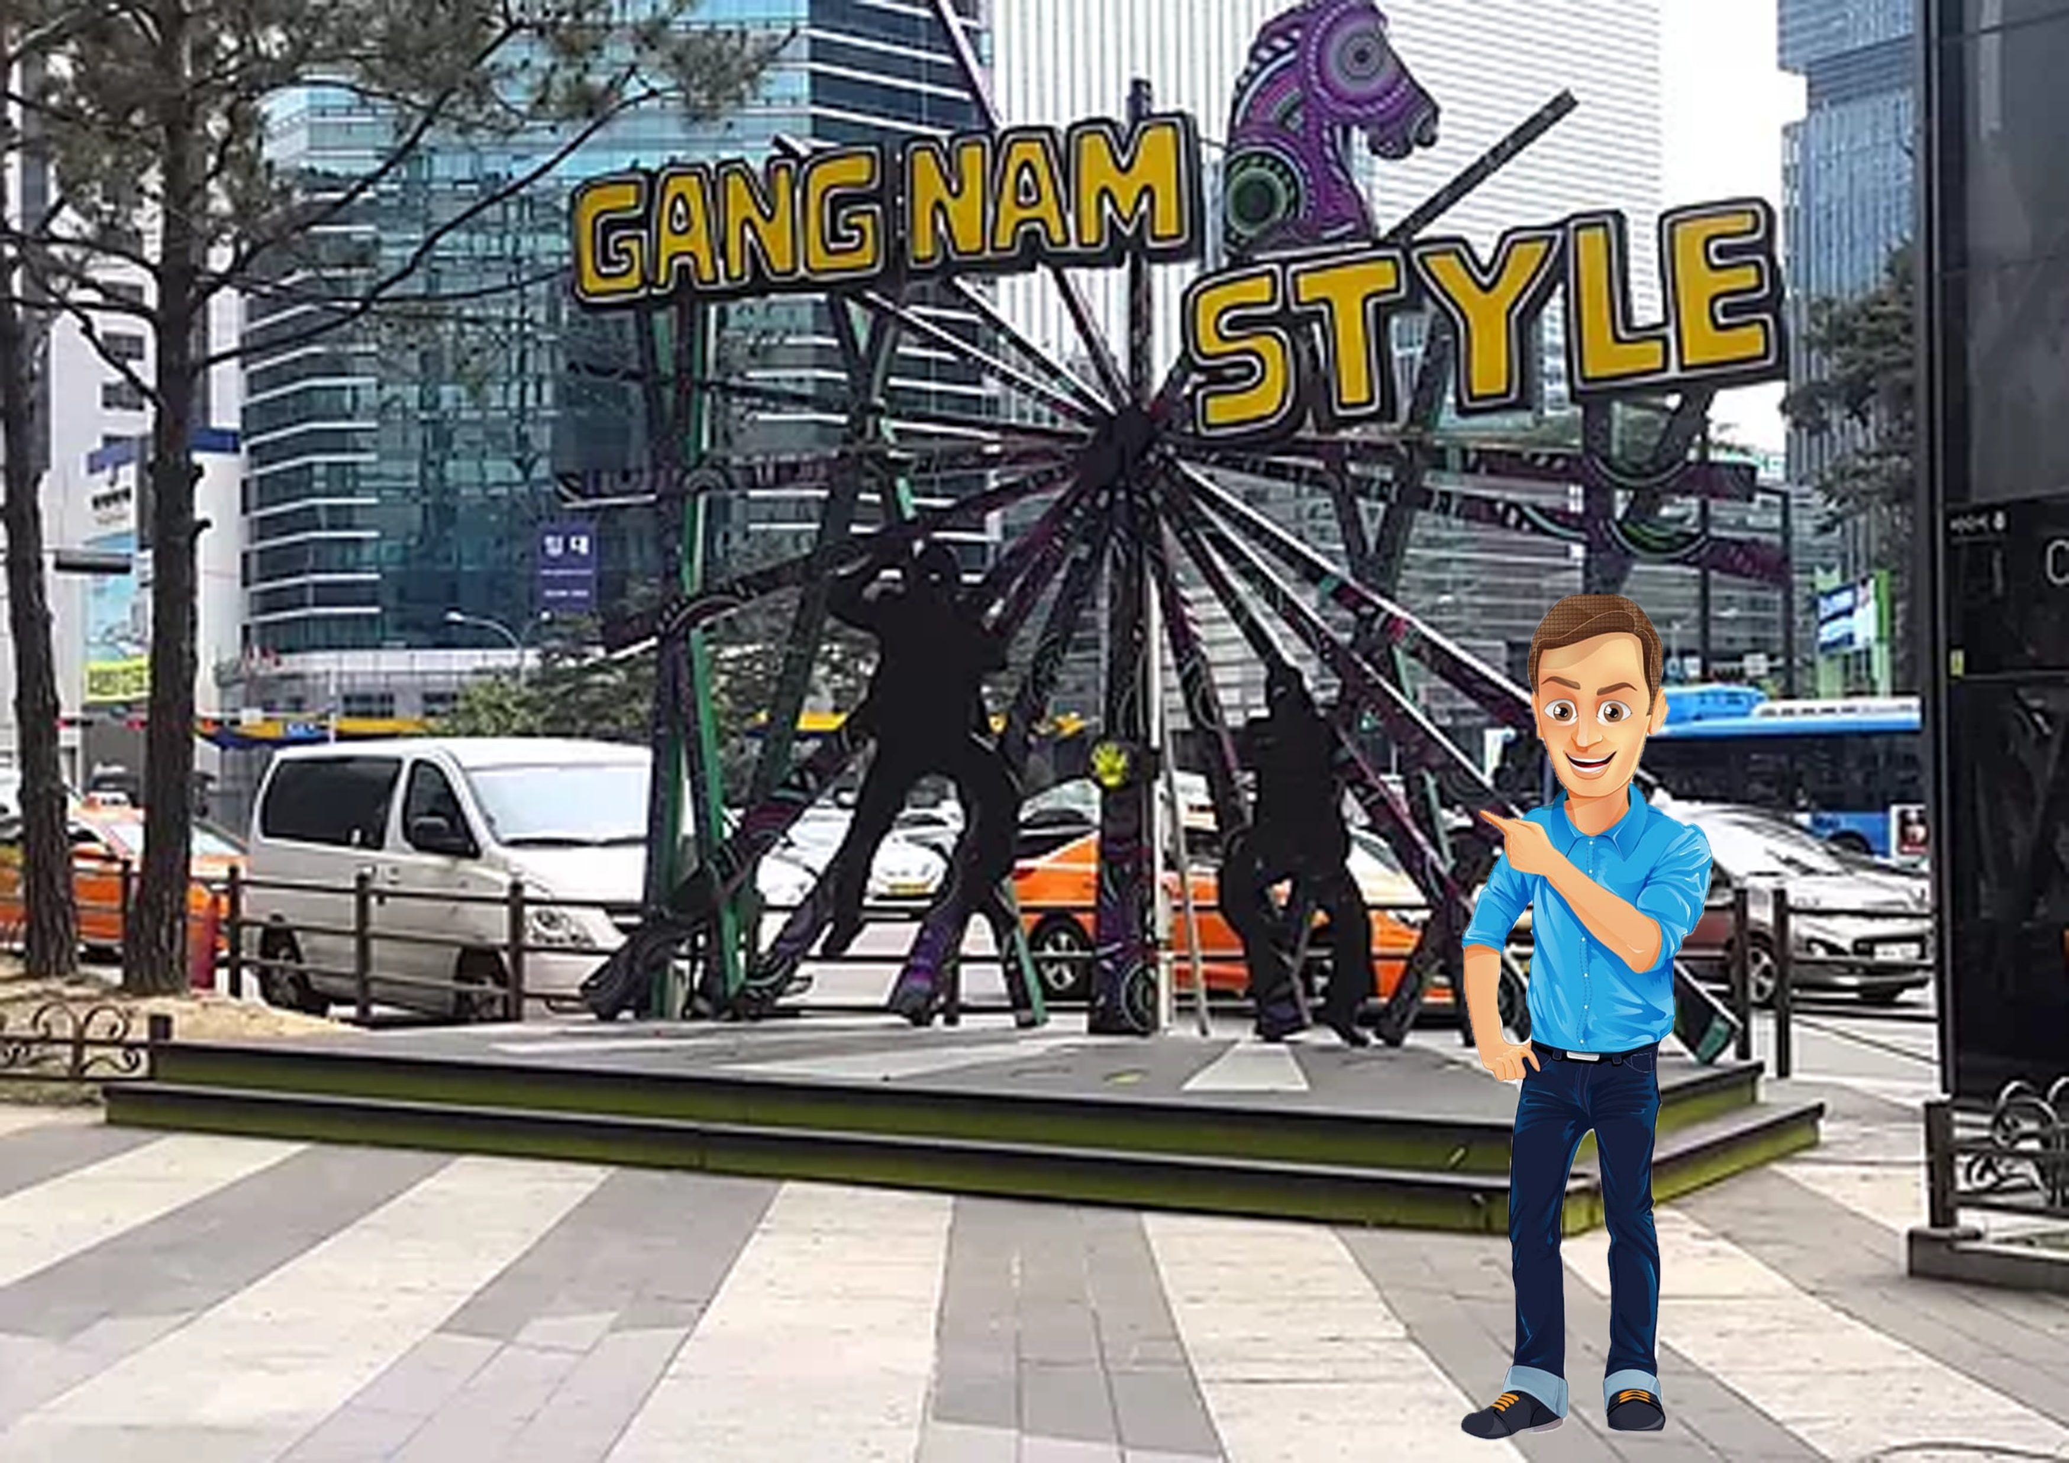

Slide 8
Some time later

Slide 9
