Slide 1
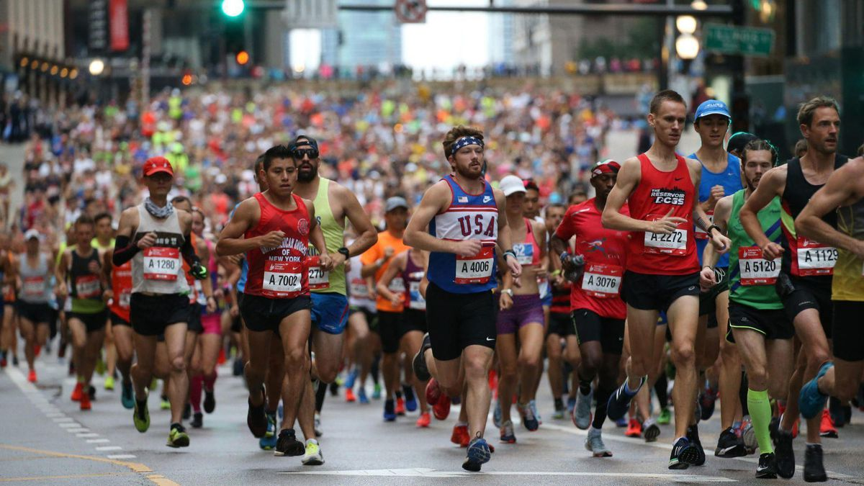

Slide 3
If you run a marathon, which is better?
Running alone VS Running with others

Slide 4
* INEOS : a global manufacturer of petrochemicals,
speciality chemicals and oil products.
* IAAF : International Association of Athletics Federations

Slide 5
Homework
* Write a paragraph about Exercise 3 questions.
You may include only one or all of them.

