Slide 1
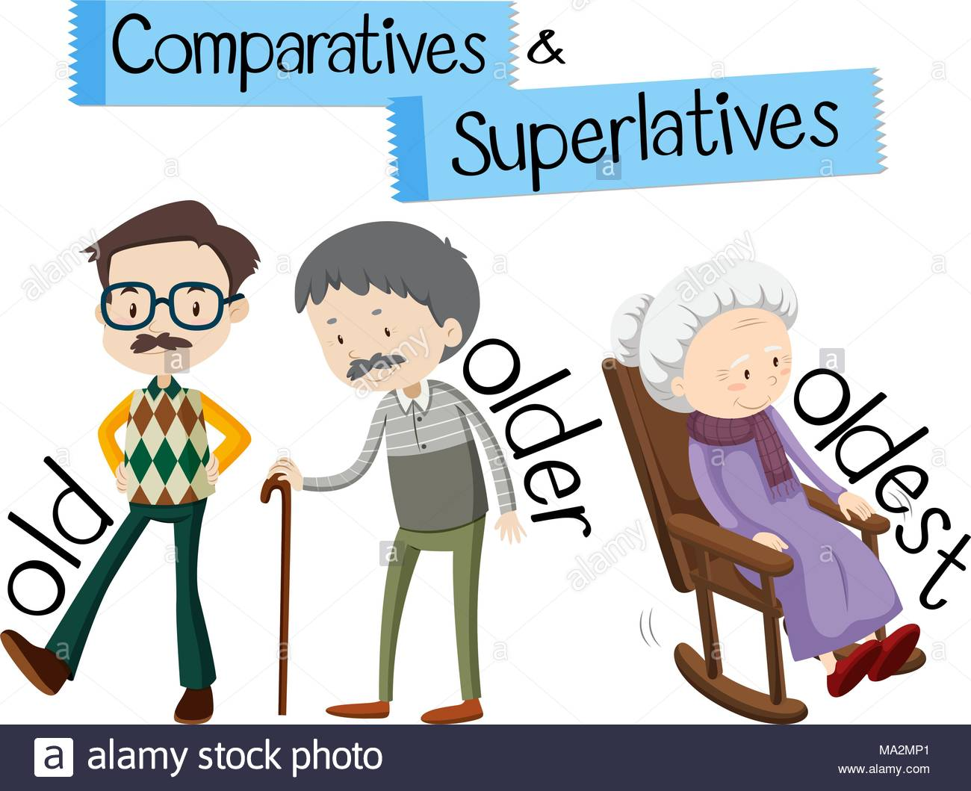
 | Son | Dad | Grandma
Age | 20 years old | 60 years old | 100 years old
Life style | Passive | Boring | Exciting
Grandma is _____________________________________________________________________________
the oldest person in the family but she has the most exciting life.

Slide 2
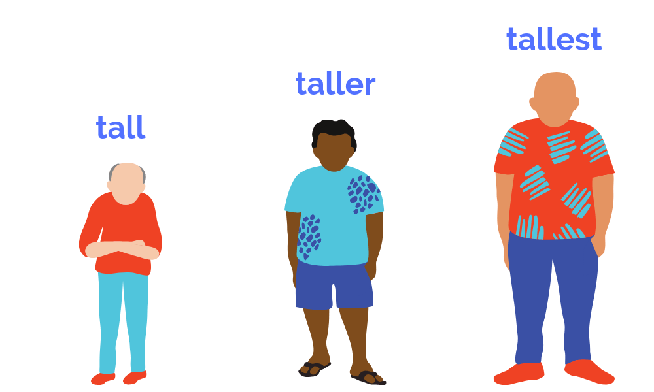
 | Sam | Aaron | Peter
Height | 140cm | 170cm | 190cm
Weight | 20kg | 50kg | 100 kg
Appearance | Below Average | Average | Hot
Peter
Peter is _____________________________________________________________________________
the tallest and the heaviest and he is also the hottest.

Slide 3
Concept checking questions:
1. Are we comparing two things?
No
2. Are comparing one thing or person in a group with all of the other things or people in a group?
Yes
3. Are we referring to one specific thing or person?
Yes
4. Do we use the article “the” before the superlative adjective?
Yes
5. Do we use a superlative to say that a thing or a person being described has more of the particular quality than anything or anyone else in the same group?
Yes

Slide 4
Adjectives/ Adverb | Superlatives | Grammatical Point
Tall
Close
Shiny
Sad
Dangerous
Quickly
Much
Little
Good
Bad
the tallest
For most short adjectives and adverbs → add the and -est
the closest
For short adjectives and adverbs ending in -e → add the and -st
the shiniest
For adjectives ending in –y → take away -y and add the and -iest
the saddest
For adjectives ending in vowel and 1 consonant (except w), double the consonant → add the and – est
the most dangerous
For adjectives with 2 or more syllables → add the and most
the most quickly
For adverbs ending in – ly → add the and most
the most
Exception
the least
Exception
the best
Exception
the worst
Exception

Slide 5
Drill:
Grandma is the oldest and has the most exciting life in the family.
Grandma is the oldest and has the most exciting life in the family.

Slide 6
Freer Practice:
Most entertaining city you have visited?
Best movie of all time?
When the time goes the fastest?

Slide 7
Grammar Worksheet (Controlled)
Fill in the blanks below to complete the sentences using the superlatives.
1. I (tall) ____________________________________ person in my family
2. Elephants (large) _____________________________ land animals on earth.
3. Which sports do you think (dangerous) _____________________________________?
4. My cat (lazy) ___________________________________ animal I know.
5. We bought (expensive) ______________________________ TV in the store.
6. This restaurant serves (good) _________________________________ food in town.
7. Last week, I had (bad) ___________________________________time of my life.
8. Which place (hot) ___________________________________ place on earth?

Slide 8
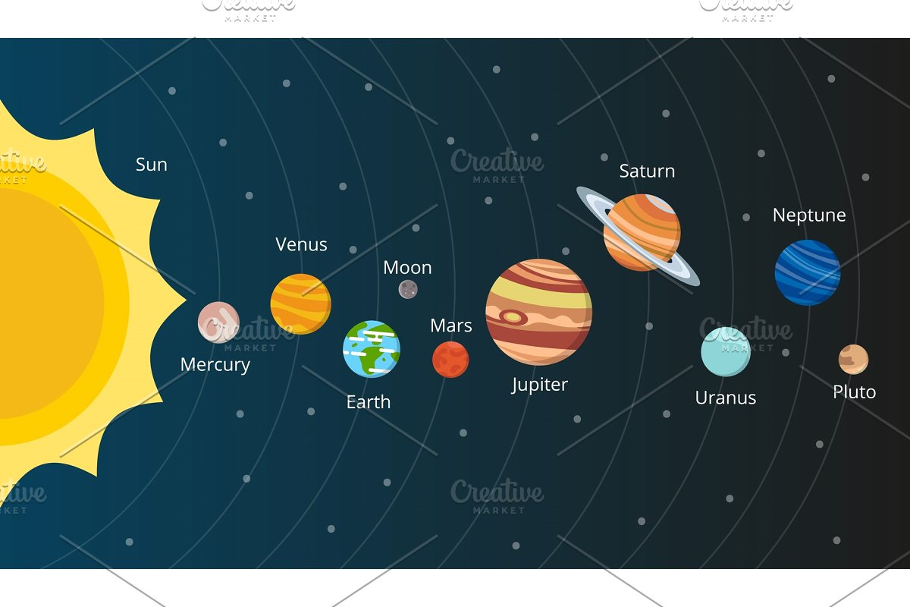
Grammar Worksheet (Less Controlled)
Write the sentences about the solar system using the superlatives.
1)
2)
3)
4)

