Slide 1
A Success story of Mimi

Slide 2
Yey! I got a job!!!
I’m not ready for this job!
Mimi
Company A
Mimi

Slide 3
Let’s try another one!
I don’t know what to do!
Mimi
Company B
Mimi

Slide 4
Maybe another?
I’m not ready nor able to do it!...
Mimi
Company C
Mimi

Slide 5
After several times…
I hope this is the one!
Yey! This is it!!!!!!
Mimi
Mimi
Company H

Slide 6
20 years later…
After a number of problems at the beginning,
I finally found a job that I liked.
After a number of problems at the beginning, I finally found a job that I liked.
SUCCESSFUL
CEO
Mimi

Slide 7
From now on, this line of bags will be called “mimi”!
From now on, this line of bags will be called “mimi”!
SUCCESSFUL
CEO
Mimi

Slide 8
Including the shape of the bag, I only used squares, triangles and circles.
Including the shape of the bag, I only used squares, triangles and circles.
What are the special features of the bag “mimi”?
SUCCESSFUL
CEO
Mimi

Slide 9
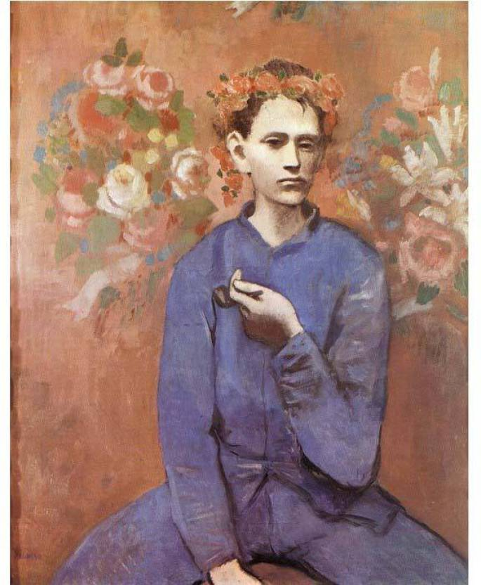

Slide 10
100 years later…
SUCCESSFUL
CEO

