Slide 1
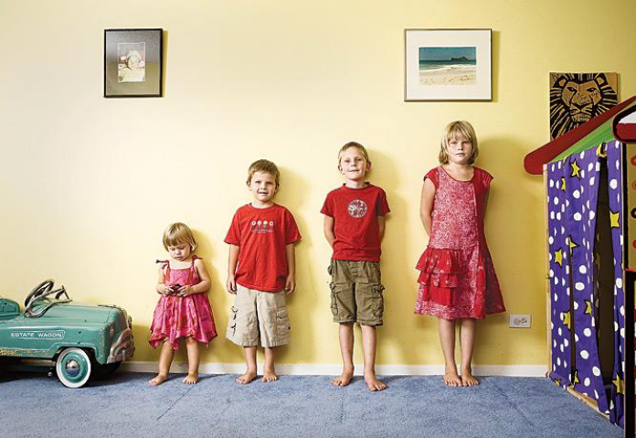

Slide 2
Slide A

Slide 3
Slide B

