Slide 1
A.
B.
PPT 1

Slide 2
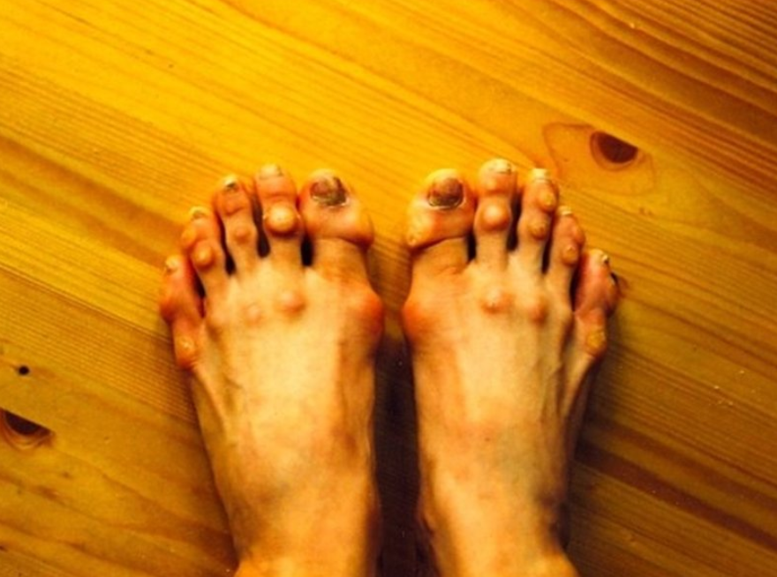
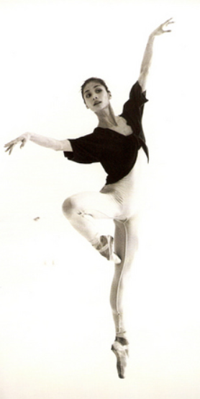
PPT 2
Notes:
C.C.C. - worthwhile

Slide 3
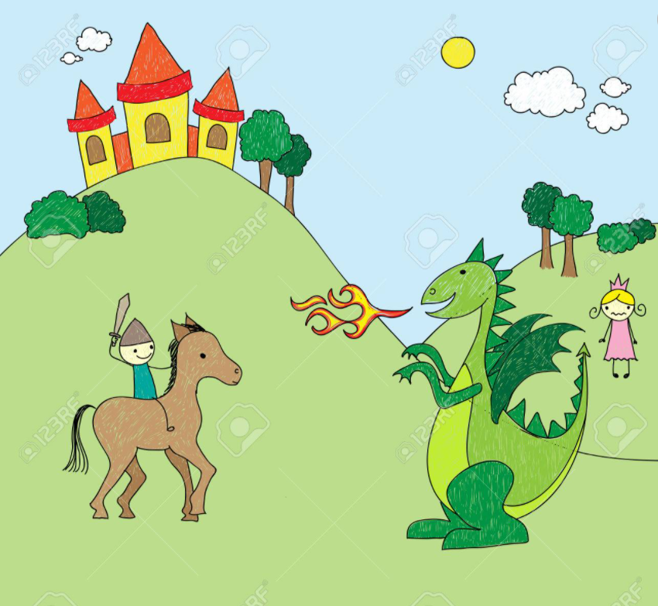
PPT 3
Notes:
C.C.C. - risk

Slide 4
PPT 4

