Slide 1
Notes:
cling

Slide 2
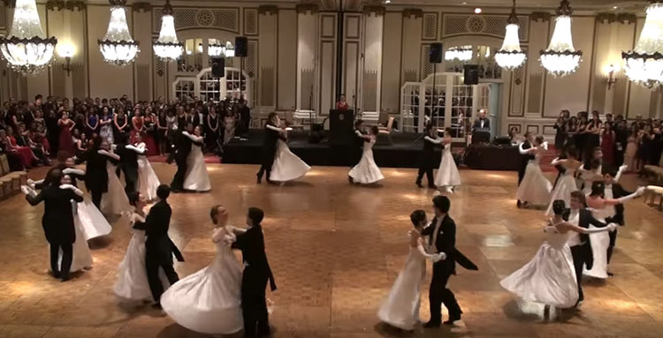
Notes:
Waltz

Slide 3
Notes:
romp

Slide 4
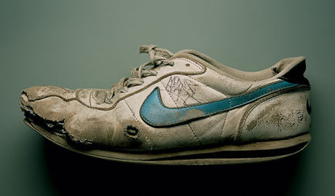
Notes:
battered

Slide 5
Notes:
cling

Slide 6
My Papa’s Waltz

