Slide 1
Reading Micro teaching
Hyun Ji Song & Yoon Jung Choi

Slide 2
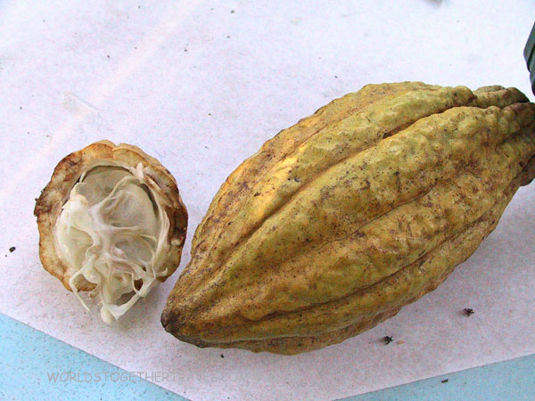
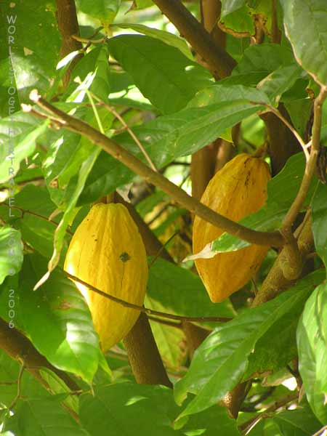
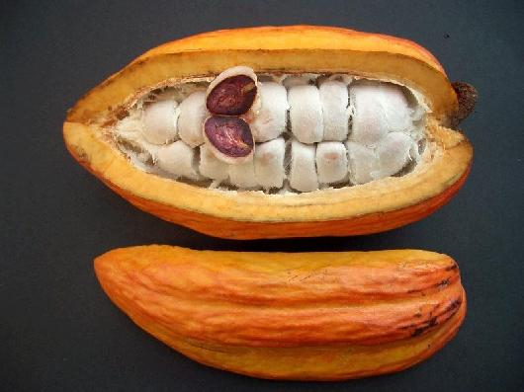
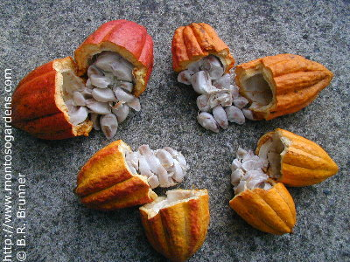
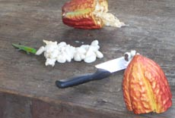
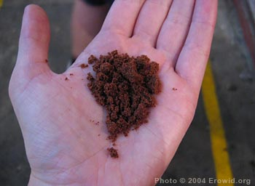
What do you think this is?
Hyun Ji Song & Yoon Jung Choi

Slide 3
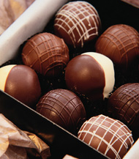
Today’s topic...
Chocolate
[’tʃɒklət]
Hyun Ji Song & Yoon Jung Choi

Slide 4
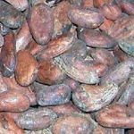
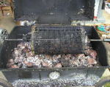
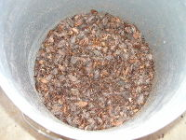
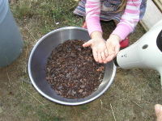
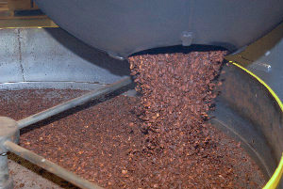
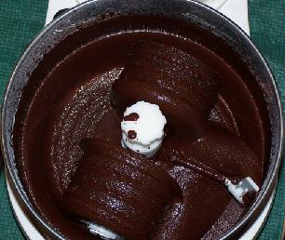
How to make chocolate
1) Roast the cocoa beans.
2) Crack and separate the beans.
3) Grind the nibs into a cocoa liqueur.
4) Conch and refine the chocolate..
Hyun Ji Song & Yoon Jung Choi

Slide 5
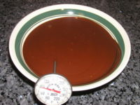
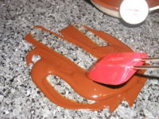
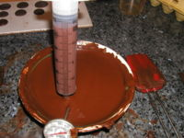
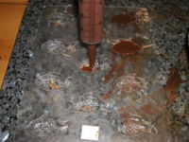
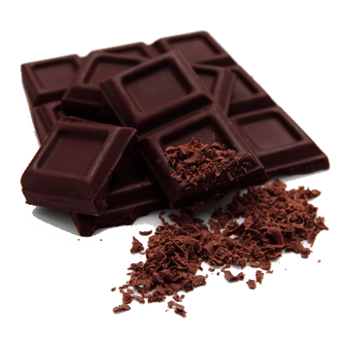
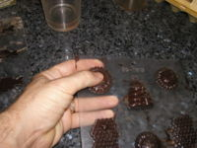
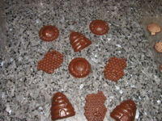
How to make chocolate
5) Temper the chocolate.
6) Mold the chocolate
7) Remove the chocolate from the molds
8) Read to eat!
Hyun Ji Song & Yoon Jung Choi

Slide 6
Vocabulary
Bitter
It is one of the four basic tastes. When we take a medicine, we can find this taste. Bitter taste is opposite to sweet taste.
dessert
It is sweet food eaten at the end of a meal.
For example, “He had apple pie with ice cream for dessert.”
snack
It means a light meal. When we eat some food between regular meals, we call “snack.”
For example “We had a snack on the train.”
Hyun Ji Song & Yoon Jung Choi

Slide 7
Vocabulary
ingredient
It means one of the things that you put in when you make something to eat.
For example, “The ingredients for cake are flour, butter, sugar and egg.”
ancient
It means very old. For example “When we travel the Rome, we can see plenty of ancient buildings.”
value
It means to think that something is very important.
For example “I value my freedom.”
Hyun Ji Song & Yoon Jung Choi

Slide 8
Vocabulary
wealthy
It means rich. For example “He is a very wealthy man.” means he is rich.
tribute
It is something that you say, do, or make to show your admiration and respect for someone.
favorite
It means you like something above all others. For example, “This is one of my favorite restaurants.”
Hyun Ji Song & Yoon Jung Choi

Slide 9
Practice
How has the chocolate been used since the ancient times?
Chocolate was often used as money
Chocolate was used as a tribute at birth or at marriage events.
Ancient times, they liked to drink chocolate.
Hyun Ji Song & Yoon Jung Choi

Slide 10
Pair work
What is your favorite dessert? why?
I like tiramisu.
It’s a traditional Italian dessert with chocolate sponge cake.
It’s has a strong coffee syrup and a rich cheese taste.
It is very delicious!!
You have 10 minutes for pair work
Hyun Ji Song & Yoon Jung Choi

Slide 11
Concept Check
The Maya added sugar to chocolate and heated it
False : Spanish people added sugar to sweeten the taste
The cacao tree grows in tropical countries.
True
Chocolate was always a dessert.
False : Chocolate was used as money and/or a tribute for birth and marriage.
Hyun Ji Song & Yoon Jung Choi

Slide 12
The End
Thank you

